Slide 1



Greater Manchester County netball Association – AGM
Wednesday 25th September 2019 – 7pm

Slide 2
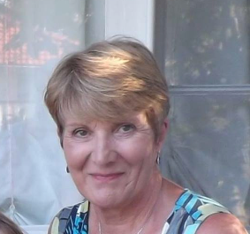
Welcome & Presidents Address
This AGM is covering the period 1st September 2018-31st August 2019
President – Kath Pemberton

Slide 3

Agenda items
Present
Apologies for Absence
Minutes of the last meeting
Affiliation Notification/Report
Changes to the Constitution
Chairperson’s report – Sam Longley

Slide 4
Areas Of Work
Finances – Janet Murray
Officiating – Lesley Smith
Competition – Dawn Day
Coaching – Teresa Monaghan
Development – Katie Thompson
Performance – Sam Longley
Schools
Achievements

Slide 5
Officiating – Lesley Smith
3 C courses
25 attendees
4 written tests
27 passed written and 7 not yet met criteria
24 practical passes and 1 not yet met criteria
4 Bench Officials/Statisticians represented Greater Manchester at the World Cup in July
A number of officials and bench officials participate in Super League
Trials used for mentoring and development of new qualified/waiting to be assessed officials
Into-Officiating – one closed course at Manchester Uni, Nov 18.
Altrincham JNC interested in holding a closed Into Award
2019/2020 Priority – Mentoring programme from Beginner to C level officials

Slide 6

Competition – Dawn Day
Opening Screening Tournament – September 2018
League of 84 teams across under 11-16
Central venue – indoor
Open to all counties
Qualification league for regional competition
Qualified Officials
2019/2020 Priority – Bee Netball Festivals
Age | Division | Winner | Runner-Up
11 | 1 | Oldham | Ribble Valley
11 | 2 | Saddleworth | Rochdale
12 | 1 | Tameside A | Oldham
12 | 2 | Rochdale | Rivington
13 | 1 | Oldham | YWCA Bury
13 | 2 | North Dragons | DNA
14 | 1 | Oldham | YWCA Bury
14 | 2 | Rivington | Deeside
15 | 1 | Oldham | Tameside
15 | 2 | Rochdale | Beechwood
16 | 1 | Oldham | Chester

Slide 7
Coaching – Teresa Monaghan
Qualification/ Course | Number Run In County | Total Number Planned
UKCC Level 1 | Platt Lane MCR started 02/09/18 | 1 – Wright Robinson MCR started Jan/Feb 2020
UKCC Level 2 | 1 – Platt Lane MCR start Jan 19 | 1 – MEA Central 28th Sept/Oct/Nov 2019
CPD Workshops | Bee Netball for County, August 19 | Bee Netball – Feb 2020
Walking Netball Host Training | 1 – Wythenshawe, 28th Oct 2018 | Walking Netball Host Training – Nov 19
2019/2020 Priorities
How do we support coaches from course to practical delivery?
How can we engage with coaches to widen their coaching experiences?
Sharing knowledge and good practice
Support clubs to adapt to Bee Netball

Slide 8
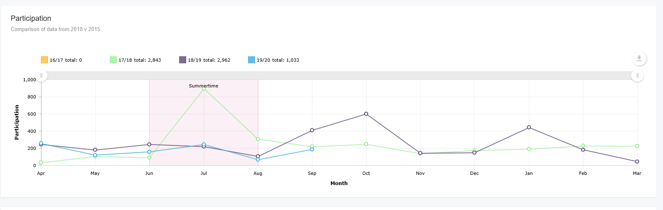
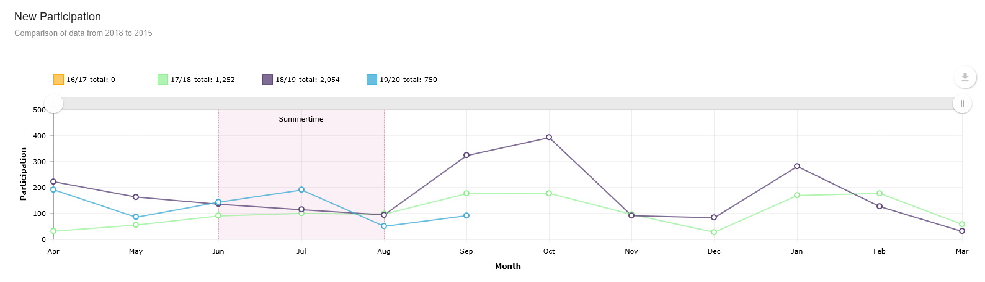
Development – Katie Thompson
County Participation
During the 2018/19 year the county team has run the following programmes which has resulted in a total of 1985 participants. The table below shows the total number of programmes run, participants engaged this financial year, which of those participants were new to netball (had not played the previous 12 months prior to joining) against the target for the financial year.
Figure 1: County Programmes & Participants (Numbers below Sept 2017 – Aug 2018)
Figure 2: County Programme participants for (April – March EN FY)
Programme | Number of Participants Sept 18-Aug19 | Number new to netball (if applicable) Sept 18-Aug19 | New to netball target
Back to Netball | 1186 | 1057 | Cannot report as our FY is Apr-Mar
Netball Festivals | 347 | 176 | Cannot report as our FY is Apr-Mar
Netball Now | 293 | 134 | Cannot report as our FY is Apr-Mar
Walking Netball | 391 | 302 | Cannot report as our FY is Apr-Mar
University Netball Officers | 544 | 288 | Cannot report as our FY is Apr-Mar
Netball Youth Camps | 0 | 0 | 0
Figure 3: County New Participation (April-March FY).

Slide 9
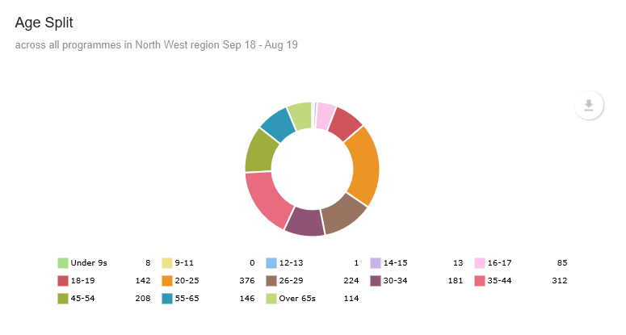
Development - Continued
New clubs formed & CAPS accreditation
Clubs working towards CAPS | Expired CAPS | Dates CAPS Due to Expire:
Unicorns NC – New to CAPS | Rochdale NC – Exp 13/6/16 Not re-doing CAPS | Rivington – 2/4/19 (Submitted Sept 19)
DNA NC – New to CAPS (re-registered) | Dominoes NC – Exp 5/3/18 – Not Doing CAPS | Denton – 7/4/19 (Submitted Sept 19)
Manchester Giants NC (prev. De la Salle) Exp 3/9/18 | Saddleworth NC – Exp 10/9/17 (Not sure if still working towards, not heard) | Tameside – 30/9/20
Trafford Juniors – Exp 1/7/19 (Registered with Cheshire for CAPS) | Flava NC – Exp 12/9/16 (Not sure if still working towards, not heard) | Hathershaw – 4/3/21
Diamonds – New to CAPS (Not heard from them for a long time) | Didsbury NC – Exp 3/9/18 (Not sure if still working towards, not heard) | Oldham – 6/3/21
 |  | Seven Stars – 6/3/21
 |  | Tyldesley – 6/3/21
 |  | YWCA Bury – 20/4/22
County Club Development & Membership
This section shows club activity during the current financial year and membership statistics for the current season with a comparison to last season.

Slide 10

Development - Continued
Affiliated members by organisation and individual participants for the current season compared to the previous affiliation year
This year so far on ENgage we can see that as of 23/9/19 4.40pm:
O18’s in Greater Manchester = 1031
U18’s in Greater Manchester = 349
U14’s in Greater Manchester = 613
U11’s in Greater Manchester = 556
England Netball - Manchester Gtr County
Membership Statistics 2018/2019
Organisations | Sep | Oct | 2018/2019
Total Clubs | 49 | 8 | 59
Total YPG | 8 | 0 | 12
Total Primary Schools | 115 | 0 | 120
Total Secondary Schools | 27 | 3 | 35
Total Colleges/Universities | 1 | 2 | 4
Total Organisations | 200 | 13 | 230
Participants | Sep | Oct | 2018/2019
Total O18 Participants | 1,096 | 237 | 1,472
Total U18 Participants | 336 | 45 | 415
Total U14 Participants | 600 | 130 | 836
Total U11 Participants | 419 | 174 | 856
Total B2N Participants | 0 | 0 | 0
Total Social & Supporter Participants | 19 | 5 | 27
Total Participants | 2,470 | 591 | 3,606

Slide 11
Development – Continued
Other Education and Training news and events to be aware of include:
Time to Listen Course – Currently Planning, waiting on tutor availability.
Partnerships Update & Other News
Delivered 1 further WI WN programme since January 2019, in Ancoats
Still waiting on an agreement to be put in place with Manchester City Council.
NDCC Jess who was on Maternity Leave isn’t returning to EN. Job advert went out for permanent NDCC role, which has now closed. Interviews to take place Wednesday 2nd October. Eliza – current NDCC covering Maternity Cover has applied for the permanent role.
Regional Staff contacts:
Role | Name | Email | Phone
Partnership Manager (North) | Caer Harrison | Caer.harrison@englandnetball.co.uk | 07458 126 661
Regional Coordinator | Helen Dulson | Northwest@englandnetball.co.uk | 0161 223 7724
Netball Development Officer | Katie Thompson | Katie.thompson@englandnetball.co.uk | 07595 086 752
Netball Development Community Coach | Eliza Morgan (Maternity Cover) | Eliza.Morgan@englandnetball.co.uk | 07854 090 643
Network Support Manager (North) | Stephanie Hastwell | Stephanie.hastwell@englandnetball.co.uk | 07458 040 674

Slide 12
Performance – Sam Longley
2018/2019
1 x under 15 academy
1 x under 13 academy
2 Regular coaches
Specialist Sessions – Dan Ryan x 2 & Sheonah Hunt
Links to Thunder – athlete movement into programme and England programme
County play days
Inter counties – Bedford
Champions at Under 14 & 16
England Netball Successes due to the schools, clubs, counties, region and Franchise in North West -is fantastic
Manchester Thunder
4 x Seniors
8 x Under 21’s
9 x Roses Academy (17/19’s)
3 x Trialists next 17/19 Camp
2019/2020 Priorities
More athletes making England programme
Development of more coaches
Reintroduce S & C, Nutrition and other relevant sessions

Slide 13
Schools
 | WINNERS | RUNNERS-UP
U12 | SADDLEWORTH | WITHINGTON
U13 | CANCELLED
U14 | BLUECOAT | BURY
U15 | WITHINGTON | CHEADLE
U16 | AGGS | BOLTON?
U19 | CHEADLE | HULME
Competition – County Schools
National School’s
Congratulations to
Under 14 Runners Up - Blue Coat
Under 16 Winners – Parrenthorn
Under 16 3rd – Withington
Under 19 11th Place – Holy Cross

Slide 14
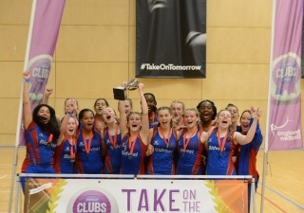
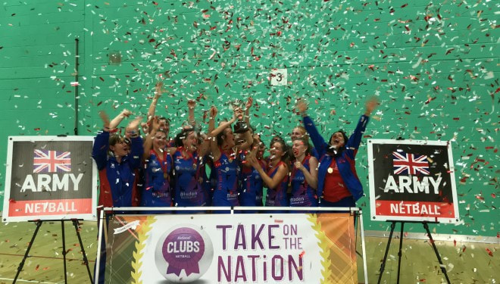
National competition
Under 16 National Clubs
Winners- Oldham NC
13th – YWCA Bury
Under 14 National Clubs
Winners – Oldham Netball Club
Runners Up – YWCA Bury
Oldham Netball Club – Senior National Premier League 1 Winners for the 7th time!

Slide 15



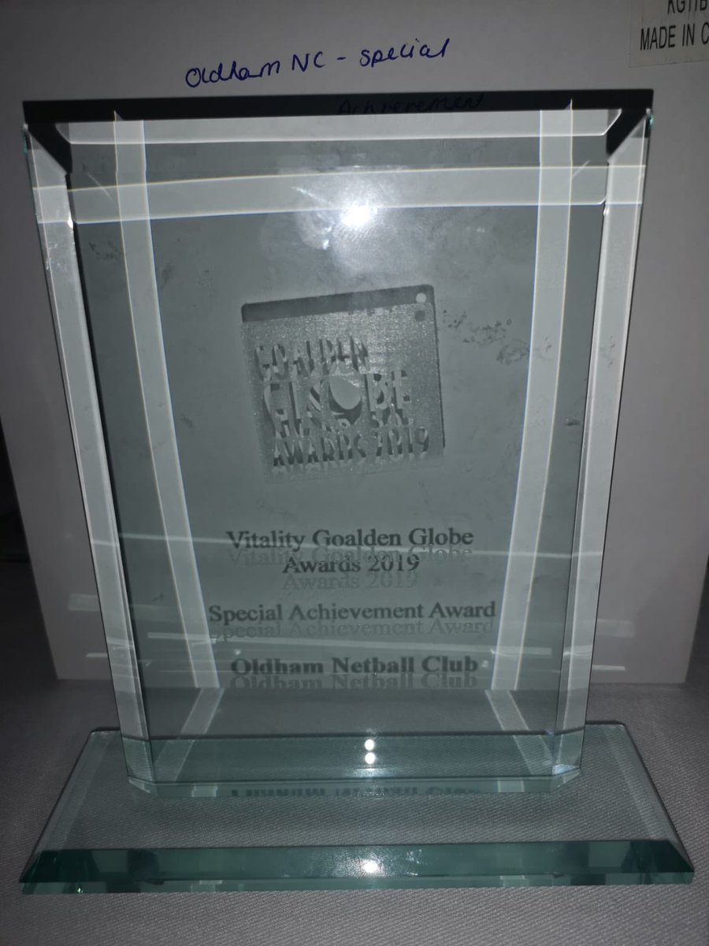
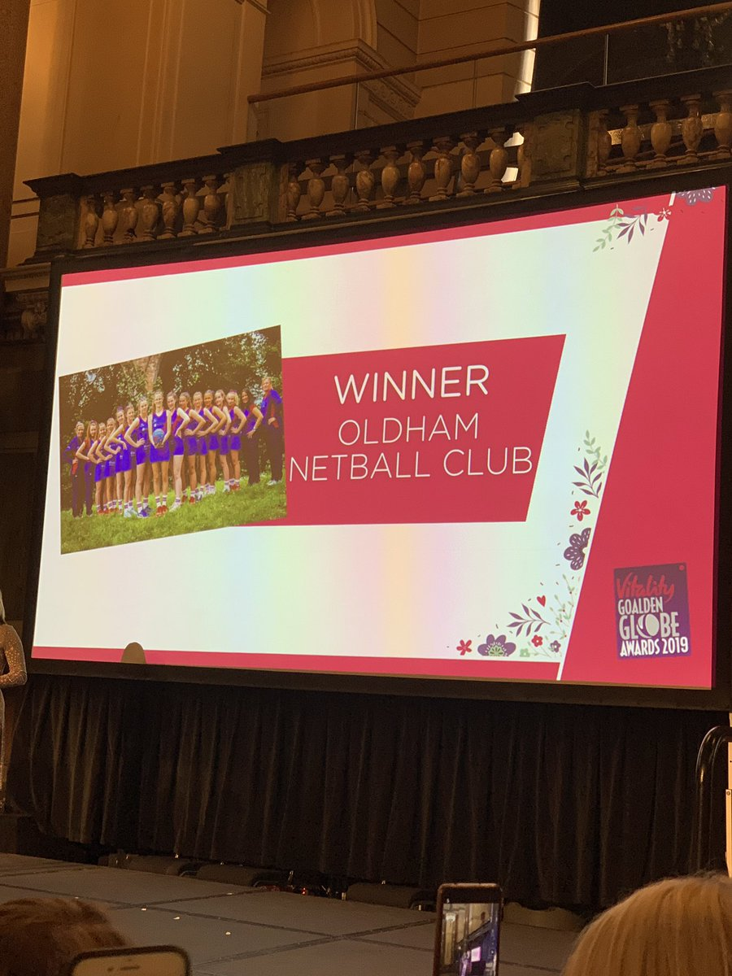
Outstanding Achievements – Oldham Netball Club
So here it goes we are Senior National Premier League 1 Winners Senior NW premier League Winners Senior NW Champions League Winners U16s National Champions U14s National Champions
Our best year ever

Slide 16
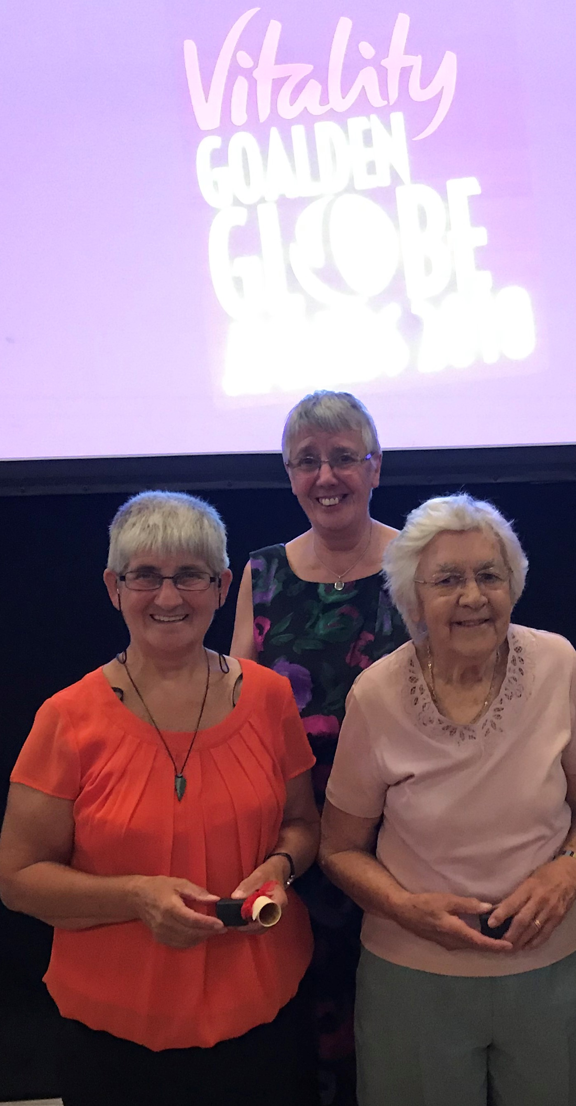
Special Awards
Honorary Life Members
Angela Hoyle
Kath Edwards
Long Service Award
Mary Slade

Slide 17
Special Mentions
Congratulations to Tracey Neville and the England World Cup team on finishing 3rd
Tracey has now stepped down to start a family, we wish her all the happiness in the world and can’t wait to meet baby and then have her back in the game!
Congratulations to Karen Greig who has been appointed as England Under 21 Coach
Congratulations to Sheonah Hunt who has left the area to work for England Netball as the Pathway Head Coach
Congratulations to Manchester Thunder on being crowned Super League Champions, Under 21 NPL Tournament Runners Up, Under 17 & Under 19 NPL Tournament Winners and Under 15 Inaugural Netball Performance Champions

Slide 18
Season Analysis
Strengths
Continue to produce high quality athletes – as reflected by number in Franchises & England programmes
Strong successful clubs & schools
Link with Manchester Thunder
Number of officials qualifying
Embracement of Engage system
High participation figures in NDO/NDCC programmes
Weaknesses
Communication
Website
Divide between standards in clubs
Time
Volunteers
Prep for Future
Gaps in committee – Volunteer/Marketing
Opportunities
Funding to help develop officials within clubs and more successful passes
Support of athletes to progress into a Performance programme
To support and develop coaches
Mentoring programmes – officiating/coaching
Transfer of participation figures into affiliation figures
Threats
Affiliation against external organisations
Changes at EN – staffing structures/CEO
Other counties/franchises
We want to hear your opinions – what do we need to do better,
what do you want from you county???

Slide 19
Agenda continued
League & Borough Reports
Adoption of Reports
Election of Officers
Election of Auditor
Close of AGM
Thank you for attending the GMCNA AGM 2018/2019 Season.
We value your support and time

