Slide 1



Greater Manchester County netball Association – AGM
Tuesday 16th October 2017 – 7pm

Slide 2
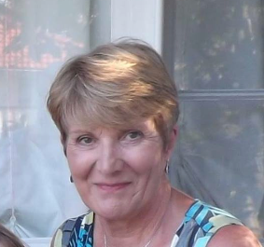
Welcome & Presidents Address
This AGM is covering the period 1st September 2017-31st August 2018
President – Kath Pemberton

Slide 3

Agenda items
Present
Apologies for Absence
Minutes of the last meeting
Affiliation Notification/Report
Changes to the Constitution
Chairperson’s report – Sam Longley

Slide 4
Areas Of Work
Finances – Janet Murray
Officiating – Lesley Smith
Competition – Dawn Day
Coaching – Teresa Monaghan
Development – Katie Thompson
Performance – Sam Longley
Schools
Achievements

Slide 5
Performance
2017/2018
2 x under 15 academies – 58 athletes
Lots of changes from England Netball with performance now lying under the franchises for 2017/2018
Counties still to be part of pathway
Manchester Thunder Partnership
2018/2019
1 x Under 13 academy
1x Under 15 academy
Manchester Thunder Partnership

Slide 6
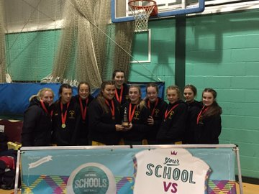
Results/achievements
Competition – County Schools
Age Group | Winners | Runners Up
U12 | Stockport GS | Cheadle Hulme
U13, 14, 15, 16 | Cancelled
U19 | Cheadle Hulme | Hulme Gram
National School’s
Congratulations to Hulme, Holy Cross and Withington for reaching the National Schools finals and double congratulations to St Monica’s for winning the U16 tournament.

Slide 7
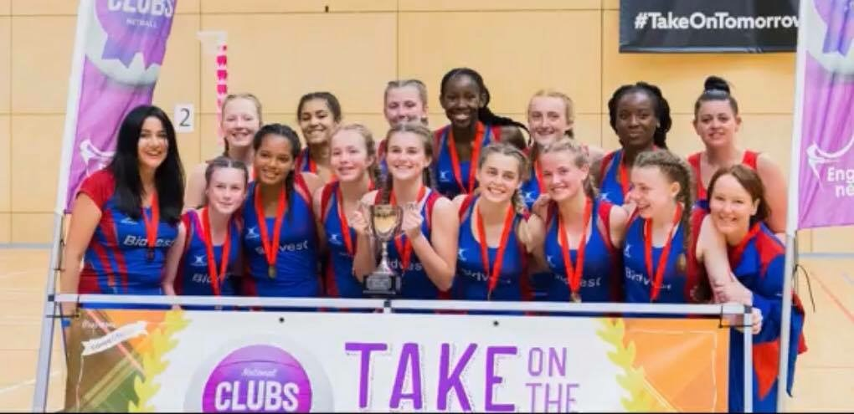
National clubs
Under 14 National Clubs
Winners – Oldham Netball Club
5th – Tameside
Under 16 National Clubs
Runners Up - Oldham

Slide 8
Season Analysis
Strengths
Continue to produce high quality athletes – as reflected by number in Franchises & England programmes
Strong successful clubs & schools
Link with Manchester Thunder
Weaknesses
Communication
Website
Divide between standards in clubs
Time
Volunteers
Prep for Future
Opportunities
Funding to help develop officials within clubs and more successful passes
Support of athletes to progress into a Performance programme
To support and develop coaches
Mentoring programmes – officiating/coaching
World Cup
Threats
Affiliation against external organisations
Changes at EN – staffing structures
Other counties/franchises
We want to hear your opinions – what do we need to do better,
what do you want from you county???

Slide 9
Agenda continued
League & Borough Reports
Adoption of Reports
Election of Officers
Election of Auditor
Close of AGM
Thank you for attending the GMCNA AGM 2017/2018 Season.
We value your support and time

