Slide 1

Greater Manchester County Netball Association - GMCNA
Annual General Meeting – 15th October 2025
On-line

Slide 2
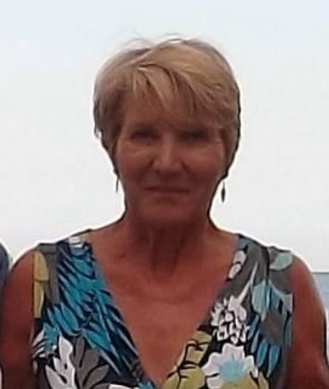
Welcome & President’s Address
This AGM is covering the period 1st September 2024 – 31st August 2025
Following the reports of the AGM, we will open and discuss our plans for 2025/2026
President – Kath Pemberton

Slide 3
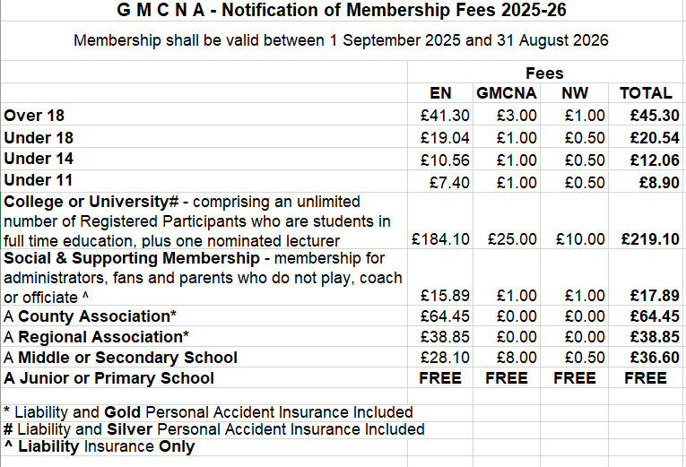
Agenda
Minutes of the last meeting – these have been circulated to those who attended or have requested them and need to be voted as a true record
Affiliation notification
Changes to the constitution

Slide 4
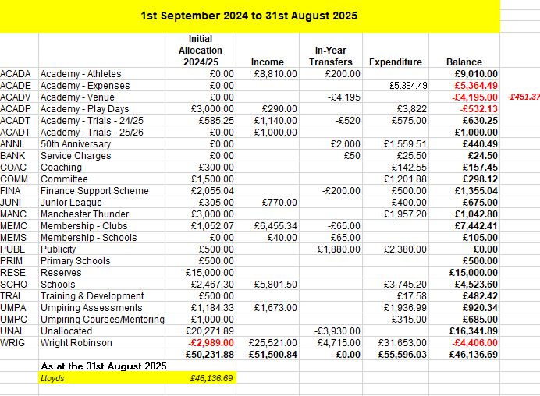
Treasurer Report – Janet Murray
Income and Expenditure
2024/2025

Slide 5
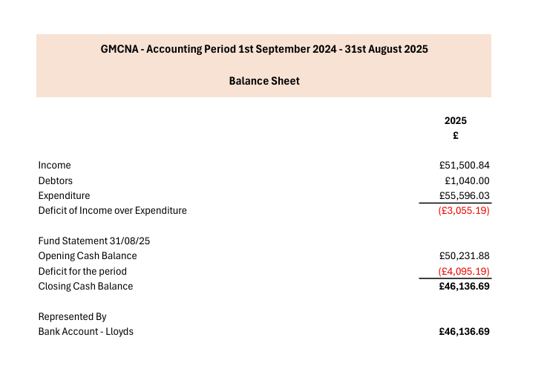
Treasurer Report – Janet Murray
Balance Sheet 2024/2025

Slide 6
Officer Reports
.
Chair – Sam Longley
Successes
Development of a new website to improve communication and accessibility.
Dedication of volunteers in running County specific work such as leagues, and organising assessments.
Celebration of 50 years - marking half a century of a wonderful and thriving county.
Challenges
Volunteer time and demands, as the organisation continues to rely heavily on their commitment and support.
Venue contracts and availability, with rising costs posing logistical challenges.
Staff turnover and role adjustments impacting continuity and work programmes - Nationally & Locally
Massive thank you to everyone who makes netball happen in Greater Manchester

Slide 7

Officiating – Lesley Smith
9 Umpires have passed their C award
21 passed the INTO award
2 New Assessors
Supported officials with implementation of new rules.

Slide 8
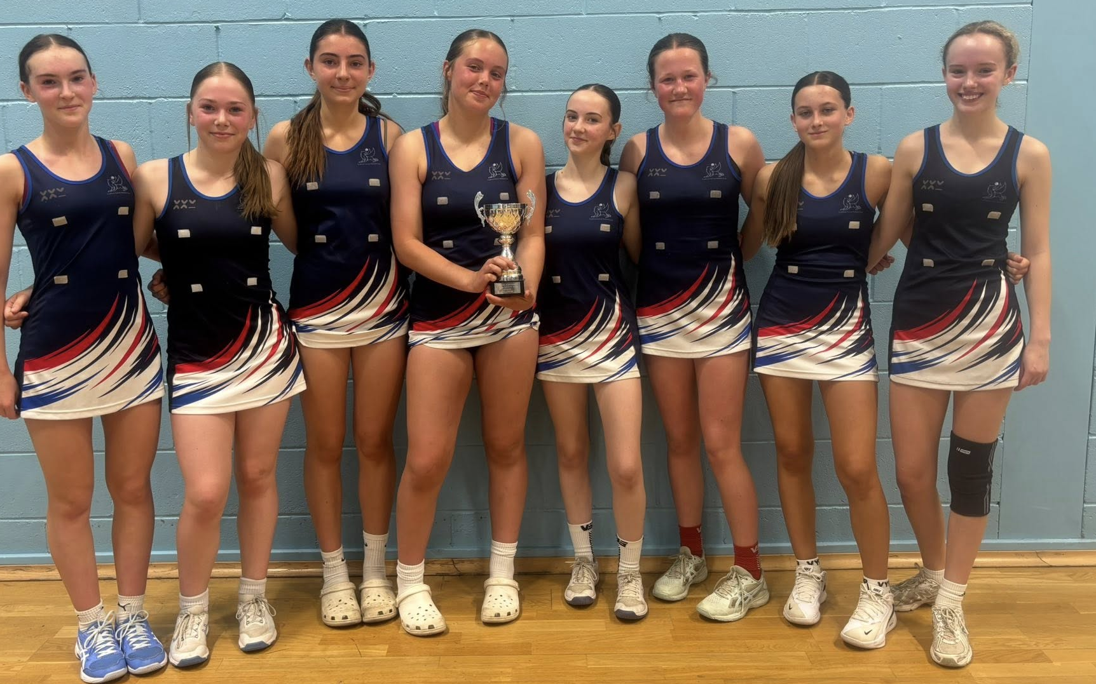
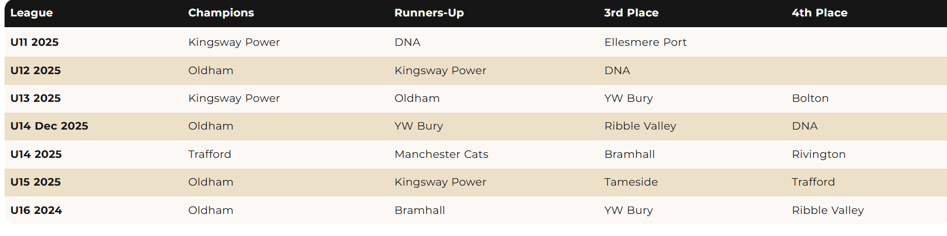
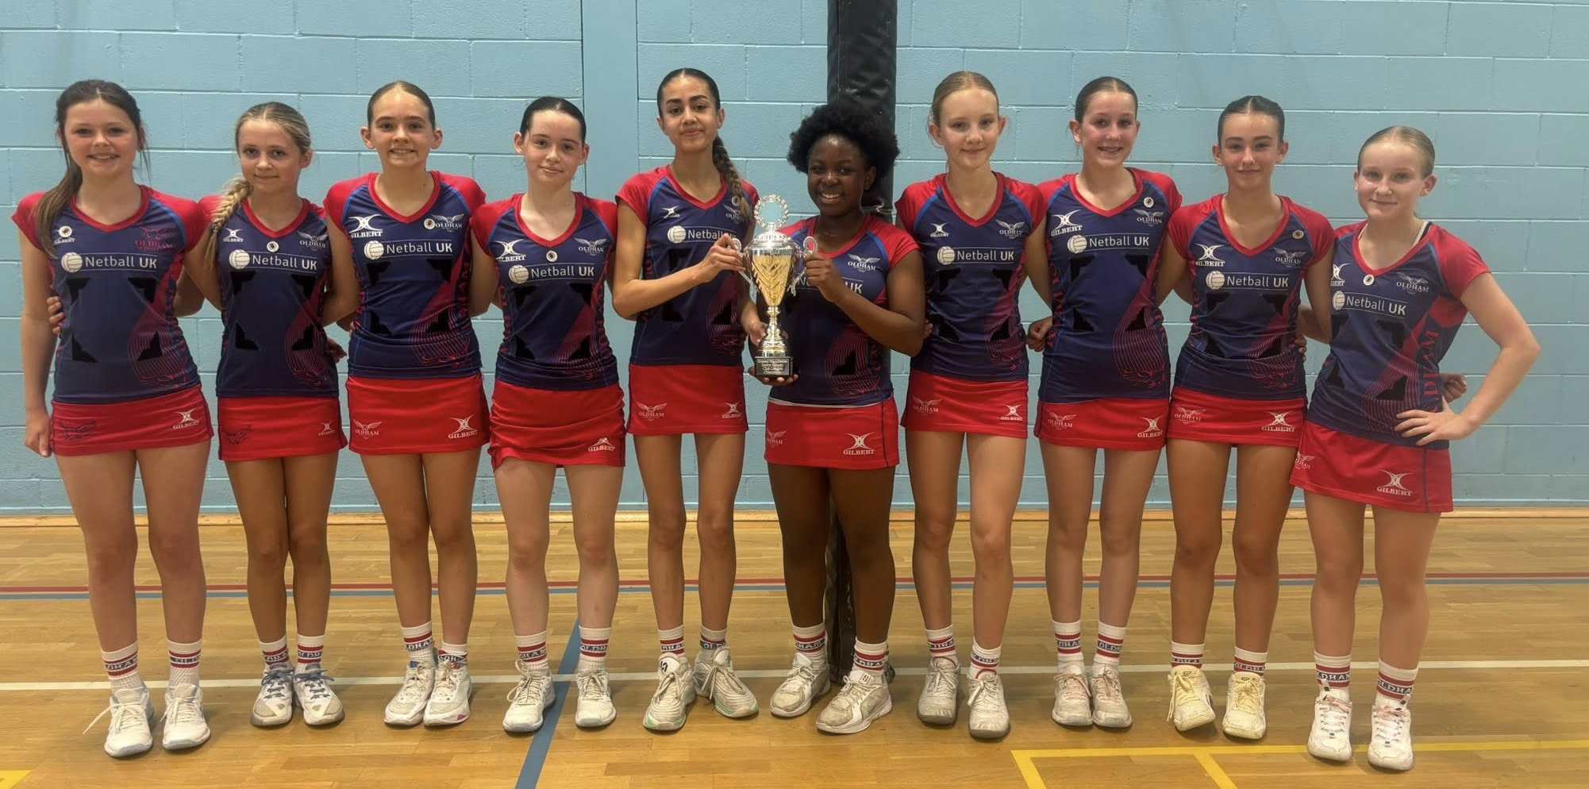
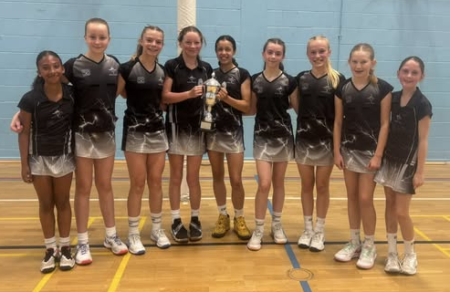
Competition – Dawn Day (GMJCCL)
Massive thank you to Dawn for co-ordinating the league
105 Teams (26 clubs) in total entered GMJCCL – 500 matches from October to June
Elite county league, with certain age groups as a qualification feed for regional competition
League was used for Umpiring Assessments.

Slide 9
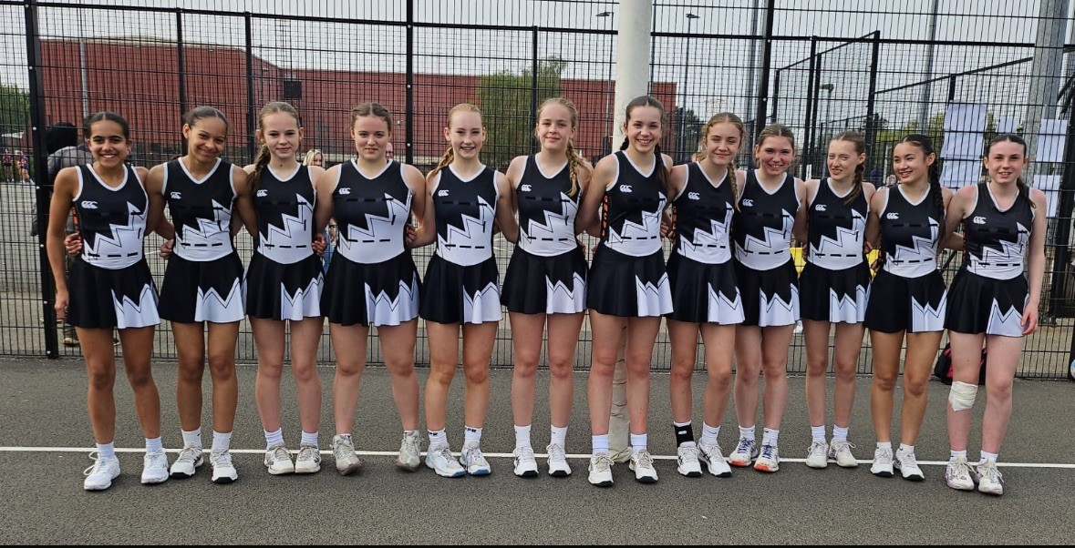
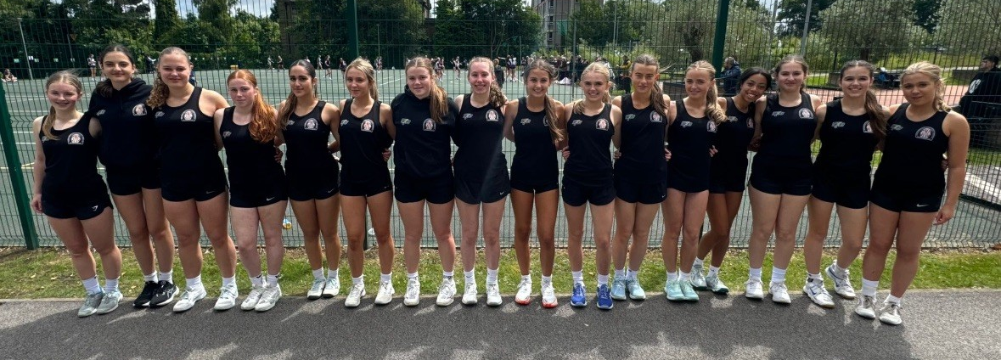
Performance – Sam Longley
A full programme was successfully delivered for both Under 13 and Under 15 age groups.
Play Days were extremely successful, providing valuable match experience and development opportunities.
Teams travelled to Bedfordshire and Staffordshire to compete in tournaments, offering players the chance to test themselves against strong opposition.
Challenges included managing the impact of a busy calendar and the increasing demands on athletes’ time and commitments.
Several players progressed to franchise and England Netball (EN) pathways, reflecting the quality of coaching and player development within the county.
A massive thank you to the incredible team of coaches for their dedication, as well as to the selectors, support staff, and umpires who represented Manchester at play days and trials — your contribution has been invaluable.

Slide 10
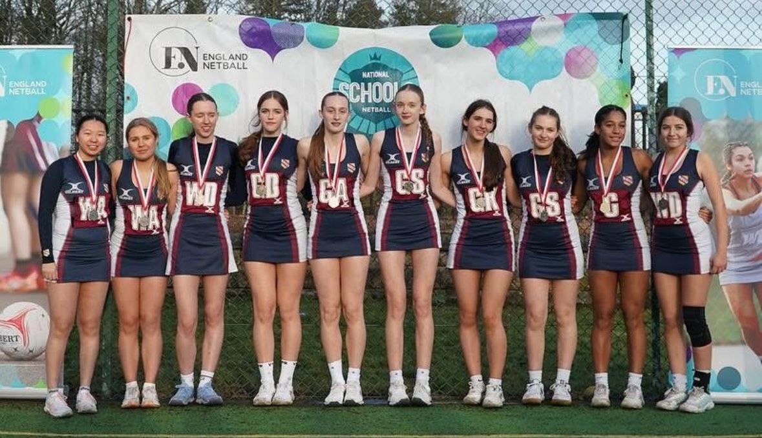
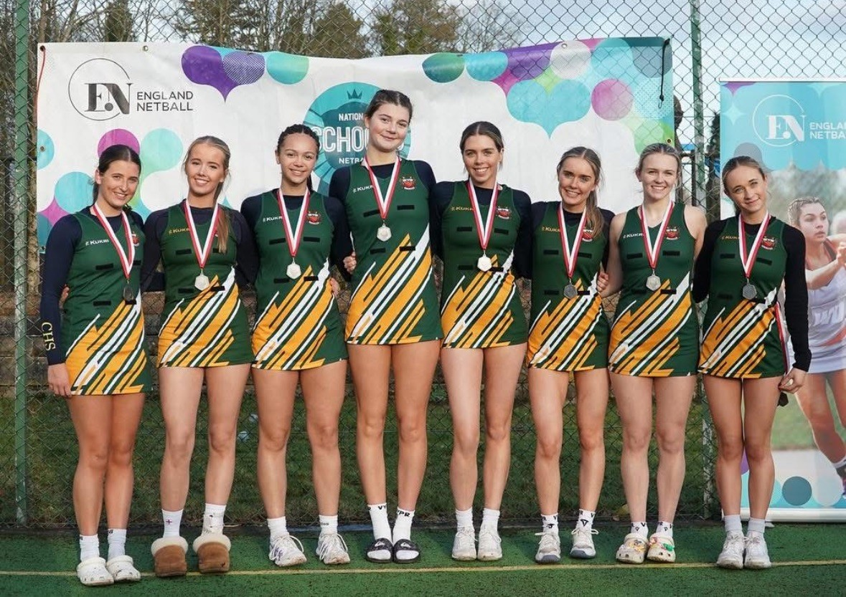
Schools
Our schools have enjoyed another fantastic season, with strong participation and great performances across all age groups.
A huge thank you to the Schools Committee for their hard work in organising and running the school leagues and qualification competitions for the Regional Schools, which in turn lead to the National Schools Competition.
We are also extremely grateful to all officials and Tournament Referees who have supported these events, and to Lesley for her outstanding efforts in sourcing and coordinating officials throughout the season.

Slide 11
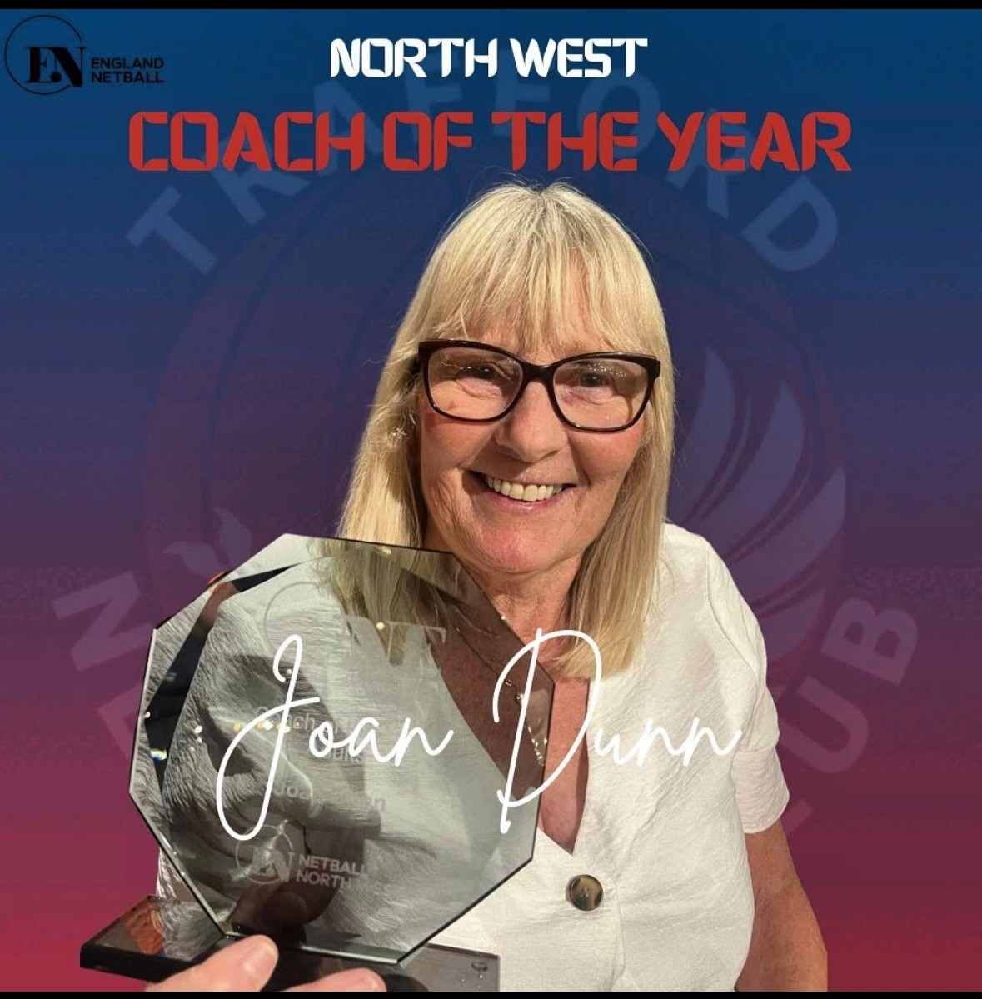
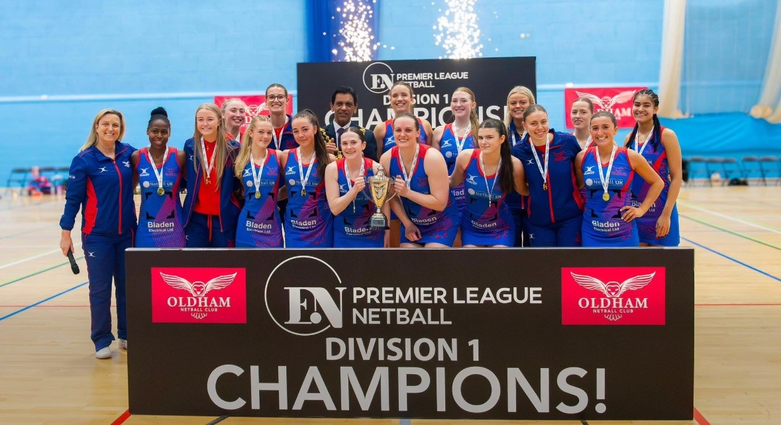
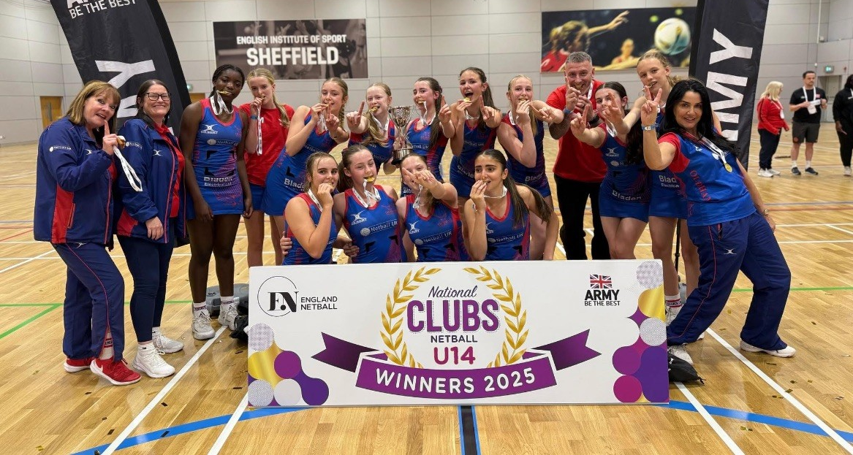
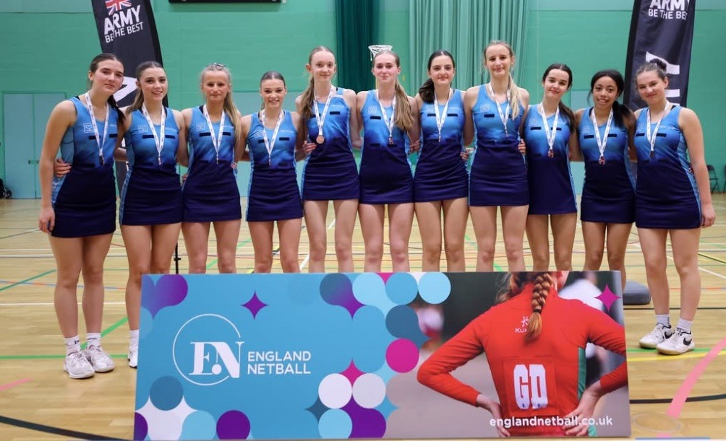
Achievements

Slide 12
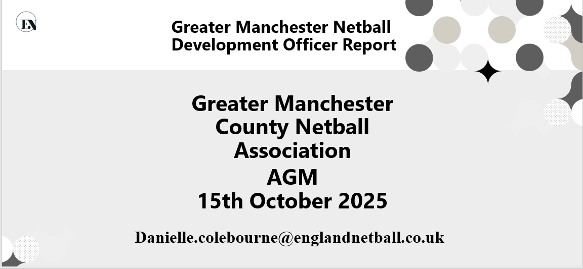
Development

Slide 13
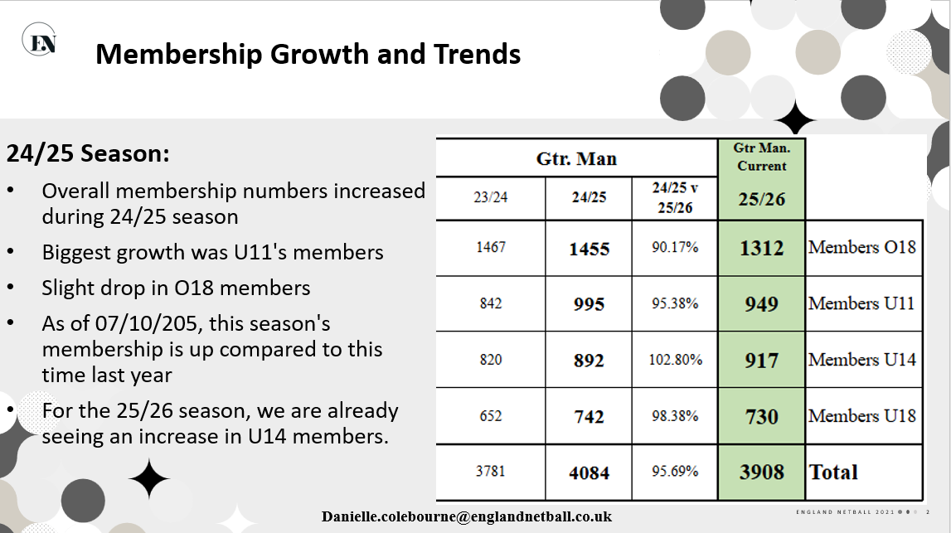
Development

Slide 14
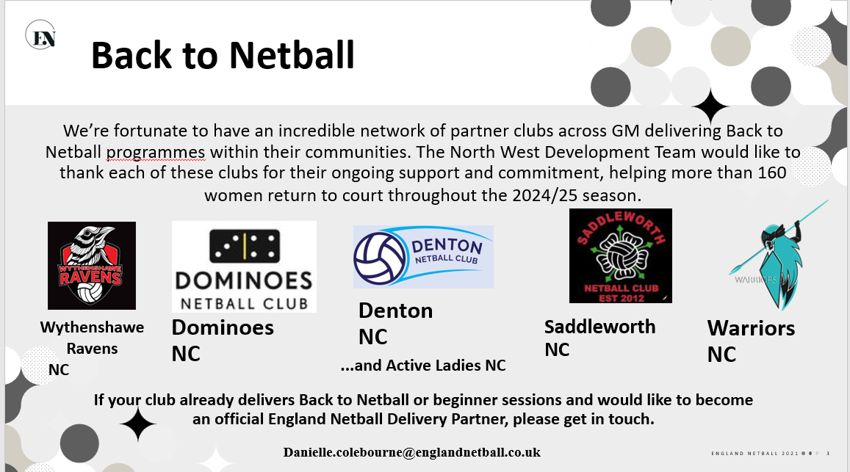
Development

Slide 15
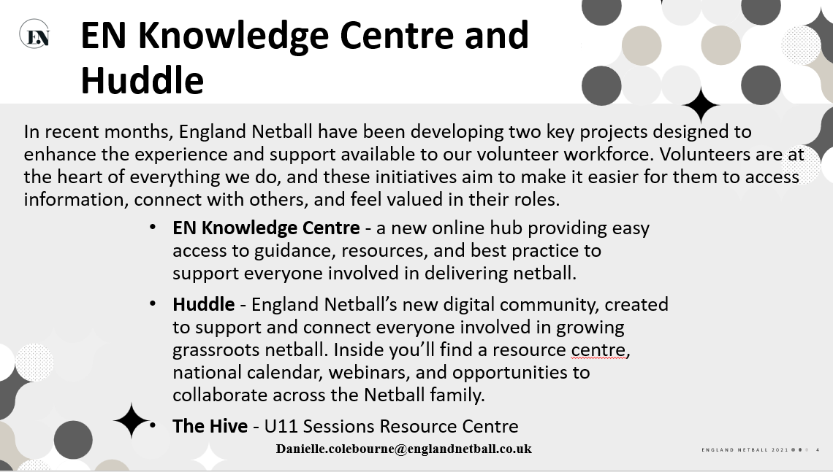
Development

Slide 16
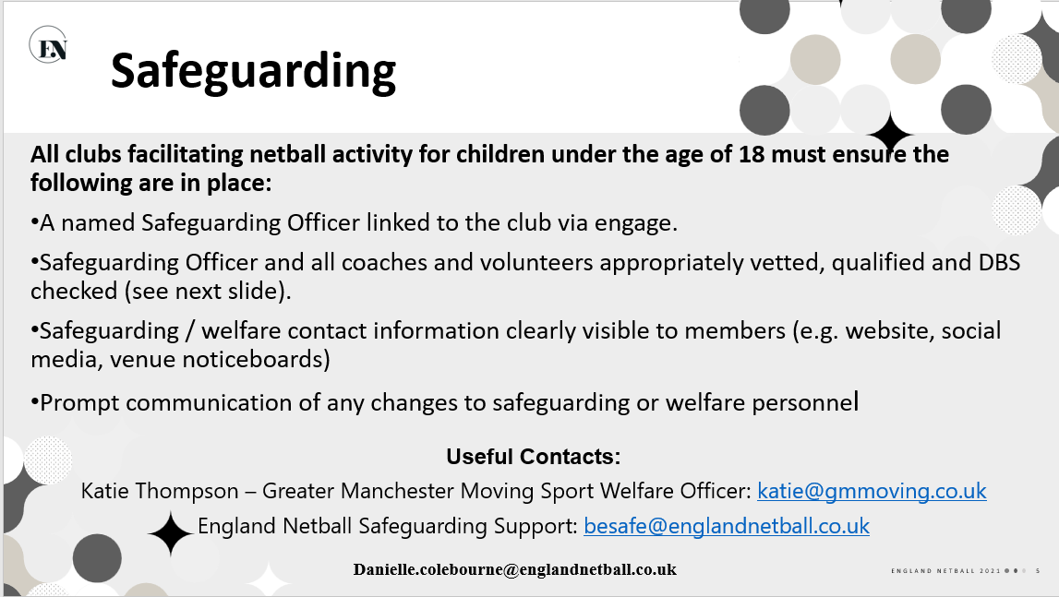
Development

Slide 17
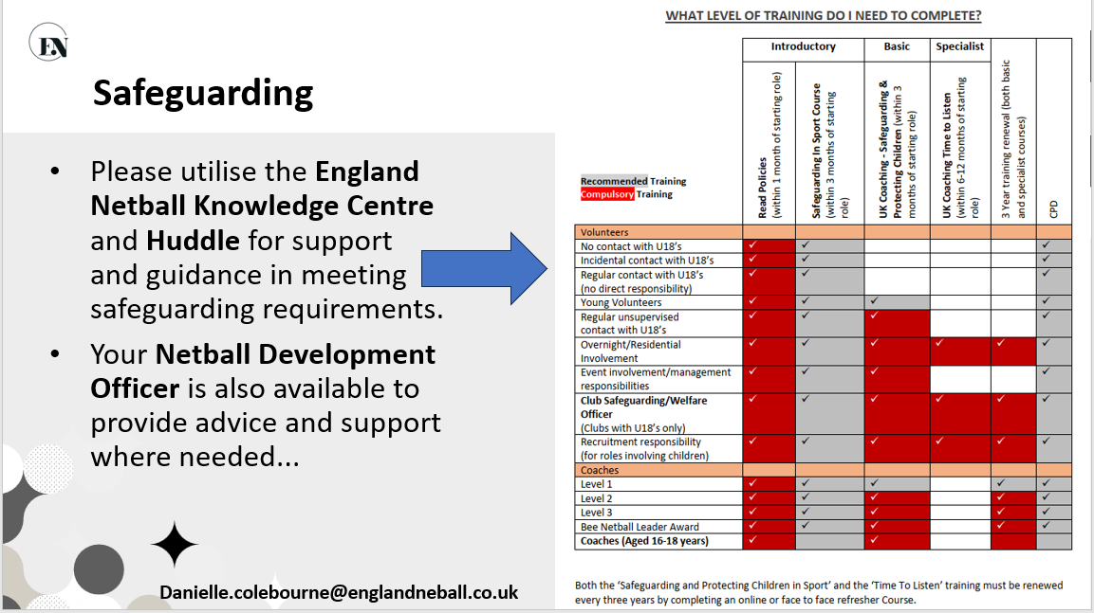
Development

Slide 18
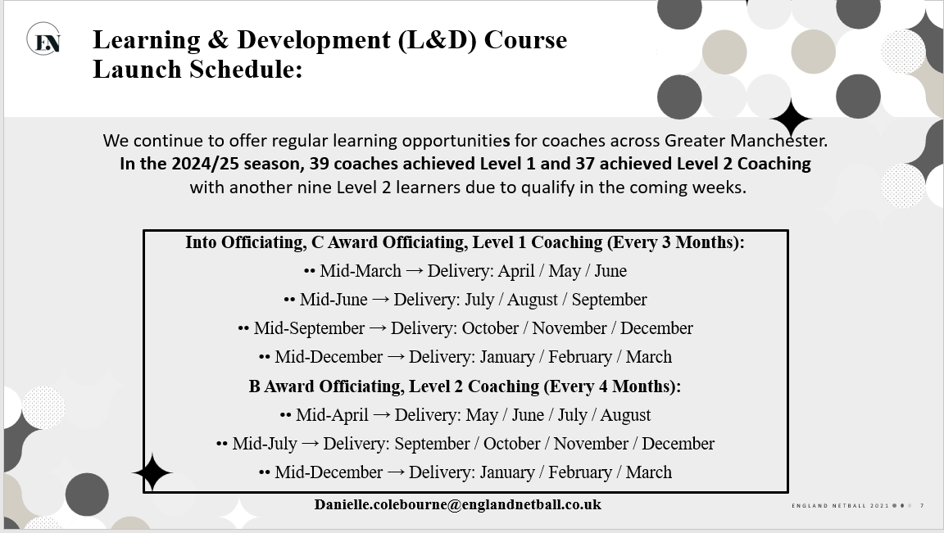
Development

Slide 19

Development

Slide 20
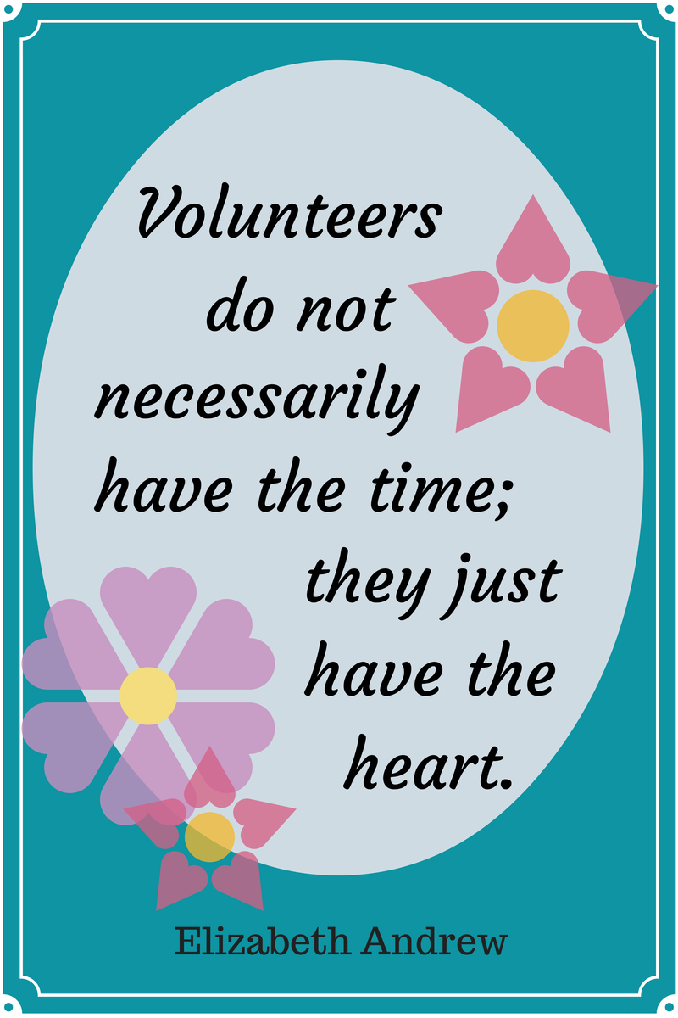
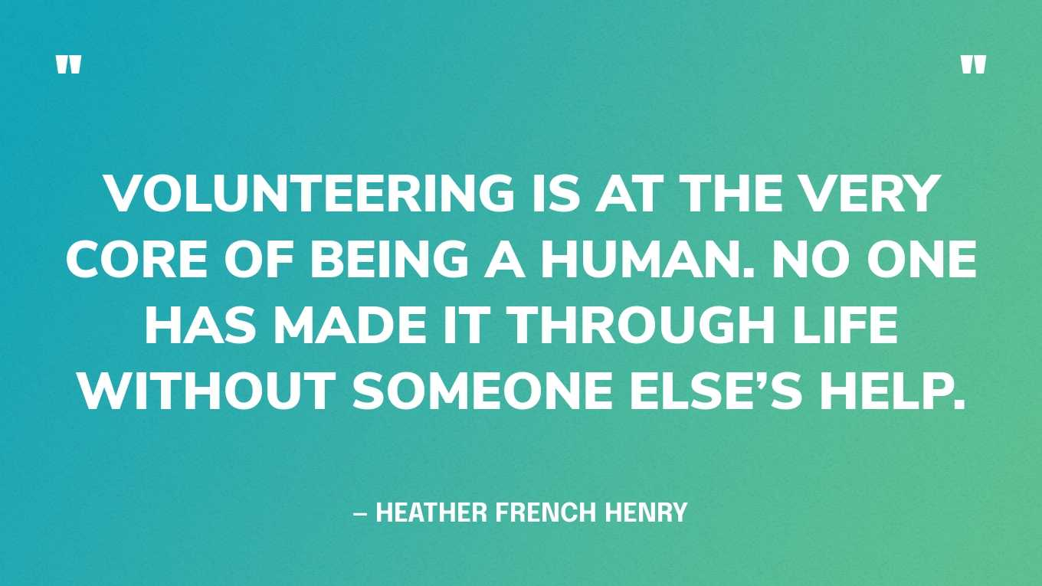
Volunteers
Netball simply would not thrive without the wonderful volunteers we are so fortunate to have across our county.
Your time, energy, and commitment make everything we do possible — from running leagues and tournaments to supporting players and officials.
A huge thank you to each and every one of you for your incredible contribution and continued dedication to Manchester Netball.

Slide 21
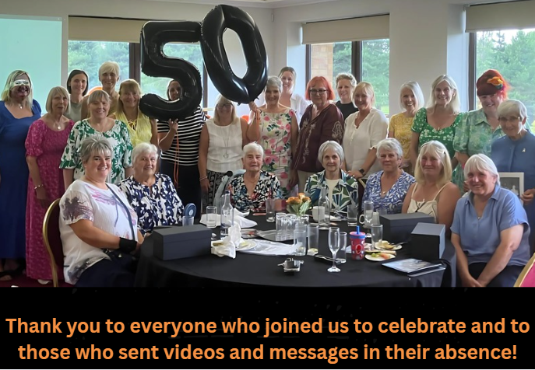
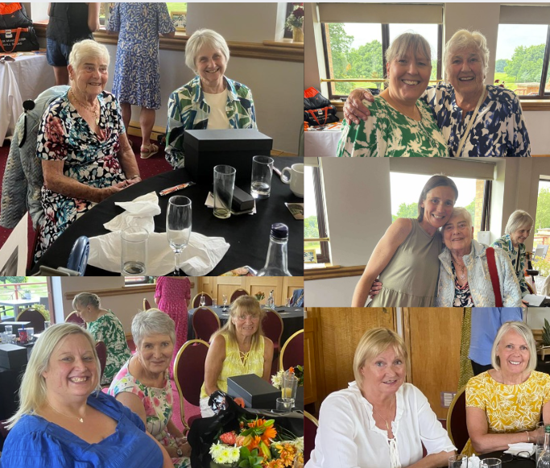
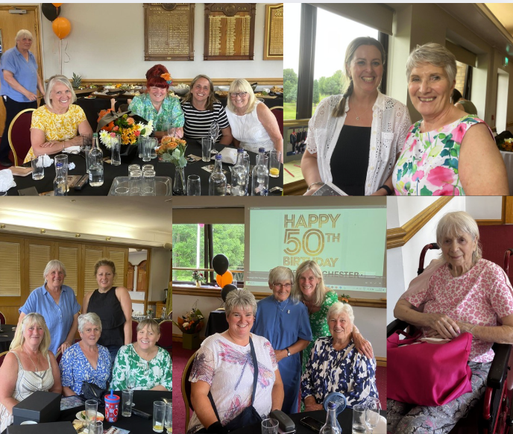
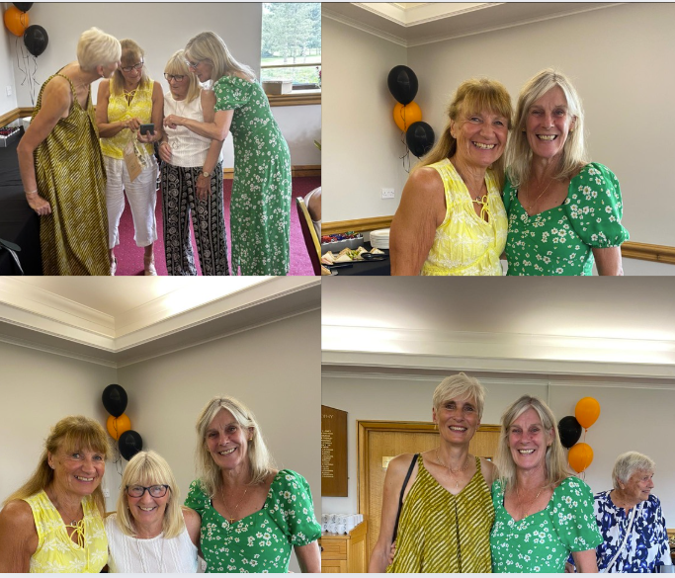
Greater Manchester County is 50!

Slide 22
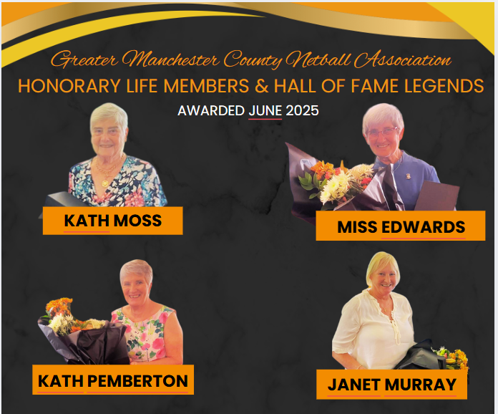
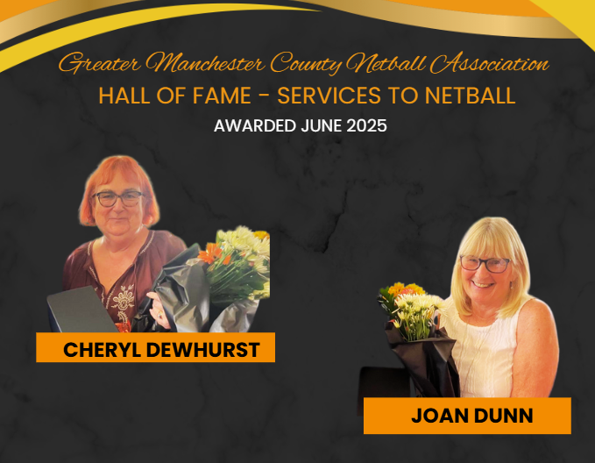
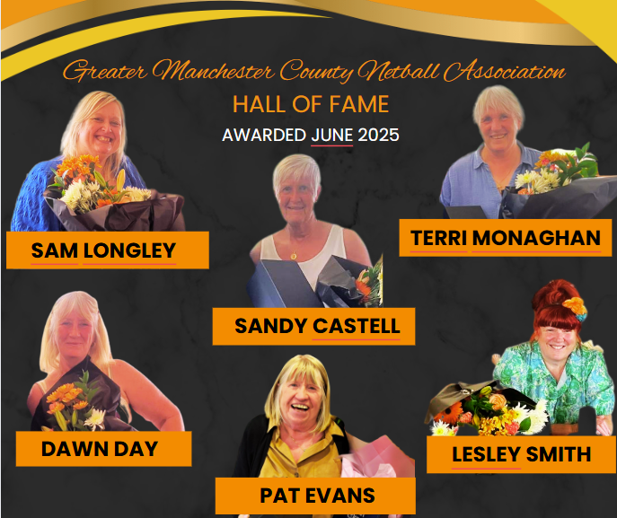
Greater Manchester County is 50- Hall of Fame!

Slide 23
2025/2026
League Structure: Continuing to review and collaborate with NW and Thunder to develop a league structure that best meets the needs of the County.
Promotion & Engagement: Actively working on enhancing our social media presence and marketing strategy to raise awareness and promote participation.
Committee Development: Focusing on recruiting new committee members and developing new officer roles to strengthen leadership and sustainability.
England Netball Centenary: Planning our contribution to England Netball’s 100th anniversary celebrations, ensuring our County plays an active and visible role.

Slide 24

Massive Thank You To All!

Slide 25
League & Borough Reports
MENL
Bolton
Wigan & Leigh

Slide 26
Other Agenda Items
Adoption Of Reports
Election of Officers
Election of Auditor

Slide 27

Questions

Slide 28
Thank you for joining us this evening and if you do have any questions please do not hesitate to get in touch! greatermanchesternetball@gmail.com www.gmcna.co.uk

