Slide 1

Greater Manchester County Netball Association - GMCNA
Annual General Meeting – 7th October 2024
Wright Robinson Sports College at 7pm

Slide 2
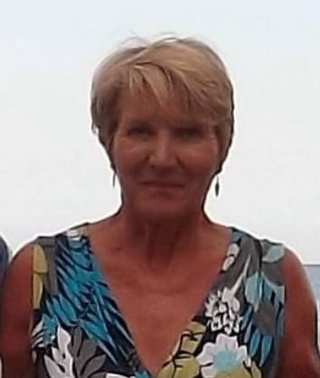
Welcome & President’s Address
This AGM is covering the period 1st September 2023 – 31st August 2024
Following the reports of the AGM period we will open and discuss our plans for 2024/2025
President – Kath Pemberton

Slide 3
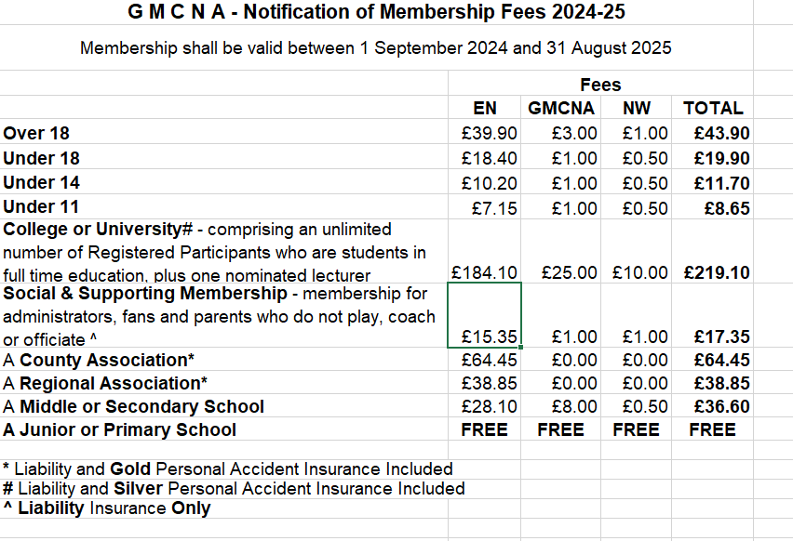
Agenda
Minutes of the last meeting – these have been circulated to those who attended or have requested them and need to be voted as a true record
Affiliation notification
Changes to the constitution – none

Slide 4
Treasurer Report
– Janet Murray
Income and Expenditure 2023/2024
Balance Sheet 2023/2024

Slide 5
Officer Reports
Chair – Sam Longley
Successes
  Strength and commitment from committee and wider pool of volunteers
  Commencement and support of leagues & competitions
  Development of Officiating, Performance players, Bee Netball
Challenges
  Committee meetings – Zoom & face to face
  Venue availabilities & costs
  Volunteer time and demands
  Pressures of commercial leagues on membership
  Massive thank you to everyone who makes netball happen in Greater Manchester

Slide 6

Officiating – Lesley Smith
13 Umpires have passed their C award
27 passed the INTO award
11 waiting for C final assessment
56 waiting for INTO assessments

Slide 7
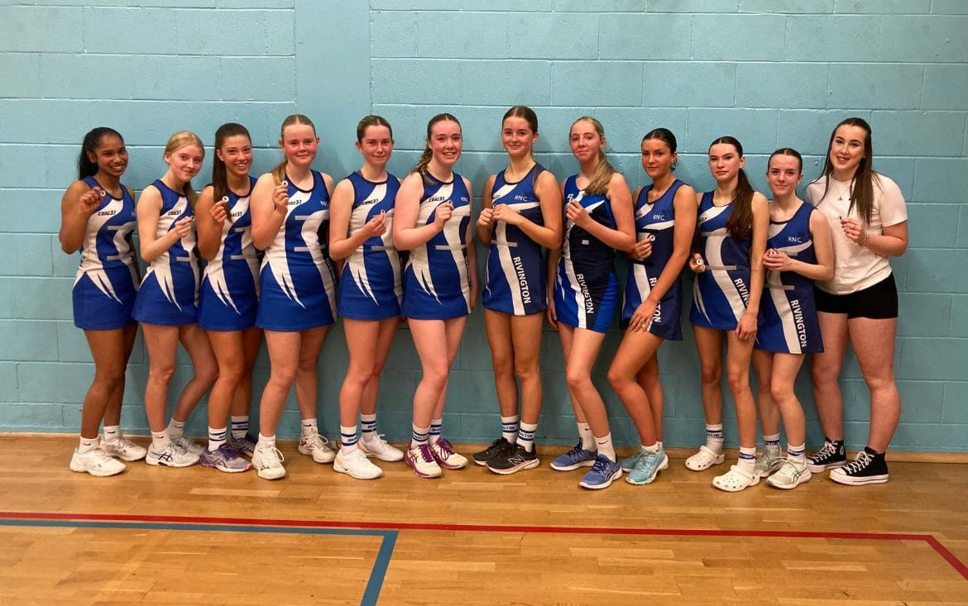
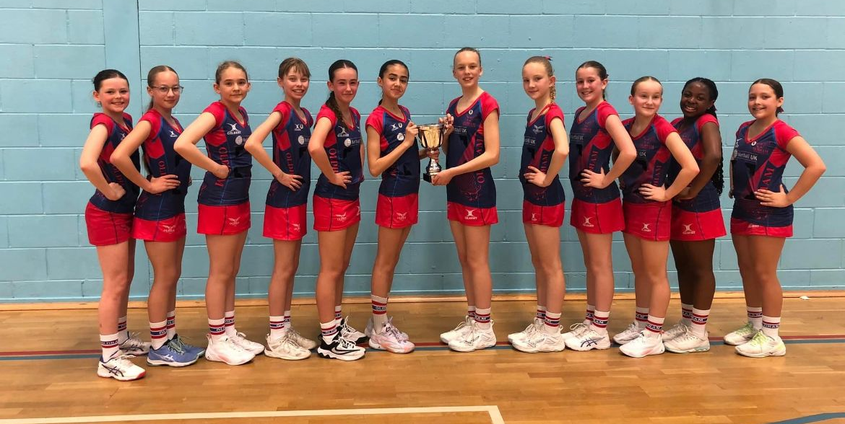
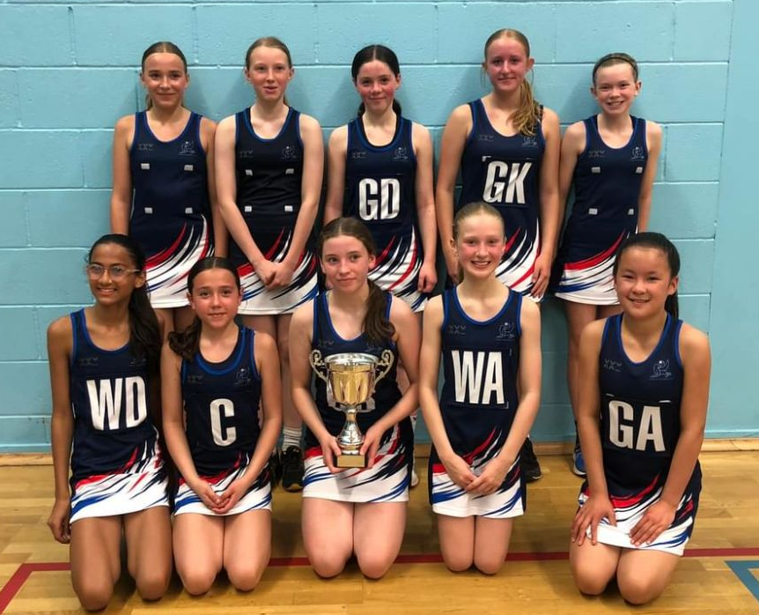
Competition – Dawn Day (GMJCCL)
Massive thank you to Dawn for co-ordinating the league and to Lesley for sourcing umpires.
87 Teams (25 clubs) in total entered GMJCCL – 800 matches from October to June
Ran an Elite & Development competition
League was used for Umpiring Assessments.
Under 11 Elite | Under 11 Development | Under 12 Elite | Under 12 Development | Under 13 Elite | Under 13 Development
Champs – Oldham | Champs – Oldham B | Champs – Kingsway Power | Champs – Trafford | Champs – Kingsway Power | Champs – Tameside B
2nd – Trafford | 2nd – Rivington | 2nd – Oldham | 2nd – DNA | 2nd – Oldham | 2nd – Rochdale
3rd – YW Bury | 3rd - Denton | 3rd – Ellesmere Port | 3rd Bramhall | 3rd – YW Bury | 3rd Bramhall
Under 14 Elite – To Qualify for Regional Comp | Under 14 Development | Under 15 Elite | Under 15 Development | Under 16 Elite – To Qualify for Regional Comp
Champs – Oldham | Champs – Rivington | Champs – Kingsway Power | Champs – Northwich Sapphires | Champs – YW Bury
2nd – YW Bury | 2nd – DNA | 2nd – Oldham | 2nd – Chorley Inferno | 2nd – Oldham
3rd – Tameside | 3rd – Trafford B | 3rd – YW Bury | 3rd - Rivington | 3rd – Bramhall
4th - Bramhall |  |  |  | 4th - Trafford

Slide 8
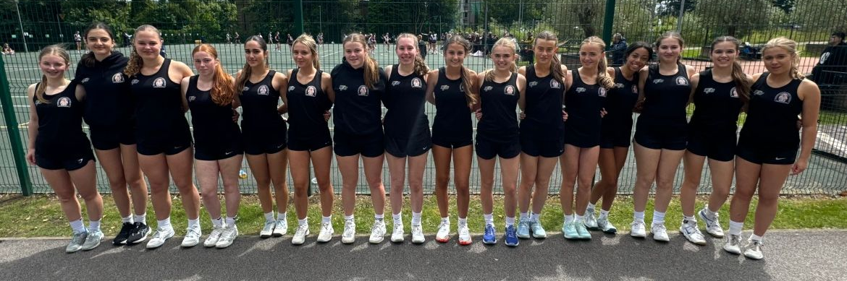
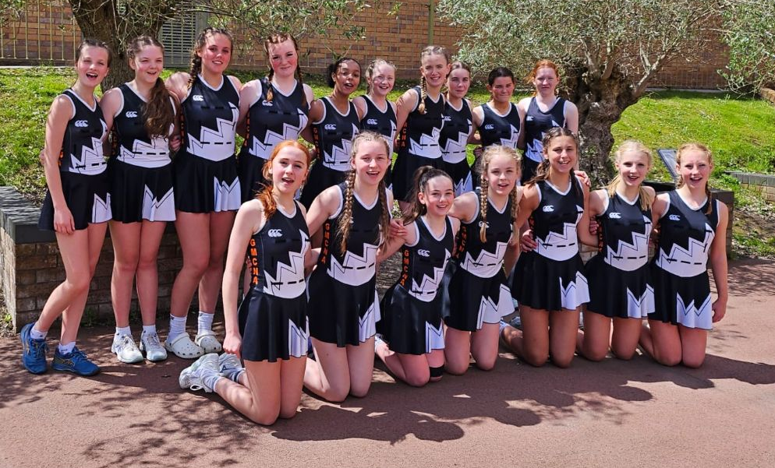
Performance – Sam Longley
Full programme ran at Under 13 & Under 15’s
Play Days – very successful
Trip to Bedfordshire & Staffordshire for tournaments.
Challenges impact of calendar and demands on athletes
Players progressing to franchise and EN
Massive thank you to my team of coaches for their invaluable coaching and the selectors and support staff and the umpires who represented Manchester at the play days and helped at trials.

Slide 9
Schools
Our schools have had another great season, thank you to the Schools Committee for running their leagues and qualification competitions for Regional Schools that lead to National School Competition.
Thank you to all officials and Tournament Referees who have supported these competitions and to Lesley for sourcing them.
Under 14 National Schools | Under 16 National Schoools | Under 19 National Schools
Cheadle Hulme 5th | Withington 2nd | Cheadle Hulme – 5th

Slide 10
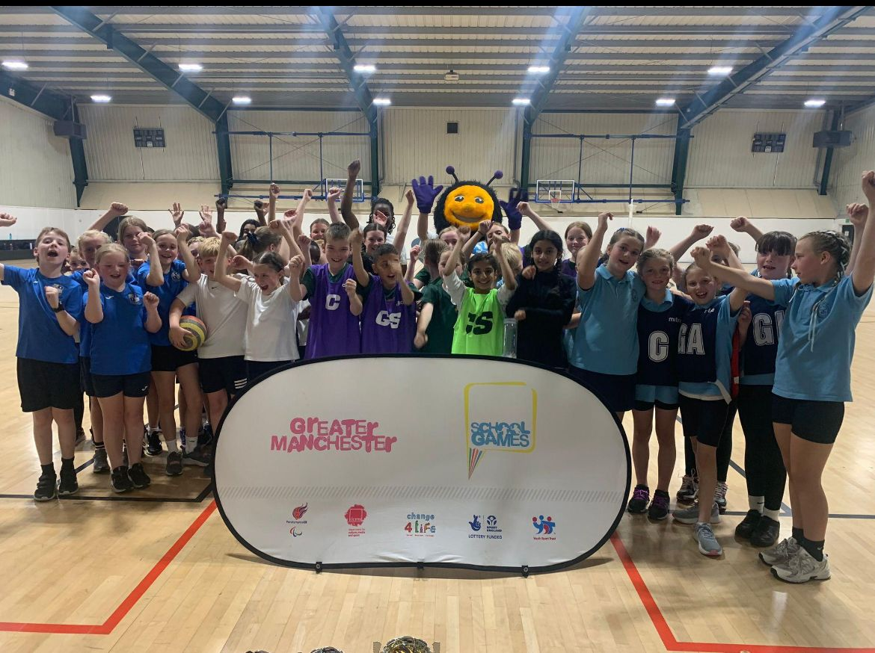
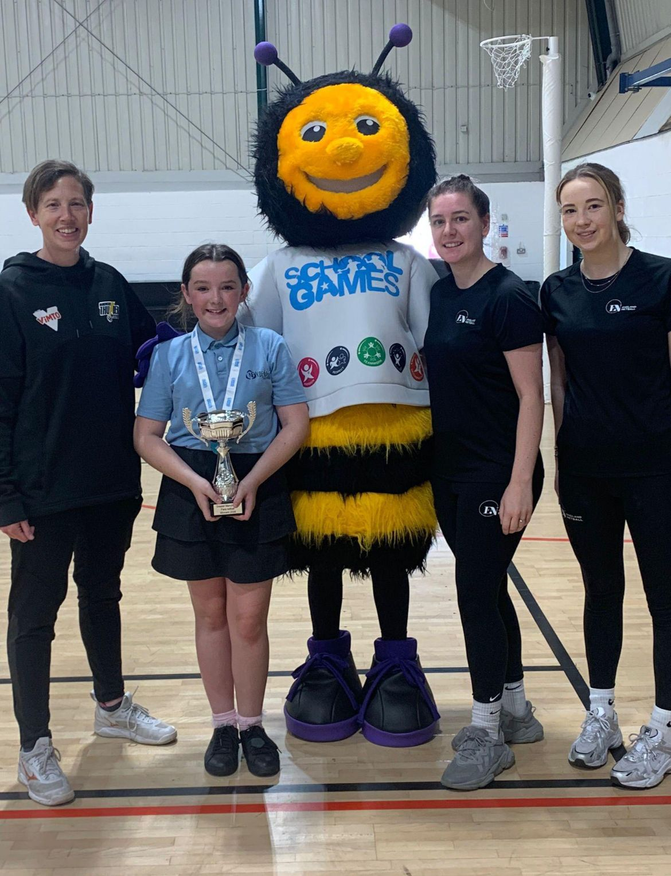
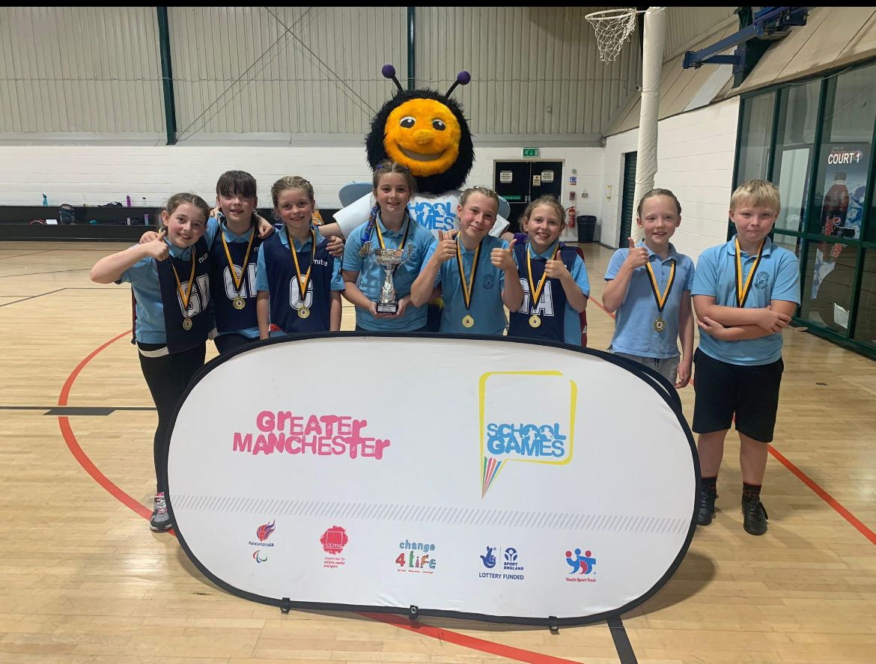
Bee Netball
Greater Manchester schools Para Netball and Bee Netball festival took place for the second year running.
Organised & supported by the GM School Games Organiser network, Greatersport, Manchester Thunder, GM County netball association & England netball, the event invited secondary school pupils in Key Stage 3 to take part in a coaching session led by qualified coaches with several skill stations to test the pupils including shooting and passing. .
Bee netball is friendly, high energy & especially designed for children. It introduces younger children to the skills of the game of netball such as passing, shooting, catching & throwing
Congratulations to Woodhouse Primary from Trafford for coming 1st in the Bee Netball

Slide 11
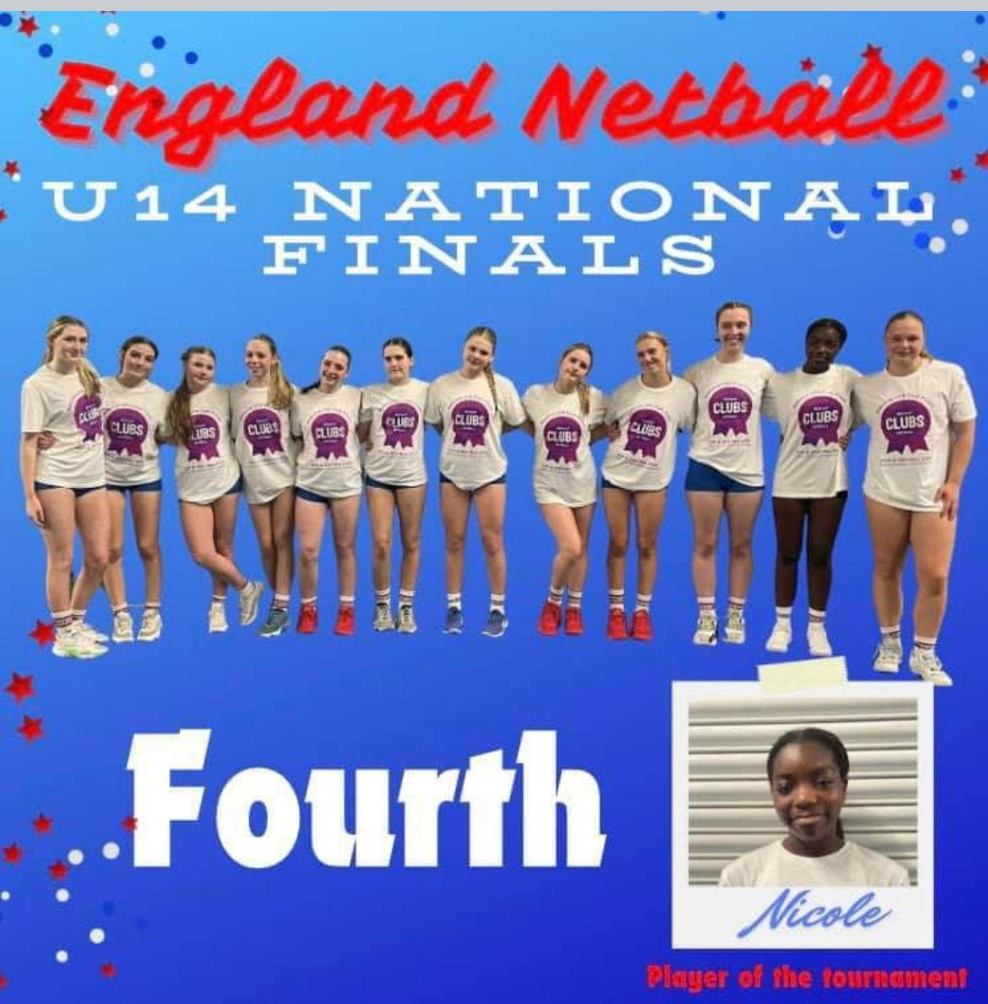
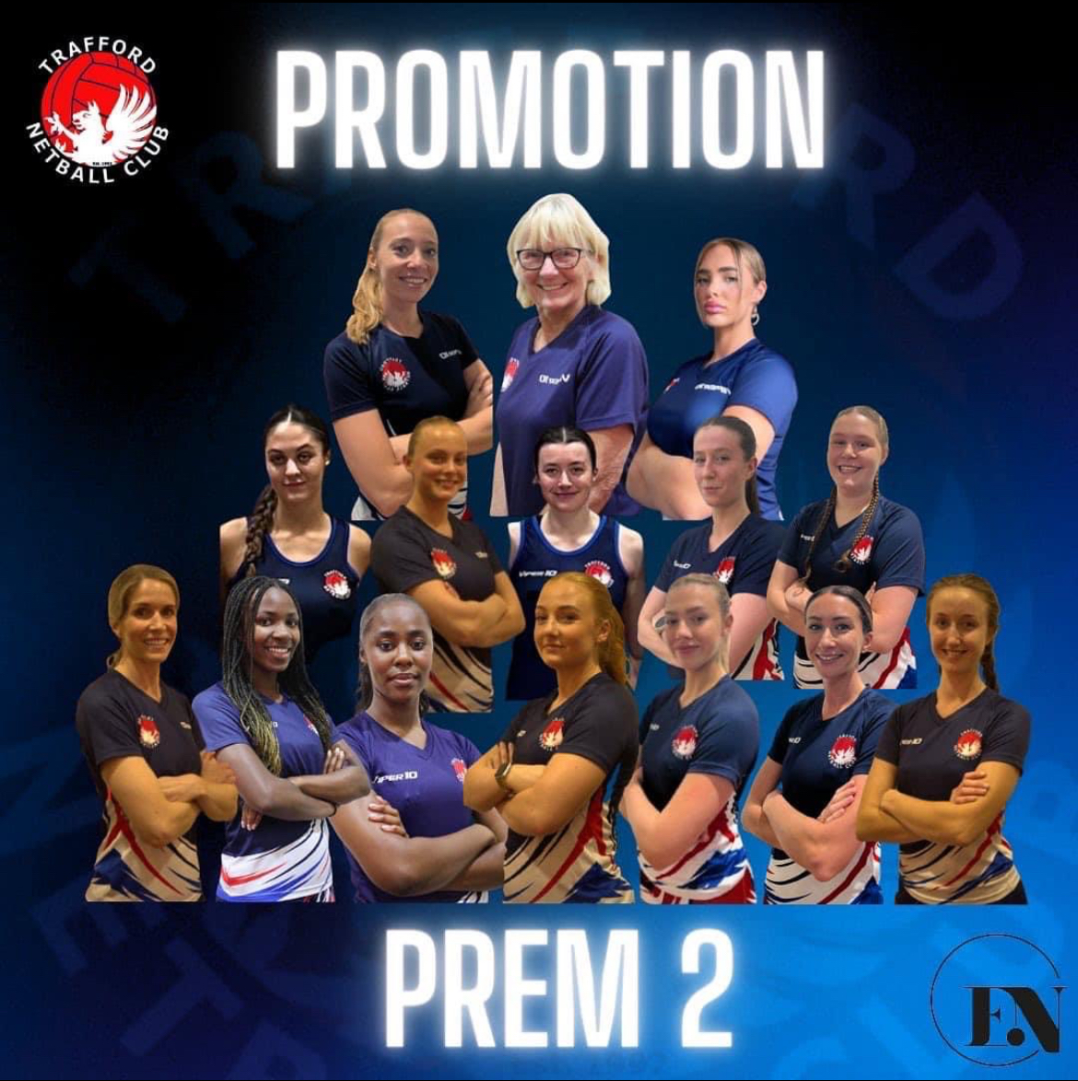
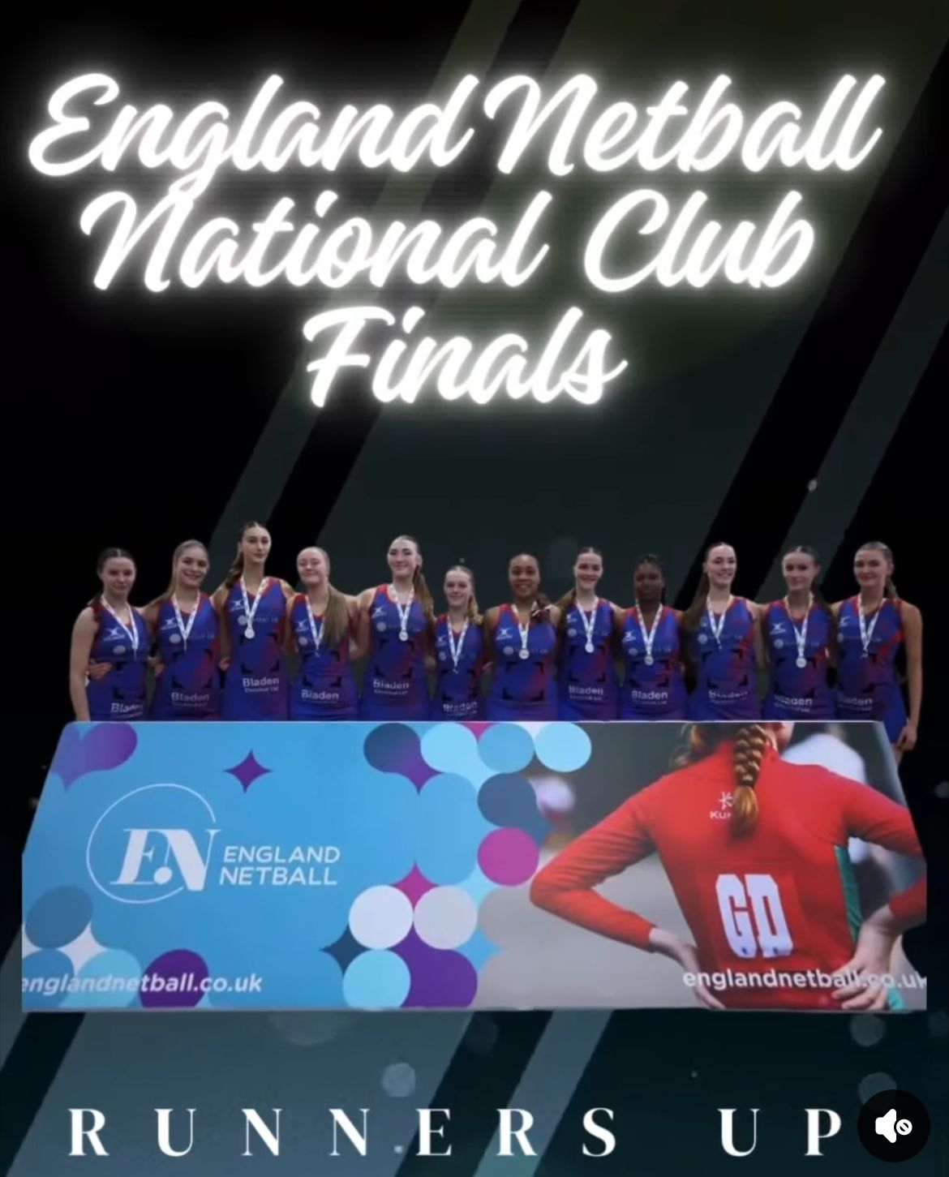
National Competitions

Slide 12
Development – Abbey Barry (see separate document)

Slide 13

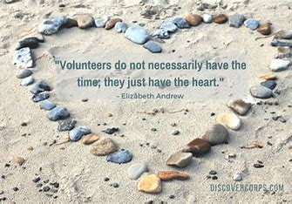
Volunteers
Netball would not survive without the wonderful Volunteers we have in our
County – so thank you to each and everyone of you!

Slide 14
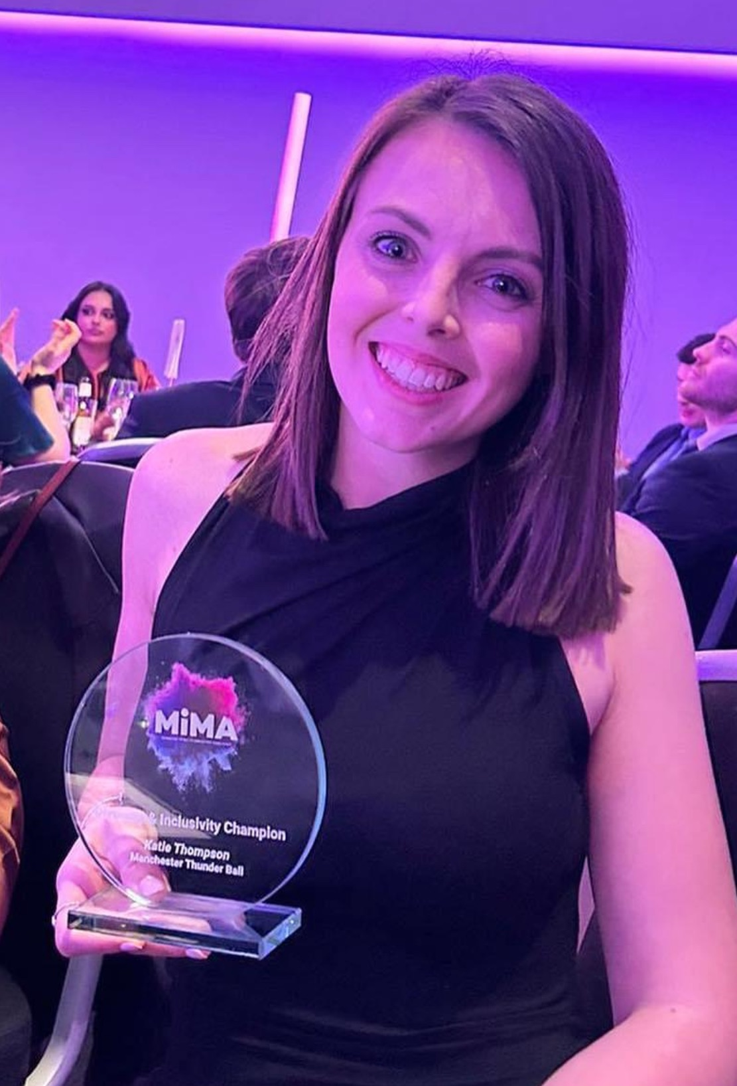
Para Netball – Katie Thompson
Congratulations to Katie on receiving her Diversity &
Inclusivity Champion Award for Manchester
Safeguarding & Welfare– Katie Thompson
Safeguarding & Welfare are a very high priority and any support needed is available.
Conference was delivered to Club Safeguarding Officers– more to follow
  katie@gmmoving.co.uk

Slide 15
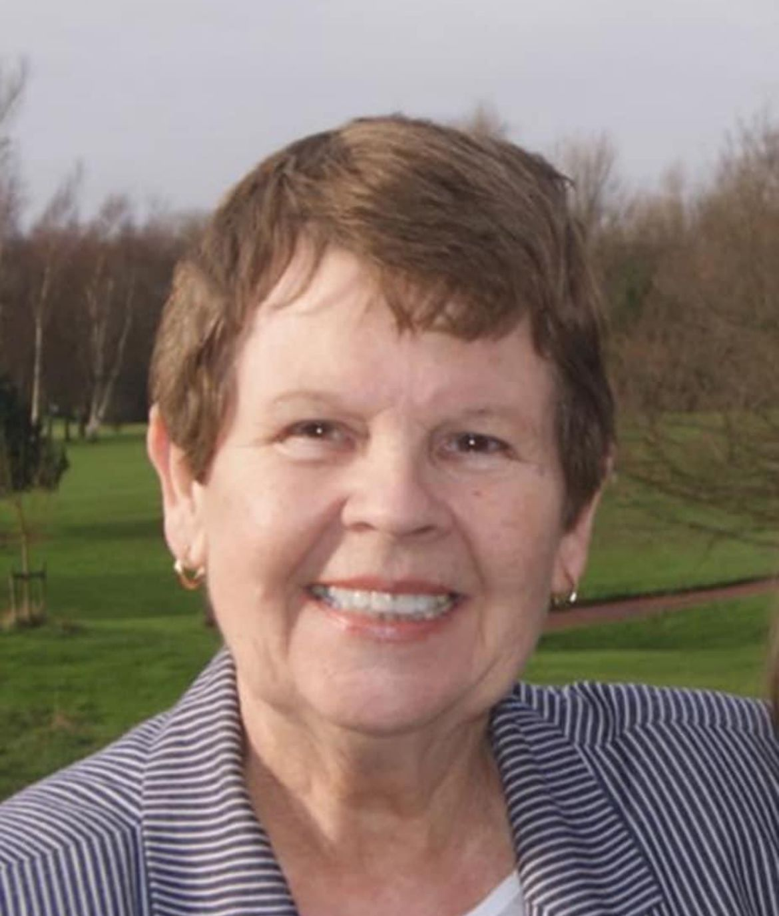
Sad News
Sadly each year we seem to loose another legend of the game
Sandra Marston OBE

Slide 16
2024/2025
Junior league – Running differently
Assessments for officiating and courses being planned
Planning of our Working As One Strategy - 2 year plans
Planning our 50th anniversary

Slide 17

Massive Thank You To All!

Slide 18
League & Borough Reports
MENL – Summer & Winter
Bolton
Wigan & Leigh
Bury

Slide 19
Other Agenda Items
Adoption Of Reports
Election of Officers
Election of Auditor

Slide 20

Questions

Slide 21
Thank you for joining us this evening and if you do have any questions please do not hesitate to get in touch! greatermanchesternetball@gmail.com or abbey.barry@englandnetball.co.uk

