Slide 1

Greater Manchester County Netball Association - GMCNA
Annual General Meeting – 3rd October 2023
Zoom Call

Slide 2
Zoom Call Rules
Please can we ask that you are all on mute. We will have time for any questions at appropriate times during the presentation.
Please avoid using the chat during the delivery of the presentation as it is distracting
Present & Apologies For Absence
Before we begin please put your name and who you are representing in the chat, so that we can ensure we have quorum and know how many votes we have.
List of apologies

Slide 3
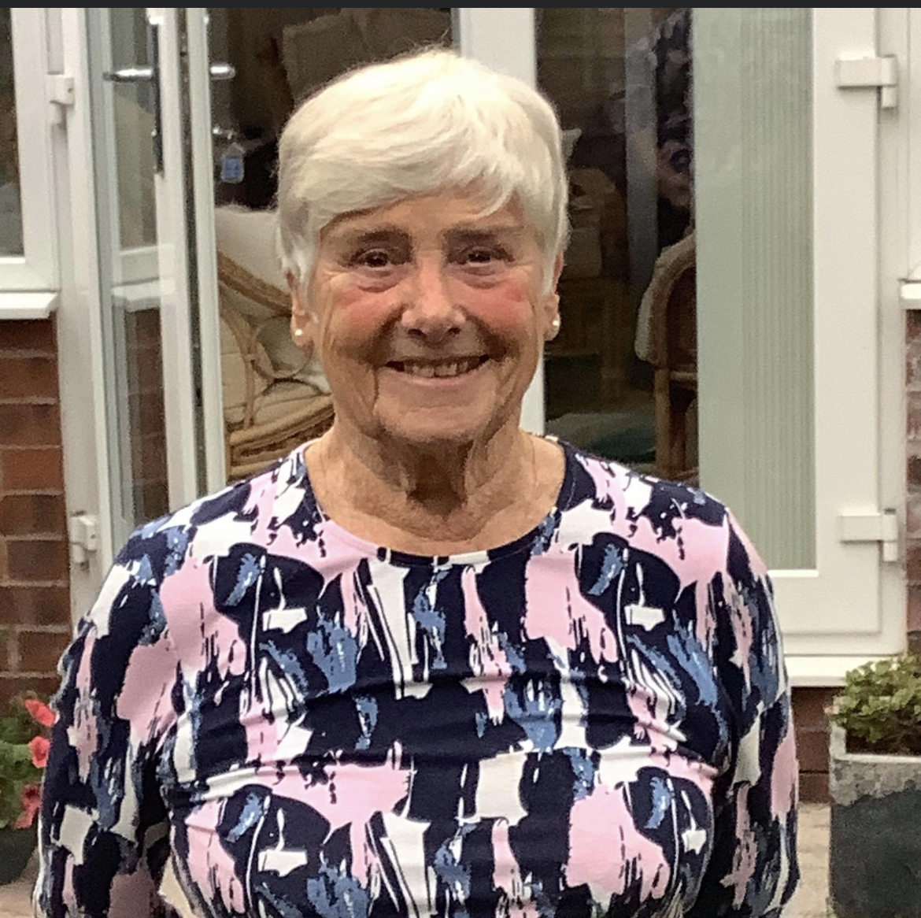
Welcome & President’s Address
This AGM is covering the period 1st September 2022 – 31st August 2023
Following the reports of the AGM period we will open and discuss our plans for 2023/2024
Vice President – Kath Moss

Slide 4
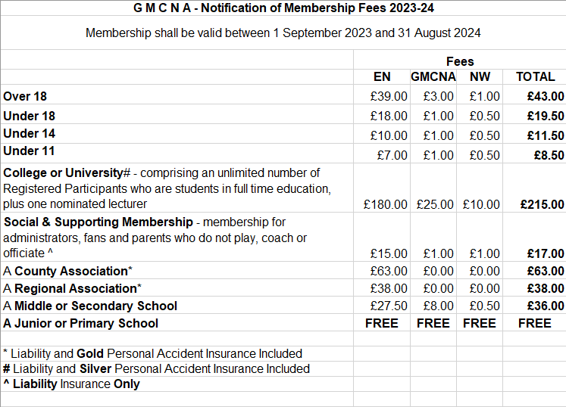
Agenda
Minutes of the last meeting – these have been circulated to those who attended or have requested them and need to be voted as a true record
Affiliation notification – this is to set the affiliation rates for 2024/2025
Changes to the constitution – none

Slide 5
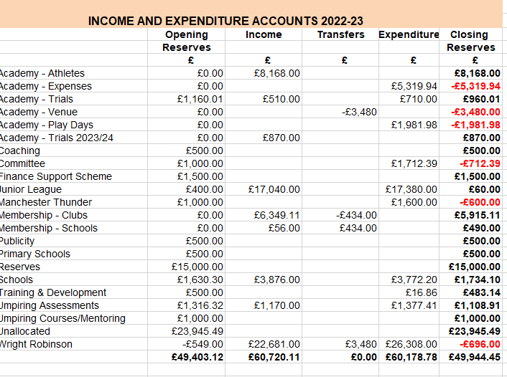
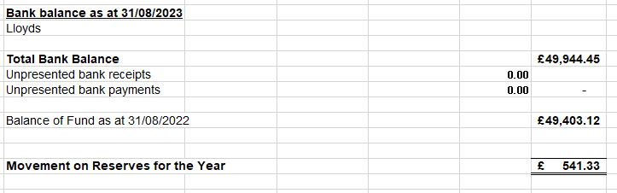
Treasurer Report – Janet Murray
Income and Expenditure 2022/2023
Lynn Morley 28th September 2023

Slide 6
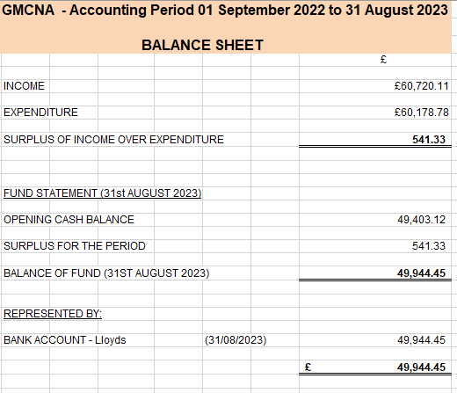
Treasurers Report - Janet Murray
Balance Sheet 2022/2023

Slide 7
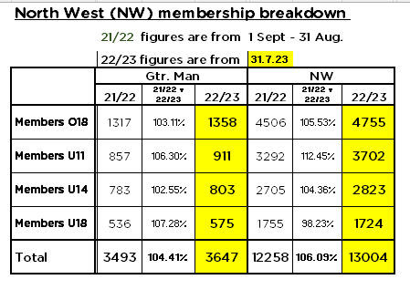
Affiliation Secretary – Janet Murray

Slide 8
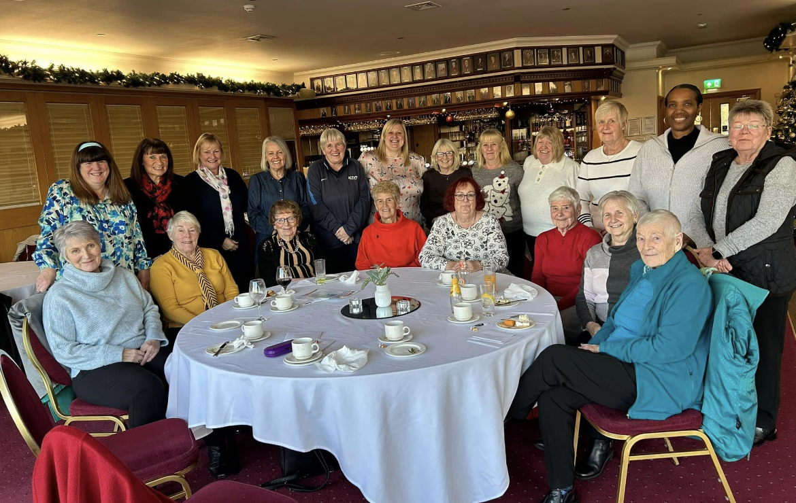
Officer Reports
Chair – Sam Longley
Successes
Committee meetings – Zoom & face to face
Strength and commitment from committee and wider pool of volunteers
Commencement and support of leagues & competitions
Development of Officiating, Performance players, Bee Netball
History and celebration day
Challenges
Venue availabilities & costs
Volunteer time and demands
Pressures of commercial leagues on membership
Massive thank you to everyone who makes netball happen in Greater Manchester

Slide 9

Officiating – Lesley Smith
10 Umpires have passed their C award – 2 NYMC
28 passed the INTO award – 2 NYMC
21 waiting for C final assessment
37 waiting for INTO assessments
7 assessors & 3 more in training
Too much competition not enough officials
Performance of officials
8 umpires in County – passed written B paper and working towards assessment
Rule forums
Game Management

Slide 10
Competition – Dawn Day (GMJCCL)
Massive thank you to Dawn for co-ordinating the league and to Lesley for sourcing umpires.
87 Teams (25 clubs) in total entered GMJCCL – 800 matches from October to June
Ran an Elite & Development competition
League was used for Umpiring Assessments.
Elite winners who qualified for GM regional paces and all received medals. All winners and runners up in other competitions received a badge along with a monetary prize. Trophies were also distributed to the winners
U16 GMC Champions - Oldham NC | U15 Elite Champions – Kingsway Power | U14 Elite GMC Champions - Oldham NC | U13 Elite + Champions Kingsway Power | U12 Elite+ Champions - Kingsway Power | U11 Elite Champions – Kingsway Power
U16 GMC Silver medallists - YW Bury | U15 Elite Runners Up - Oldham | U14 Elite GMC Silver medallists – YW Bury | U13 Elite + Runners-Up Oldham | U12 Elite+ Runners Up - Oldham | U11 Elite Runners-Up - Oldham
U16 GMC Bronze medallist - Rivington NC | U15 Development Champions - Rivington | U14 Elite GMC Bronze medallist - Saddleworth NC | U13 Elite Champions - Chester | U12 Elite Champions - Northwich Sapphires | U11 Development Champions – YW Bury
U16 GMC Bronze medallist - Tameside NC | U15 Development Runners-up -Bramhall | U14 Elite GMC Bronze medallist - Bramhall NC | U13 Elite Runners Up - Chorley Inferno | U12 Elite Runners Up – Ribble Valley | U11 Development Runners-up – Chorley Inferno
Non -GMC winners Kingsway Power |  | Non -GMC Winners Kingsway Power | U13 Development Champions - DNA | U12 Development Champions – Rivington
Non -GMC runners up - Warrington |  | Non- GM Runners Up - Chester | U13 Development Runners Up – Macclesfield | U12 Development Runners Up - Rochdale
U16 GMC Champions - Oldham NC
U16 GMC Silver medallists – YW Bury
U16 GMC Bronze Medallist - Rivington NC
U16 GMC Bronze Medallist - Tameside NC

Slide 11
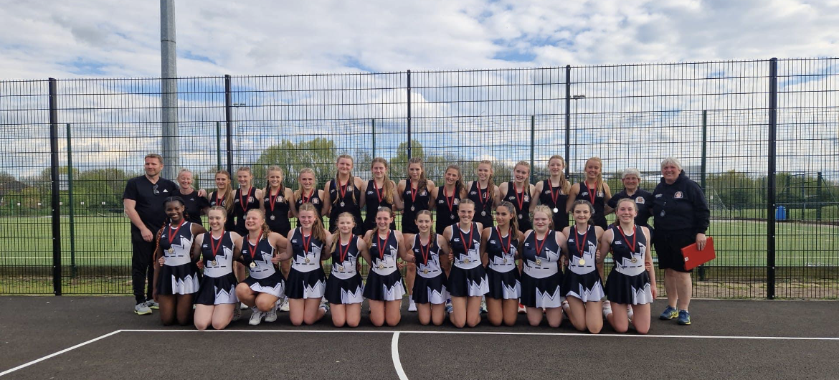
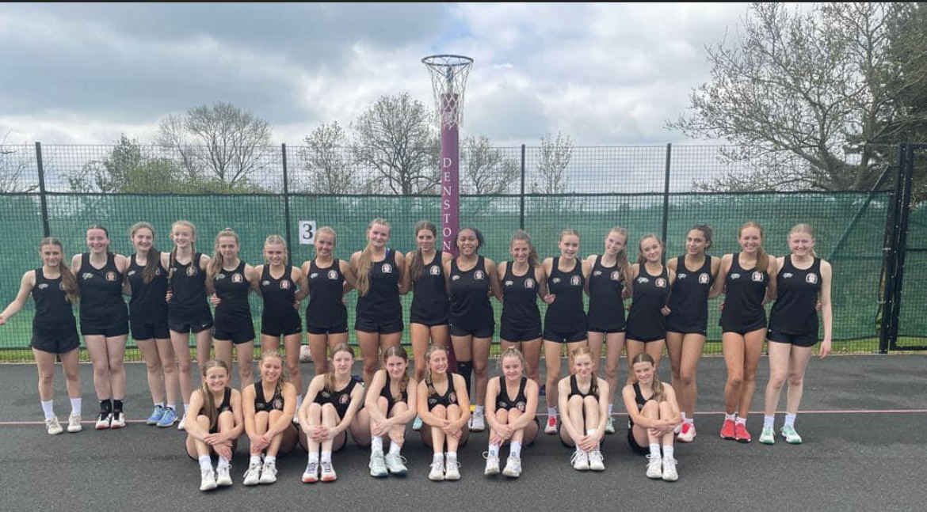
Performance – Sam Longley
Full programme ran at Under 13 & Under 15’s
Extra intra NW sessions for 15’s - Thunder
Play Days – very successful
Trip to Bedfordshire & Staffordshire for tournaments.
Challenges impact of calendar and demands on athletes
Massive thank you to my team of coaches for their invaluable coaching and the selectors and support staff and the umpires who represented Manchester at the play days and helped at trials.

Slide 12
Schools
Our schools have had another great season, thank you to the Schools Committee for running their leagues and qualification competitions for Regional Schools that lead to National School Competition.
Thank you to all officials and Tournament Referees who have supported these competitions and to Lesley for sourcing them.
Under 14 National Schools | Under 16 National Schoools | Under 19 National Schools
Withington – 2nd | North Chadderton – 4th | Cheadle Hulme – 11th
 | Cheadle Hulme – 6th

Slide 13
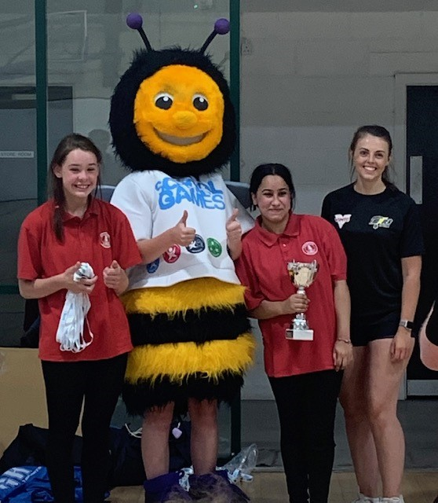
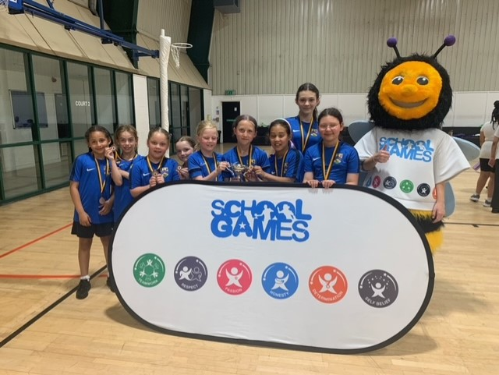
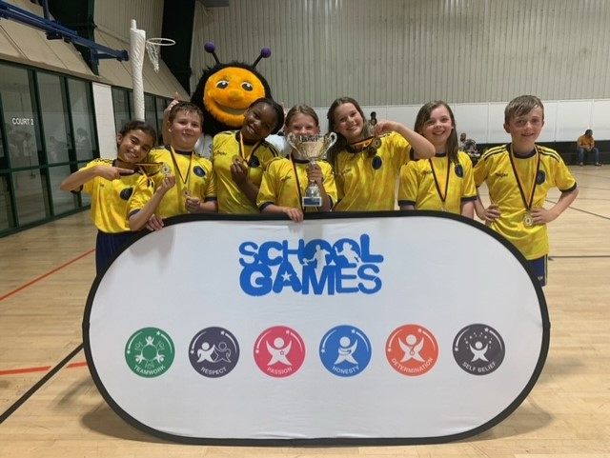
Bee Netball
The first ever Greater Manchester schools Para Netball festival took place in Oldham.
Organised & supported by the GM School Games Organiser network, Greatersport, Manchester Thunder, GM County netball association & England netball, the event invited secondary school pupils in Key Stage 3 to take part in a coaching session led by qualified coaches with several skill stations to test the pupils including shooting and passing.
Players were supported by young coaches from Tyldesley Netball club & The Prince's Trust.
RESULTS:
1st : Redwood Secondary School (Rochdale)
2nd : Spring Brook Academy (Oldham)
3rd place: New Bridge School (Oldham)
Greater Manchester Bee Netball festival
Bee netball is friendly, high energy & especially designed for children. It introduces younger children to the skills of the game of netball such as passing, shooting, catching & throwing
RESULTS:
1st : Our Ladys of Mount Carmel RC school (Tameside)
2nd : The Olive school (Bolton)
3rd : Greswell Primary school (Tameside)

Slide 14
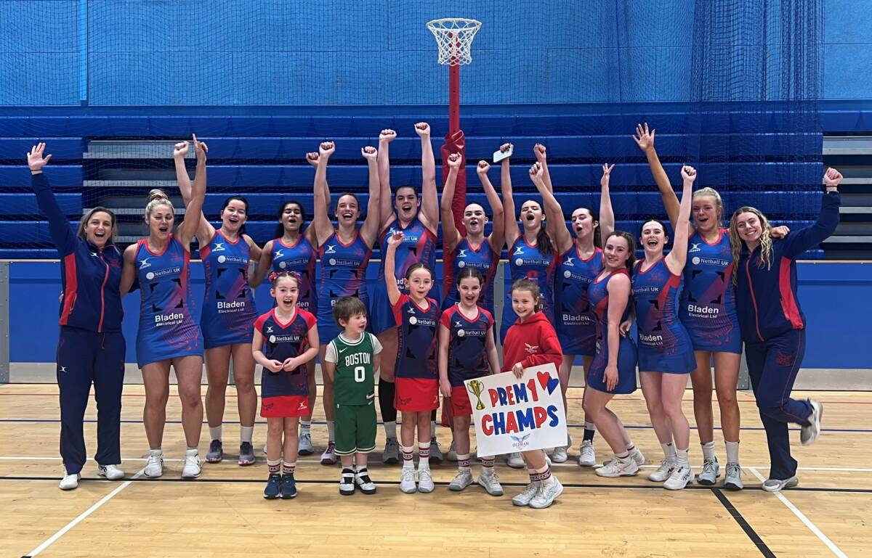
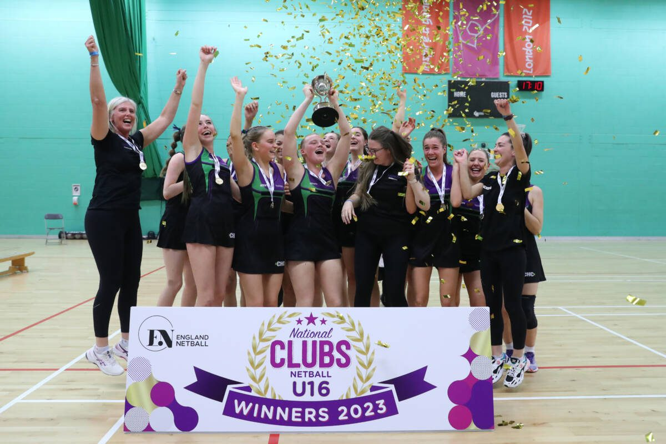
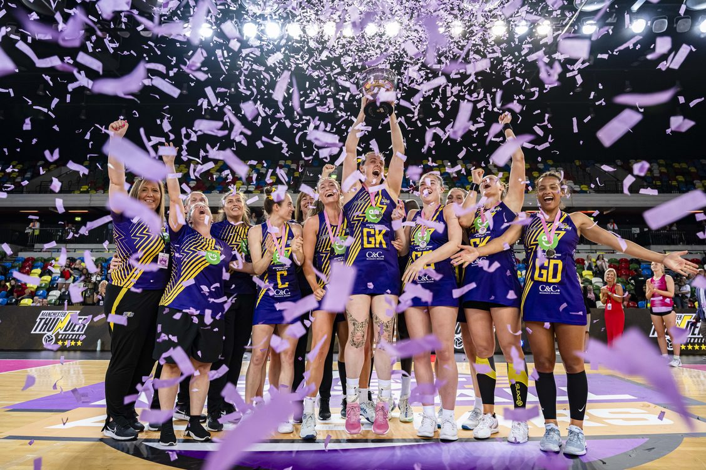
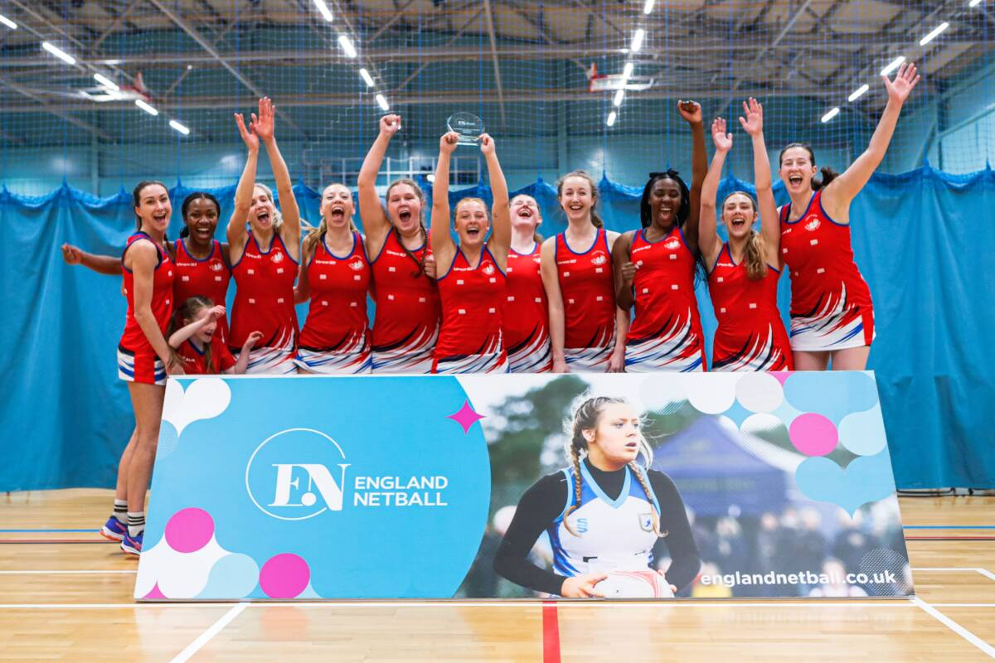
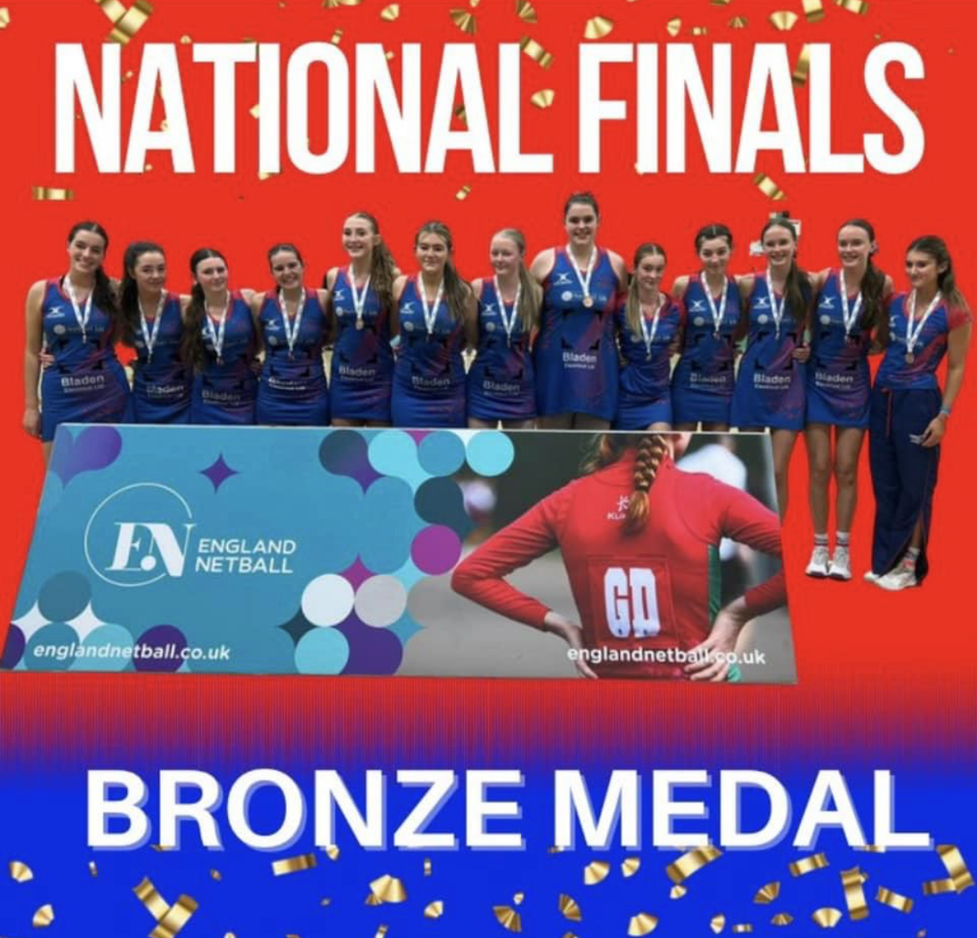
National Competitions

Slide 15
Development – Abbey Barry (see separate document)

Slide 16


Volunteers
Netball would not survive without the wonderful Volunteers we have in our
County – so thank you to each and everyone of you!

Slide 17
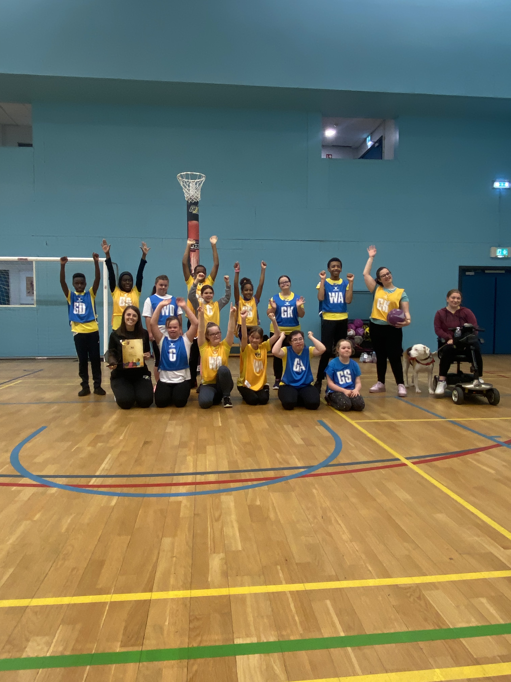
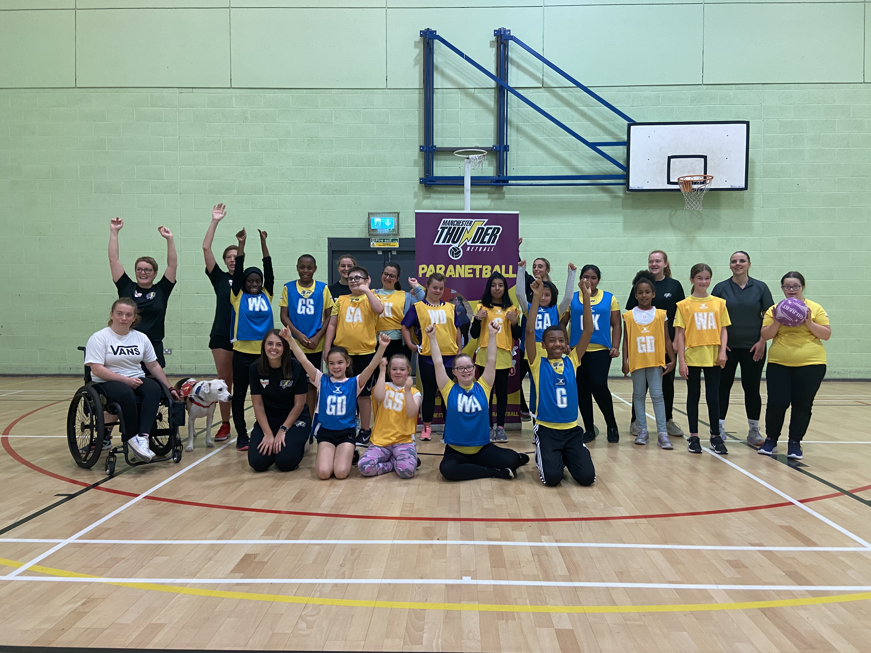
Para Netball – Katie Thompson
The Para netball programme within Manchester and the North West continues to grow and enables more young people who are deaf or disabled to have an opportunity to take part in the sport we all love.
In November 2023 Dominoes Para Netball Club was taken over by Manchester Thunder, with the club being called ‘Manchester Thunder Para Netball Club’.
Vimto Partnership
Increased volunteer coaches – still headed up by Katie Thompson
In February 2023 we took a team to the Para Netball Championships in Nottingham, hosted by England Netball
Working with MMU on a study
Severn Stars and other clubs wanting to set
up based on this work

Slide 18
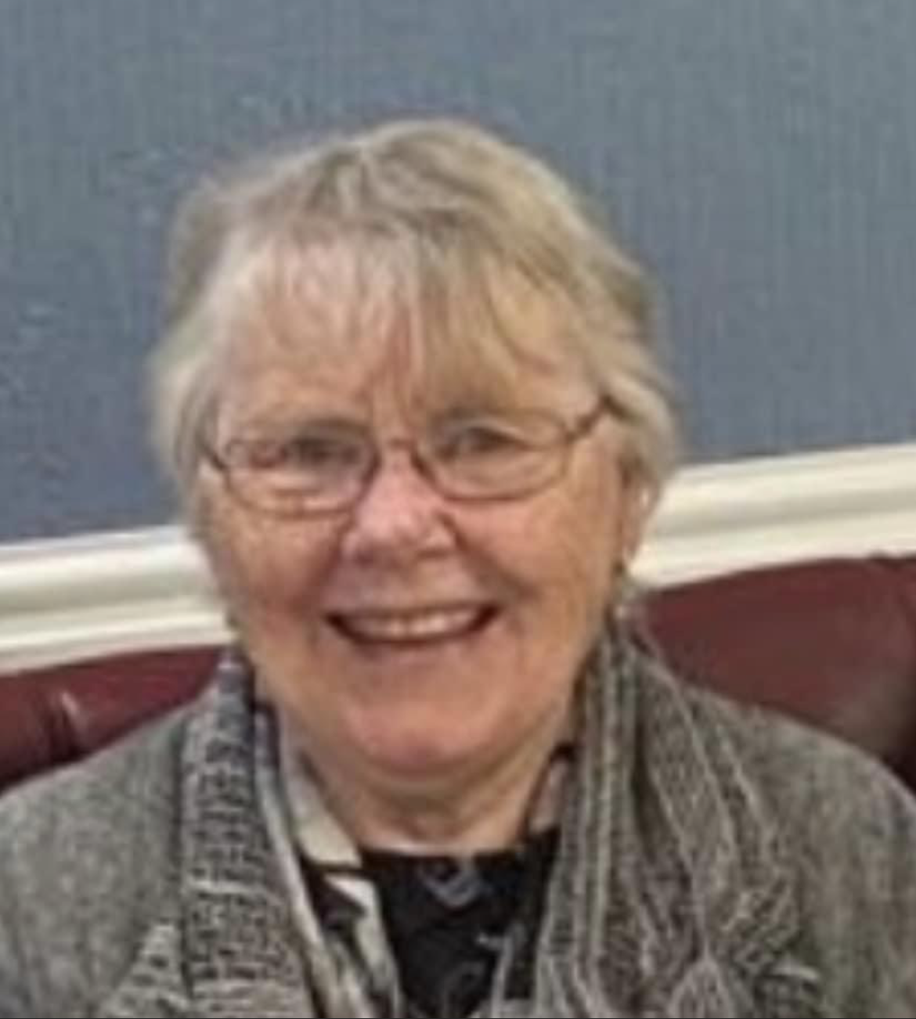
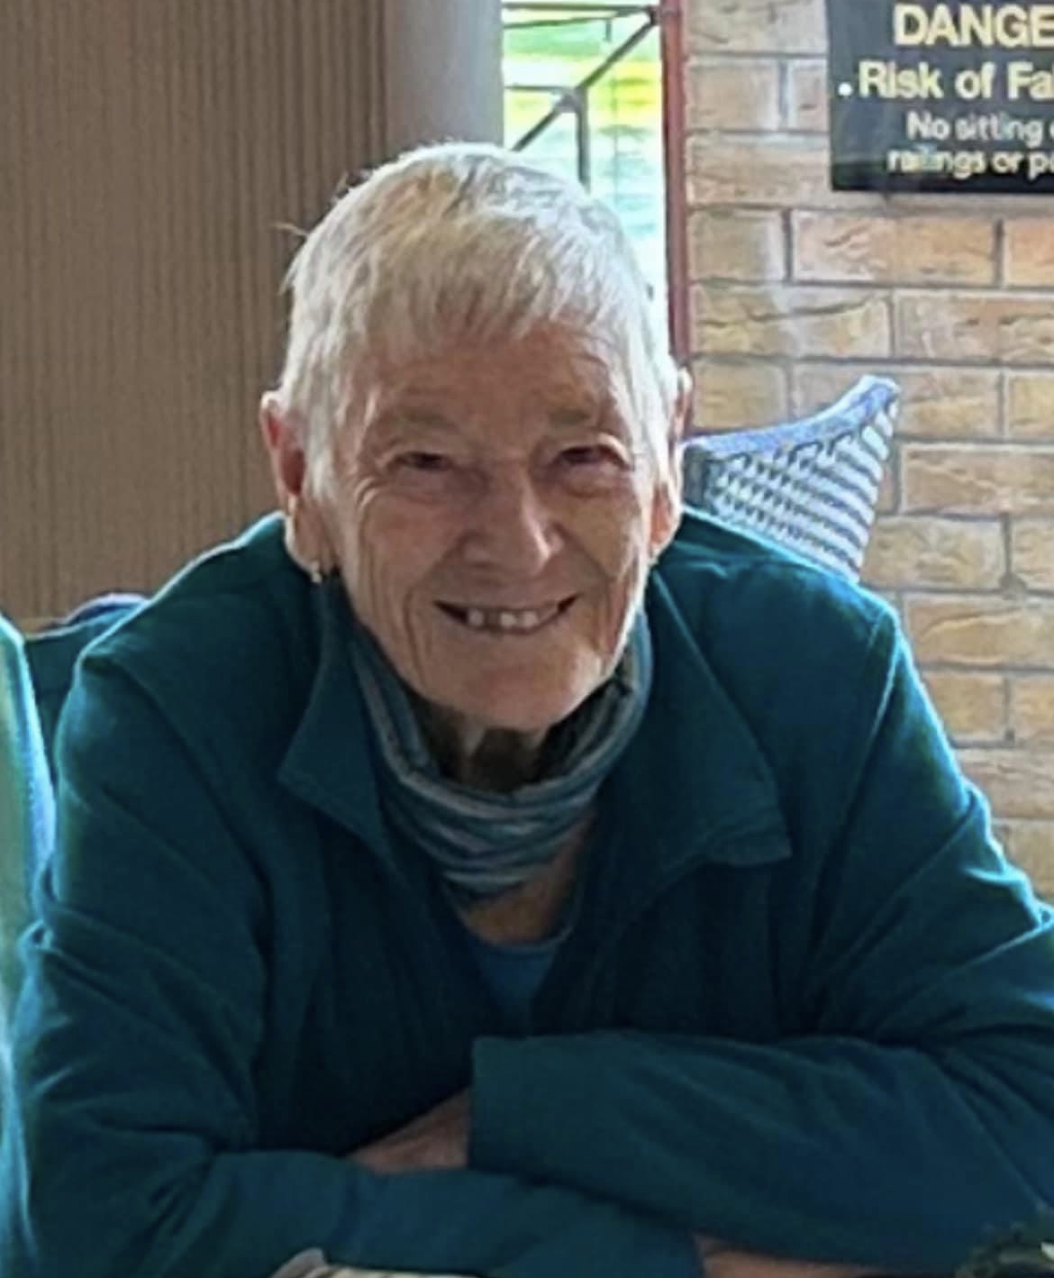
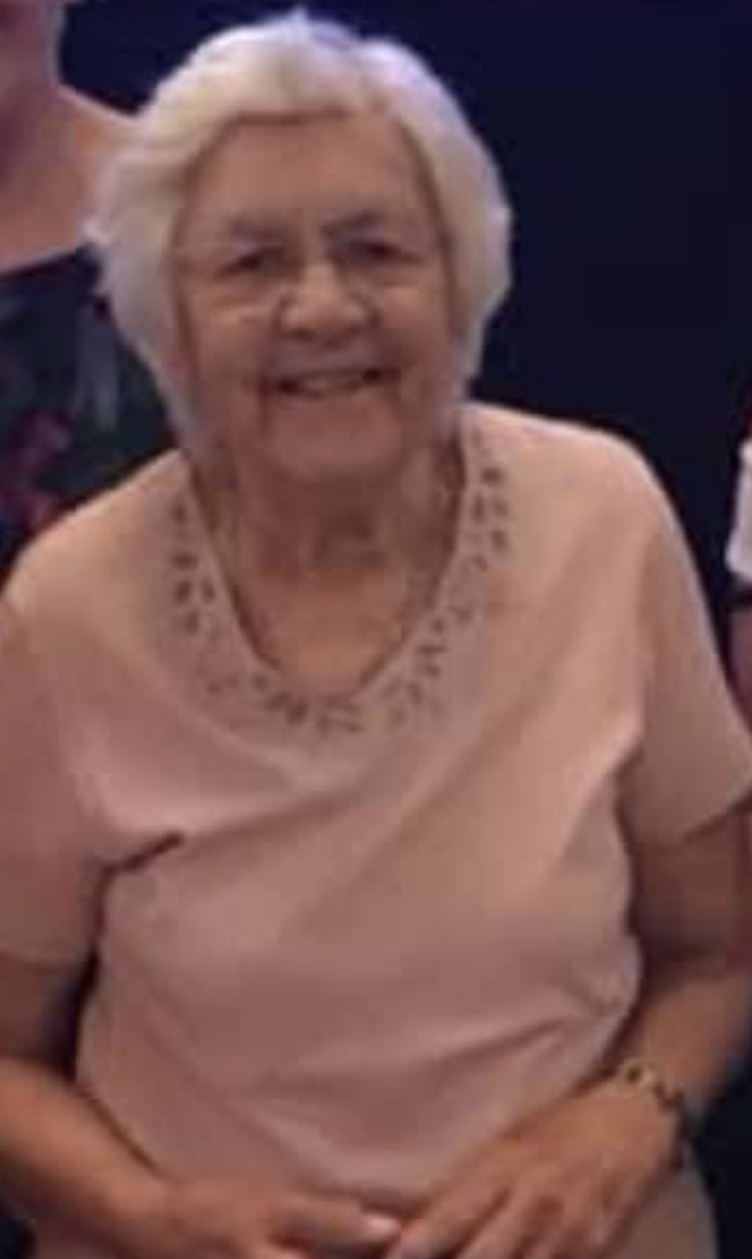
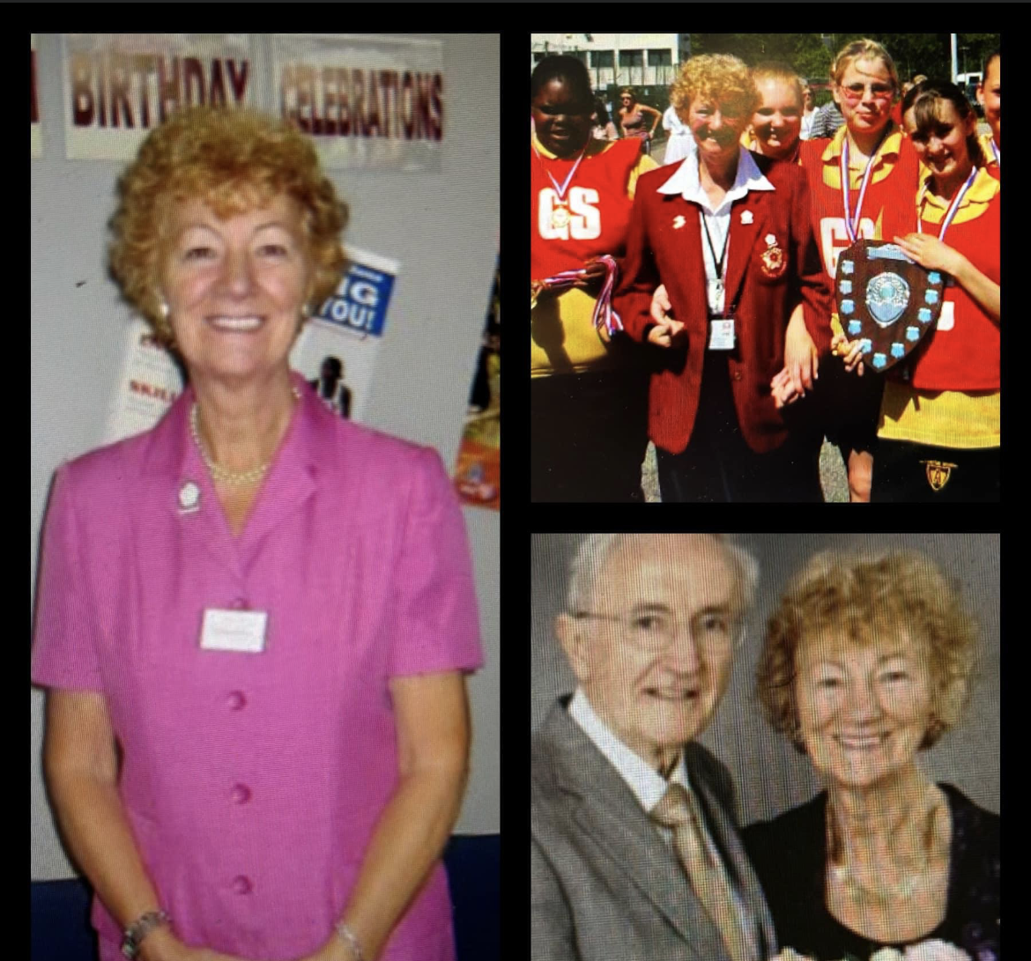
Sad News
The County has lost so many legends this season – its been a very emotional year. The County would not be where it is today without these wonderful ladies and we are eternally grateful for the work they gave to the County.
Jackie Ashworth
Angela Hoyle
Eileen Carlton
Barbara Bishop

Slide 19
2023/2024
Junior league – REVIEW
Assessments for officiating and courses being planned
Performance partnership at Under 15 with other Counties & Thunder
Planning of our Working As One Strategy - 2 year plans
Planning our 50th anniversary

Slide 20

Massive Thank You To All!

Slide 21
League & Borough Reports
MENL – Summer & Winter
Bolton
Wigan & Leigh
Bury

Slide 22
Other Agenda Items
Adoption Of Reports
Election of Officers
Election of Auditor

Slide 23

Questions

Slide 24
Thank you for joining us this evening and if you do have any questions please do not hesitate to get in touch! greatermanchesternetball@gmail.com or abbey.barry@englandnetball.co.uk

