Slide 1

Greater Manchester County Netball Association - GMCNA
Annual General Meeting – 6th October 2022
In Person & Zoom Call

Slide 2
Zoom Call Rules
Please can we ask that you are all on mute. We will have time for any questions at appropriate times during the presentation.
Please avoid using the chat during the delivery of the presentation as it is distracting
Present & Apologies For Absence
Before we begin please put your name and who you are representing in the chat, so that we can ensure we have quorum and know how many votes we have.
List of apologies

Slide 3
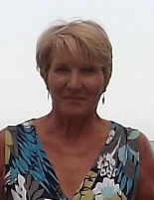
Welcome & President’s Address
This AGM is covering the period 1st September 2021 – 31st August 2022
Following the reports of the AGM period we will open and discuss our plans for 2022/2023
President – Kath Pemberton

Slide 4
Agenda
Minutes of the last meeting – these have been circulated to those who attended or have requested them and need to be voted as a true record
Affiliation notification – this is to set the affiliation rates for 2023/2024
Changes to the constitution – none
G M C N A - Notification of Membership Fees 2023-24
Membership shall be valid between 1 September 2023 and 31 August 2024
 | Fees
 | EN | GMCNA | NW | TOTAL
Over 18 | £39.00 | £3.00 | £1.00 | £43.00
Under 18 | £18.00 | £1.00 | £0.50 | £19.50
Under 14 | £10.00 | £1.00 | £0.50 | £11.50
Under 11 | £7.00 | £1.00 | £0.50 | £8.50
College or University# - comprising an unlimited number of Registered Participants who are students in full time education, plus one nominated lecturer | £180.00 | £25.00 | £10.00 | £215.00
Social & Supporting Membership - membership for administrators, fans and parents who do not play, coach or officiate ^ | £15.00 | £1.00 | £1.00 | £17.00
A County Association* | £63.00 | £0.00 | £0.00 | £63.00
A Regional Association* | £38.00 | £0.00 | £0.00 | £38.00
A Middle or Secondary School | £27.50 | £8.00 | £0.50 | £36.00
A Junior or Primary School | FREE | FREE | FREE | FREE
* Liability and Gold Personal Accident Insurance Included
# Liability and Silver Personal Accident Insurance Included
^ Liability Insurance Only

Slide 5
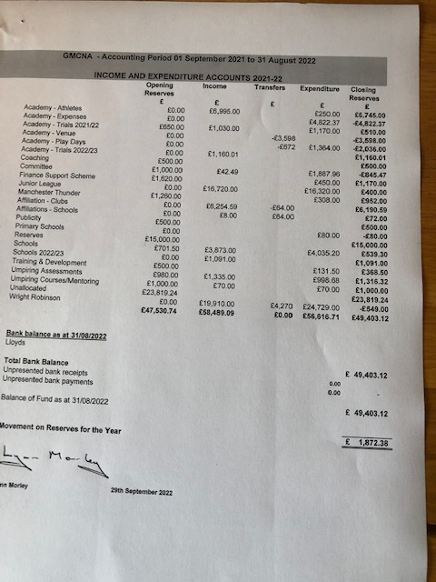
Treasurer Report
– Janet Murray
Income and Expenditure 2021/2022

Slide 6
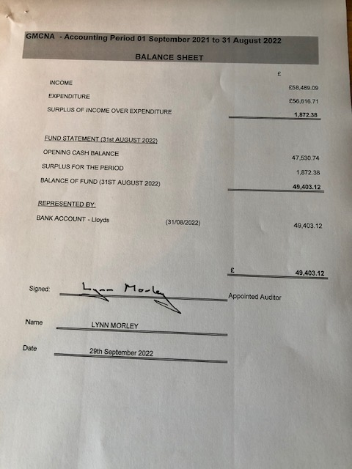
Treasurers Report
- Janet Murray
Balance Sheet 2021/2022

Slide 7
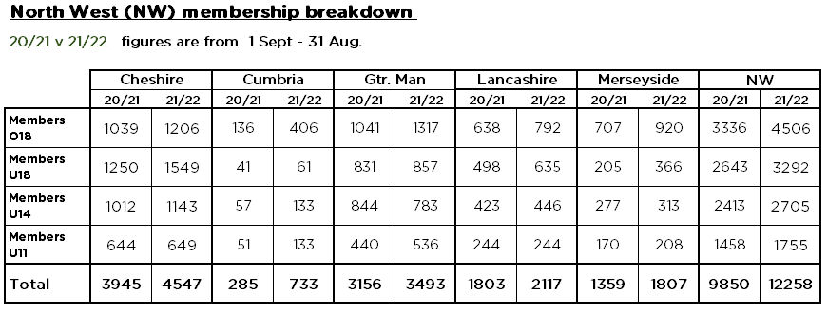
Affiliation Secretary
– Janet Murray

Slide 8
Officer Reports
Chair – Sam Longley
Successes
  Covid Free Season – impact of getting back to normal
  Committee meetings - Zoom
  Strength and commitment from committee
  Commencement and support of leagues & competitions
  Development of Officiating, Performance players, Bee Netball
Challenges
  Venue availabilities & costs
  Volunteer time and demands
  Pressures of commercial leagues on membership
  Massive thank you to everyone who makes netball happen in Greater Manchester

Slide 9

Officiating – Lesley Smith
All assessments commenced for the 21/22 season
Into Assessment now Compulsory before C qualification
All courses now Virtual – great take up
Congratulations to Sophia Dahou who gained her ‘A’ award, Netty Miles & Andrea Robinson who gained their ‘B’ awards.
Well done to Farrah Jaura & Caswell Palmer for their officiating in the VNSL.
Mentoring/Assessments
Into Assessments - 36
C Assessment - 22

Slide 10
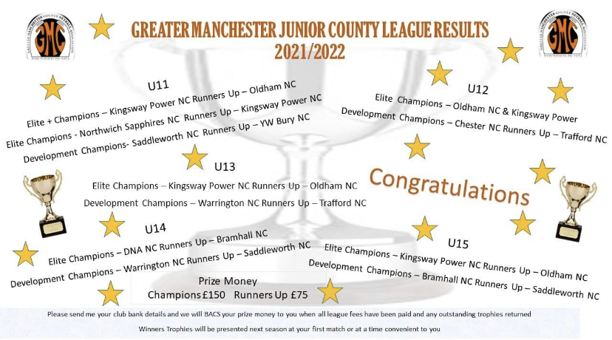
Competition – Dawn Day (GMJCCL)
Massive thank you to Dawn for co-ordinating the league and to Lesley for sourcing umpires.
New league format saw elite and developments leagues starting at different times to fit in with the qualification for Regional competition.
League was used for Umpiring Assessments.

Slide 11
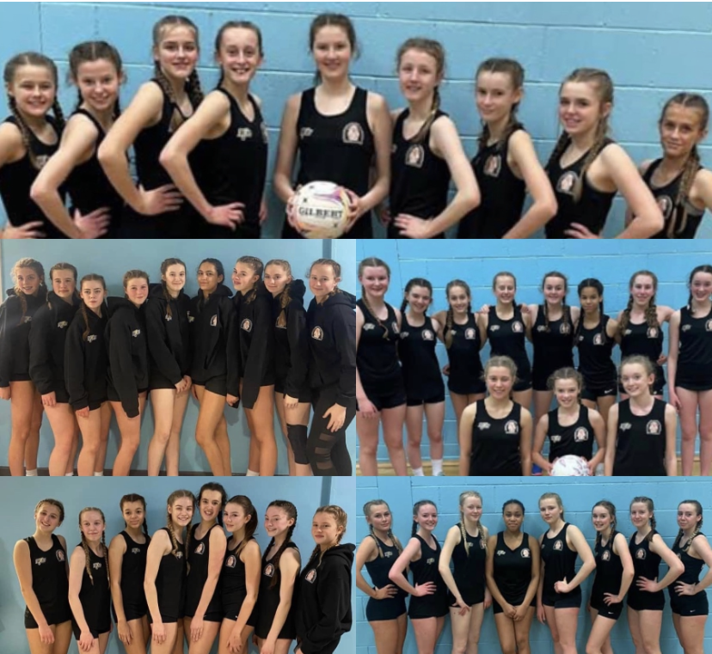
Performance – Sam Longley
Full programme ran at Under 13 & Under 15’s
Play Days – very successful
Trip to Bedfordshire & Staffordshire for tournaments.
Challenges impact of calendar and demands on athletes
Massive thank you to my team of coaches for their invaluable coaching and the selectors and support staff and the umpires who represented Manchester at the play days and helped at trials.

Slide 12
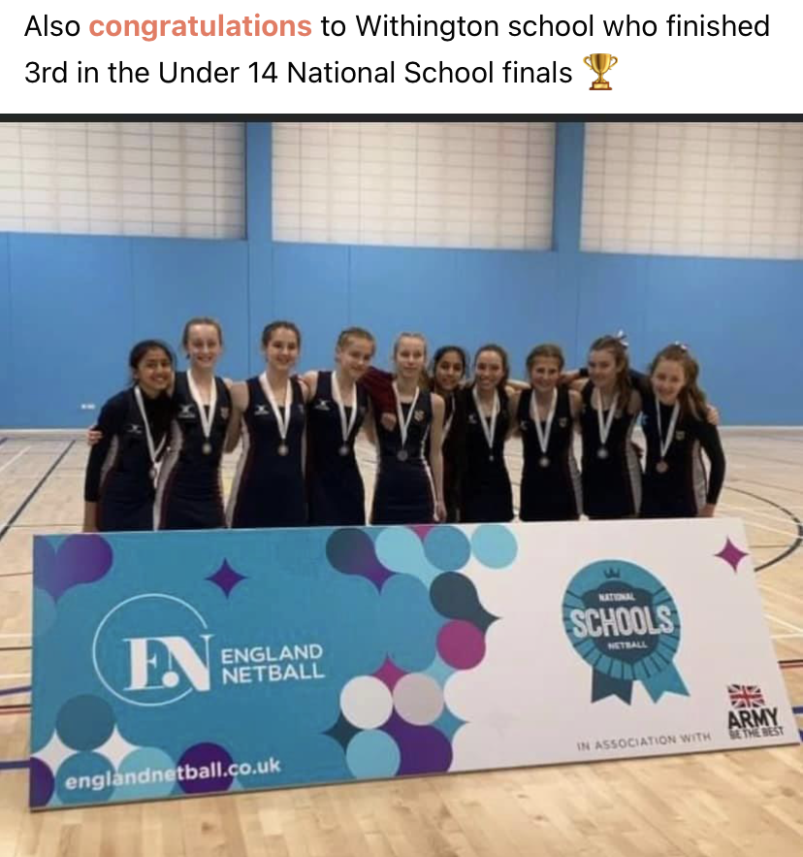
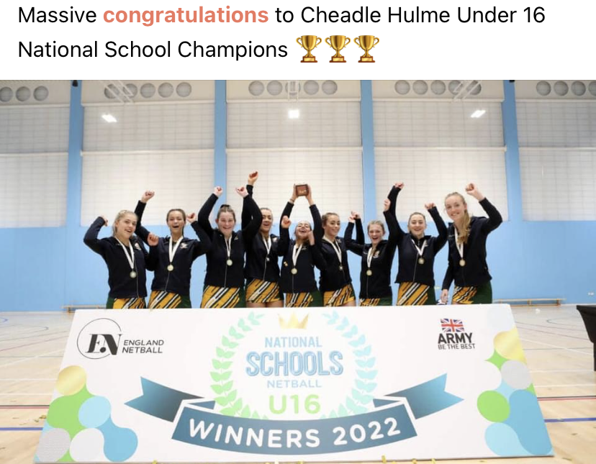
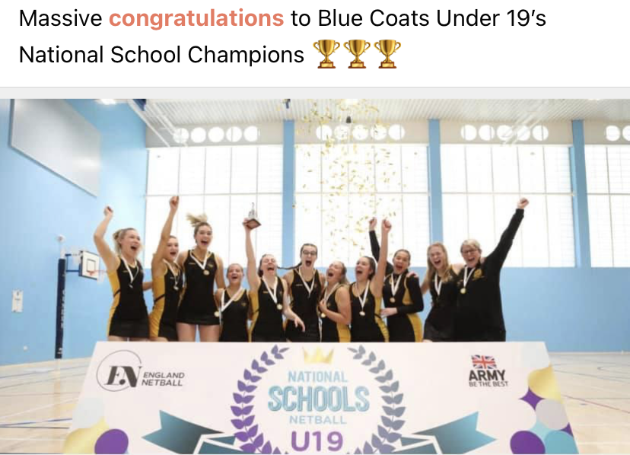
Schools
Our schools have had another great season, thank you to the Schools Committee for running their leagues and qualification competitions for Regional Schools that lead to National School Competition.
Thank you to all officials and Tournament Referees who have supported these competitions and to Lesley for sourcing them.

Slide 13
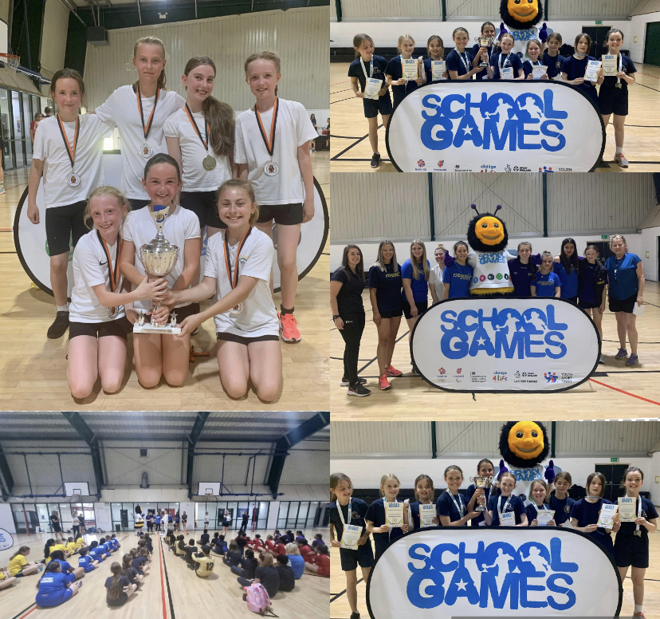
Bee Netball
First Bee Netball Festival
–Winners St Paul’s Manchester
  BME – 27
  Children – 68
  Boys – 5
  7 Schools/boroughs
High 5 Schools Festival
  – South Failsworth Primary, Oldham
  9 Teams/boroughs
  70 children
Massive thanks to Emma Toone for organising and running the event and to the coaches and volunteers for their help on the day.
Special recognition to the volunteers from Tyldesley NC, Tameside NC, Rivington NC, Dominoes Nc & Trafford NC who did an amazing job!
Thanks to the partners who supported the event EN, Greater Sport and GM SGO Network

Slide 14
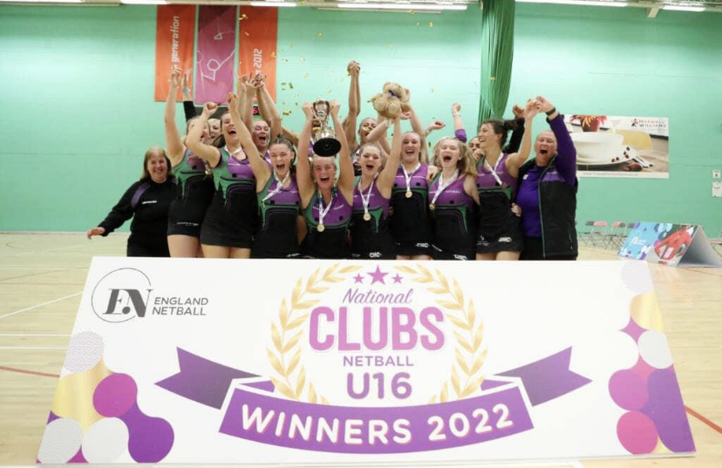
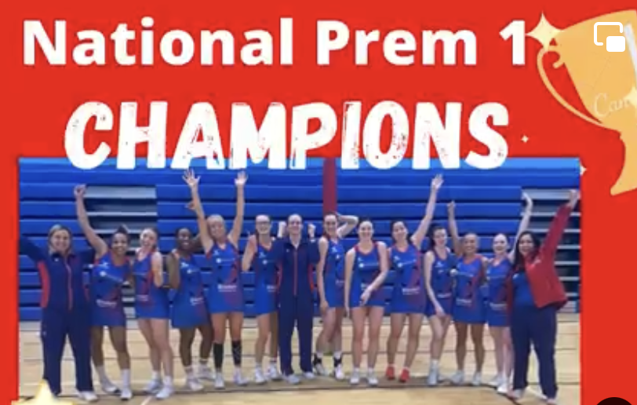
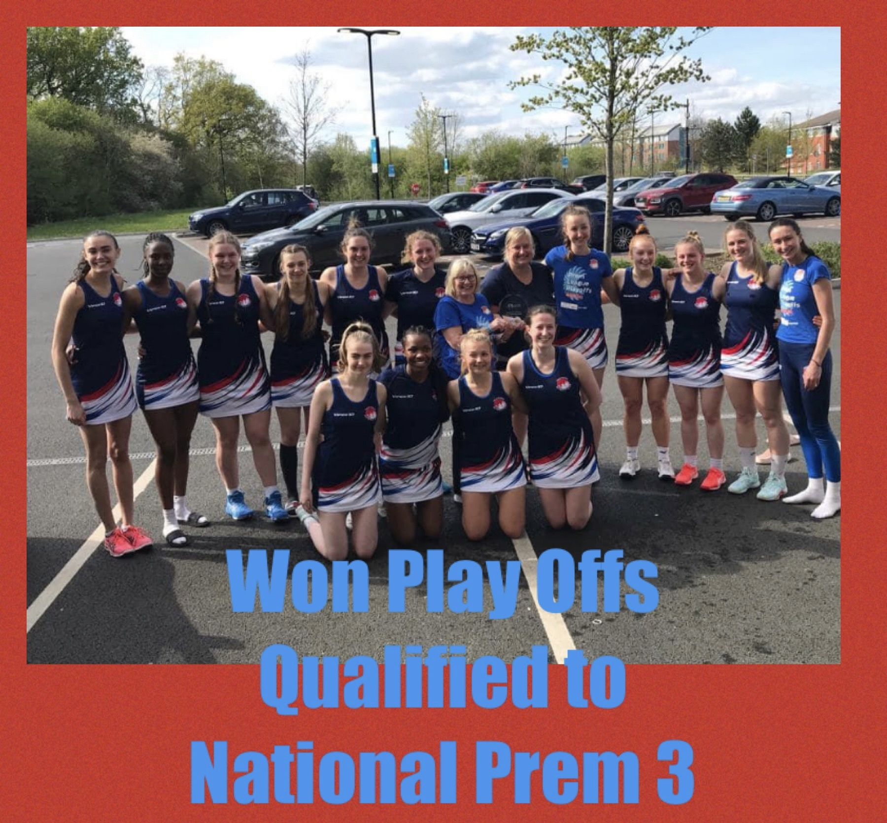
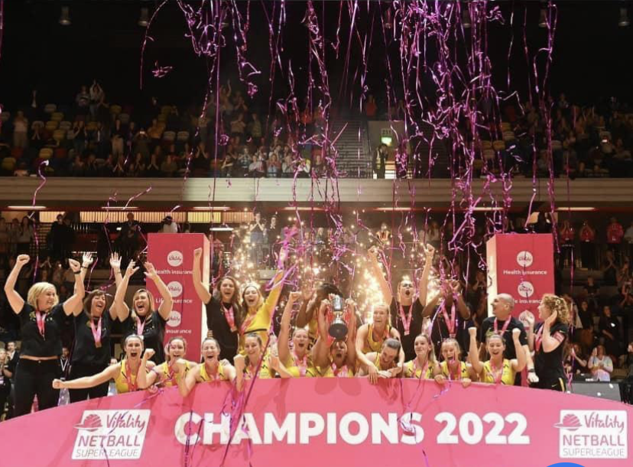
National Competitions

Slide 15
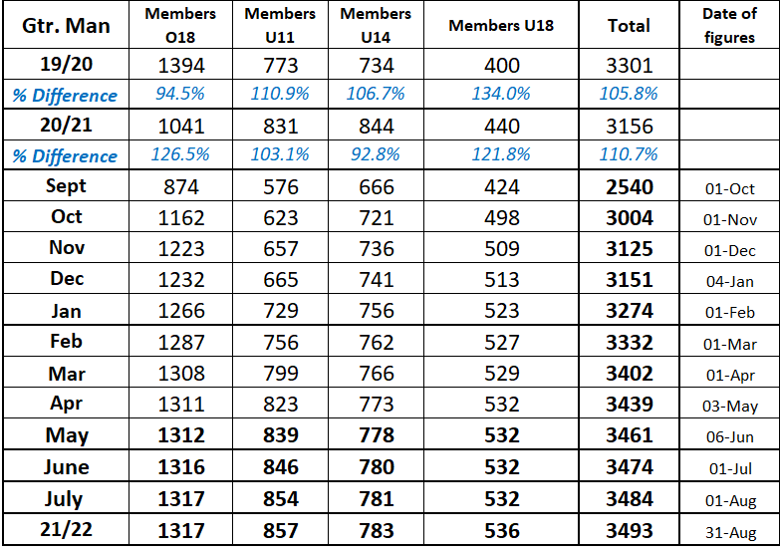
Development – Abbey Barry (see also separate document)
Membership
Participants
  B2N – 337
  Bee – 93
  Festivals – 381
  NN – 73
  Para Netball – 224
  WN - 93
Courses
F2F L2s – Eccles Sept 2022 and Feb 2023 @ MEA (sold out within a couple of days)
Community Events Attended
  UniteHER
  Wythenshawe Games
  Radcliffe Fair
  Stockport Baton Relay
  Manchester Communication Academy Summer Activation
  New Bridge School Sports Day (ParaNetball)
  Windrush Event
  Manchester Pride (16 people came to last week’s LGBTQ+ session)
  School Games

Slide 16


Volunteers
Netball would not have survived Covid without the wonderful Volunteers we have in our
County – so thank you to each and everyone of you!

Slide 17
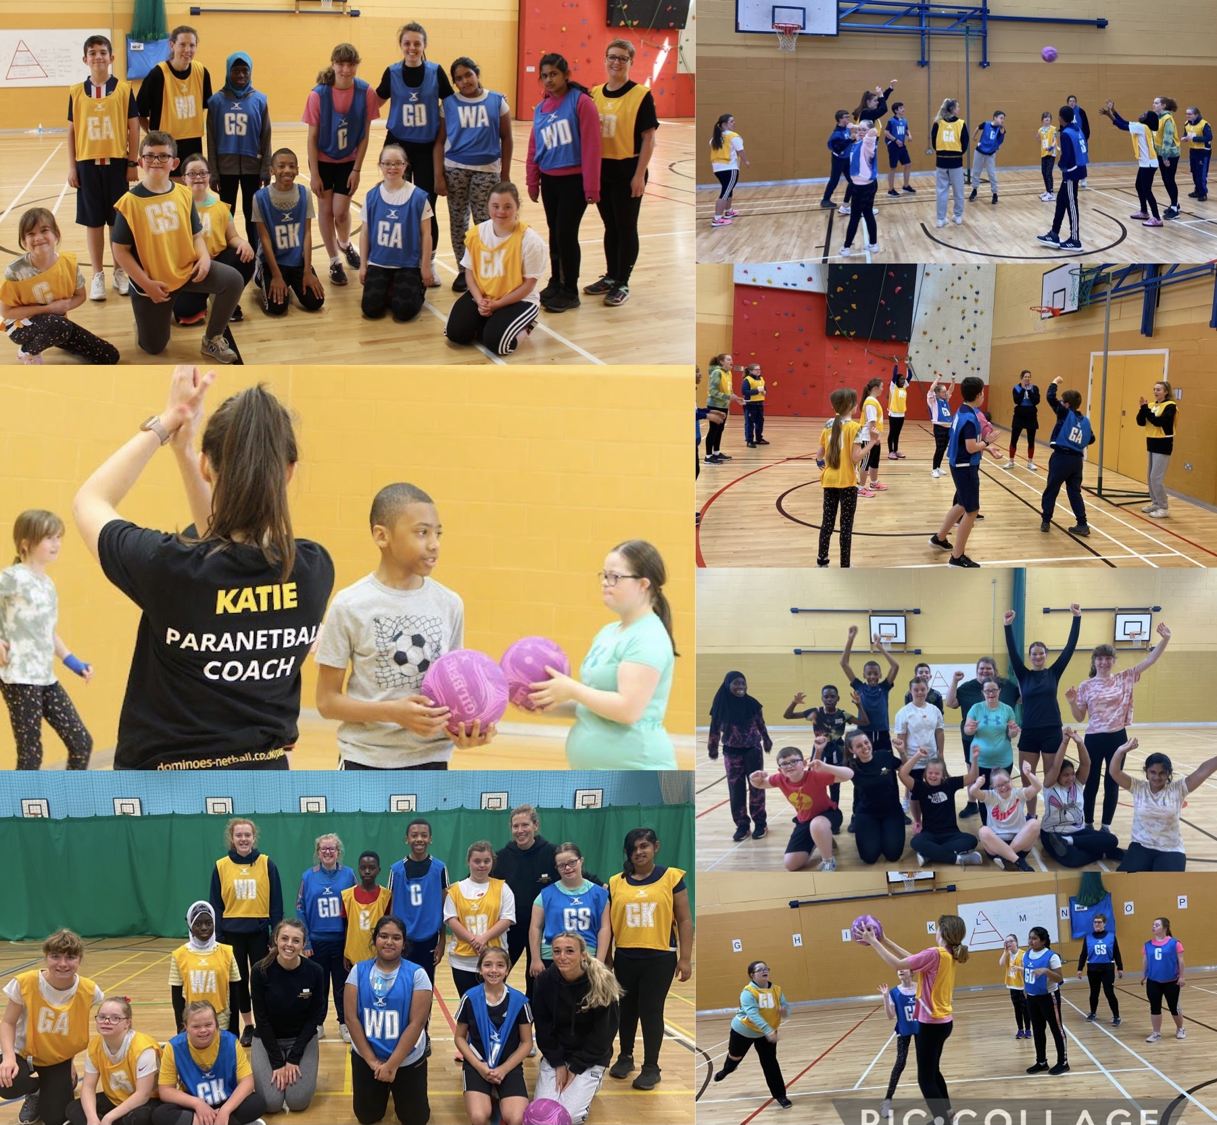
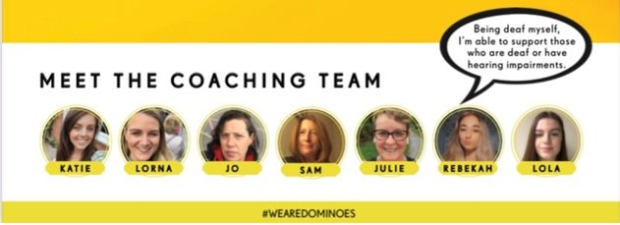
Para Netball – Katie Thompson
Launched November 2021​- First session 8 participants attended​
Sessions ran monthly (10-11am, 1st Saturday of each month) at Wright Robinson College​
7 dedicated volunteers (Katie, Rebekah, Julie, Jo, Lorna, Lola, Sam) ​
21 participants to sessions​
Variety of disabilities to include: Down's syndrome, Autism, Cerebral Palsy, Global Development Delay, Speech & Learning Difficulties, ADHD.​

Slide 18
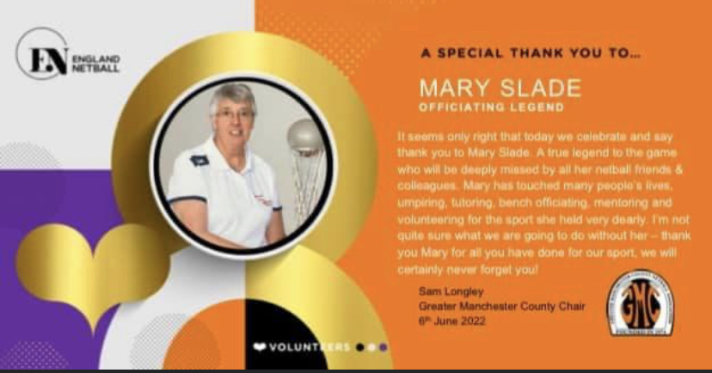
Sad News
We were very saddened to hear about the passing of one of our True County Legends Mary Slade– our thoughts go to her family and friends. The game certainly won’t be the same without her and she will be truly missed.

Slide 19
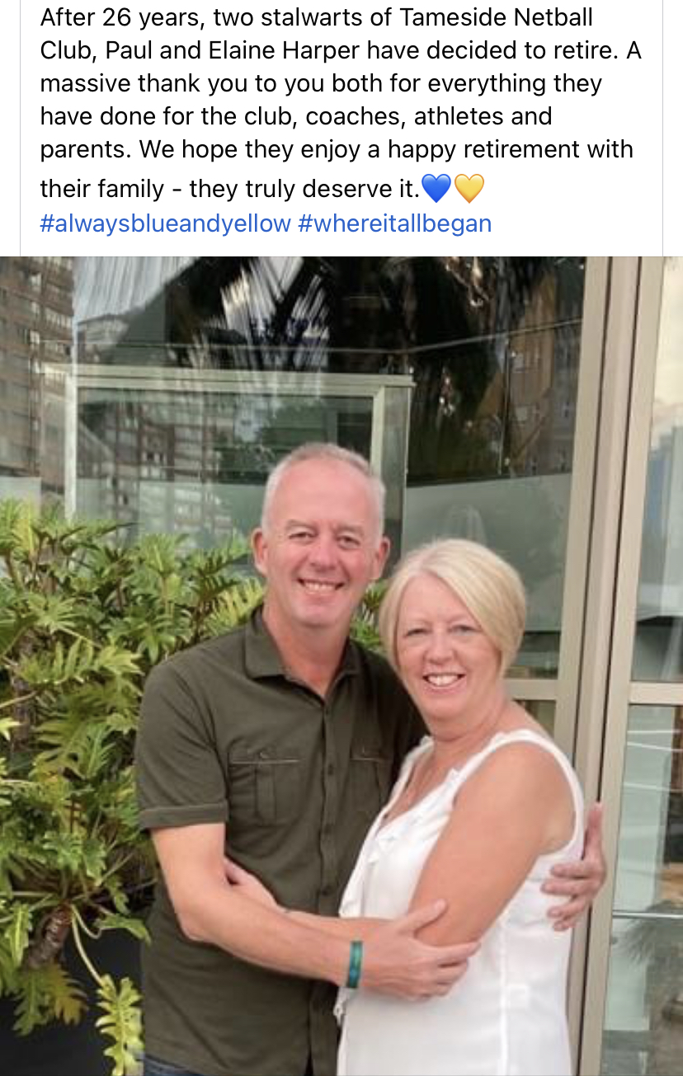
Retirement News
Some very special legends of the game have decided the time has come to retire. We owe them a massive thank you for all their hard work, dedication and commitment to the sport for such a long long time – it will not be the same without you around!

Slide 20
2022/2023
Junior league – same format with Regional league changing their format
Assessments for officiating and courses being planned
Para Netball Partnership with Manchester Thunder & Vimto
Performance partnership at Under 15 with other Counties & Thunder
Return of face to face meetings
Planning of our Working As One Strategy - 1 year and 5 year plans

Slide 21

Massive Thank You To All!

Slide 22
League & Borough Reports
MENL – Summer & Winter
Bolton
Wigan & Leigh
Bury

Slide 23
Other Agenda Items
Adoption Of Reports
Election of Officers
Election of Auditor

Slide 24

Questions

Slide 25
Thank you for joining us this evening and if you do have any questions please do not hesitate to get in touch! greatermanchesternetball@gmail.com or abbey.barry@englandnetball.co.uk

