Slide 1

Greater Manchester County Netball Association - GMCNA
Annual General Meeting – 27th September 2021
Zoom Call

Slide 2
Zoom Call Rules
Please can we ask that you are all on mute. We will have time for any questions at appropriate times during the presentation.
Please avoid using the chat during the delivery of the presentation as it is distracting
Present & Apologies For Absence
Before we begin please put your name and who you are representing in the chat, so that we can ensure we have quorum and know how many votes we have.
List of apologies

Slide 3
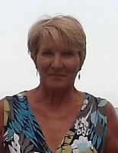
Welcome & President’s Address
This AGM is covering the period 1st September 2020 – 31st August 2021
Following the reports of the AGM period we will open and discuss our plans for 2021/2022
President – Kath Pemberton

Slide 4
Agenda
Minutes of the last meeting – these have been circulated to those who attended or have
requested them and need to be voted as a true record
Affiliation notification – this is to set the affiliation rates for 2022/2023
Changes to the constitution – additional lines/replacements in line with Governance EN changes
7.3 - Formal Notice of the AGM shall be circulated in writing not less than 21 days prior to the date of such a meeting, to each Officer of the CNA Committee listed in clause 4.2.1 above. The notice shall give details of the time, date and location of the meeting and shall contain details of any resolutions to be considered, details of nomination for office and the general nature of the business to be transacted. For the purposes of this clause format can mean physical, hybrid or virtual meeting.
12- DISCIPLINARY POWERS, PROCEDURES AND APPEALS
12.1- The County adopts the England Netball Disciplinary Regulations which shall apply to and bind all members of the County and all persons and entities participating in any way in activities controlled and/or sanctioned by the County. The County shall have the power to discipline such persons and entities who breach those Regulations.
12.2 The CNA Committee shall appoint a Disciplinary Secretary who shall:
12.2.1 Administer the process of any complaints under the terms contained within the England Netball Code of Conduct and Disciplinary Regulations; and
12.2.2 Report to the CNA Committee as they consider appropriate and under guidance from England Netball.
12.1 The County adopts the England Netball Disciplinary Regulations which shall apply to and bind all members of the County and all persons and entities participating in any way in activities controlled and/or sanctioned by the County.

Slide 5
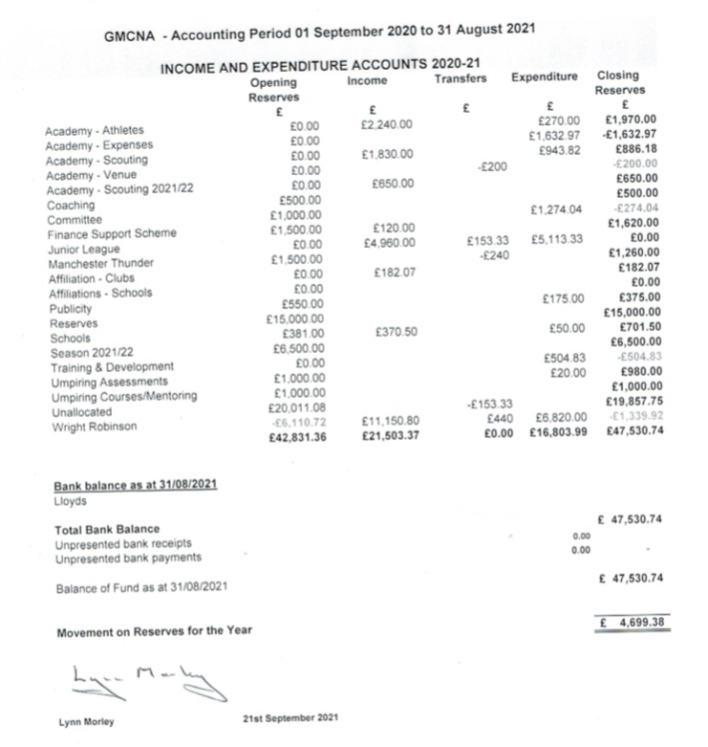
Treasurer Report – Janet Murray
Income and Expenditure 2020/2021

Slide 6
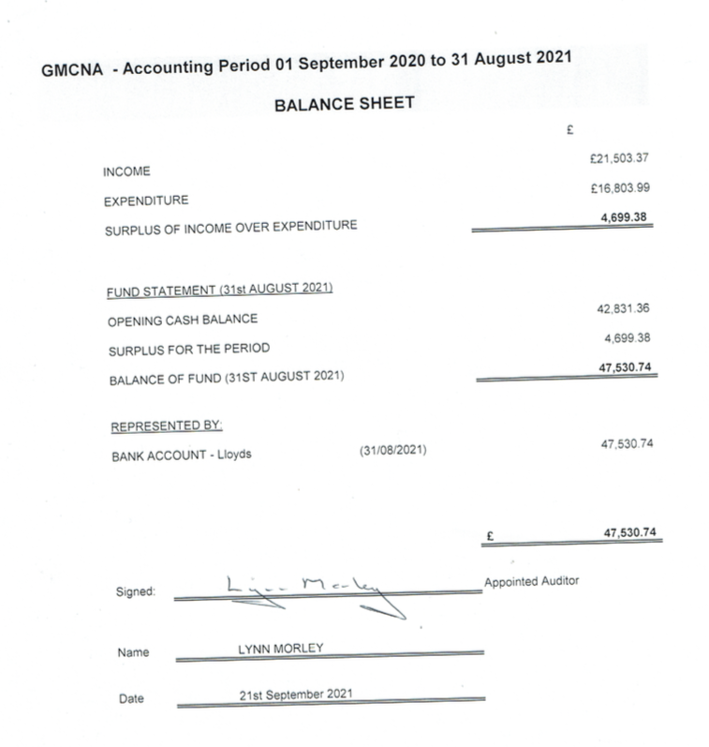
Treasurers Report - Janet Murray
Balance Sheet 2020/2021

Slide 7
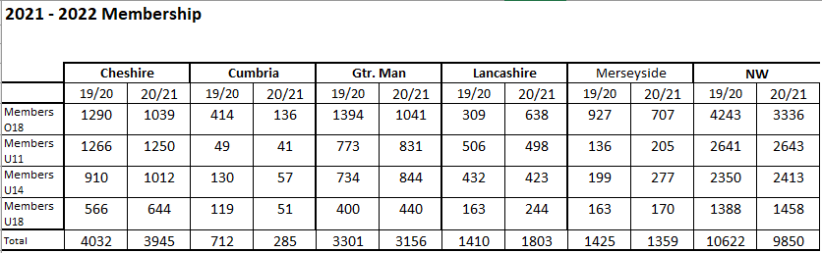
Affiliation Secretary – Janet Murray

Slide 8


Officer Reports
Chair – Sam Longley
Successes
Rise Again and Success of Members
Regular meetings - Zoom
Dealt with demands and unexpected challenges brought on by COVID-19
Strength and commitment from committee
Commencement and support of Summer leagues
Recognising Volunteers and Inspirational Women
Competitions to promote website - https://gmcna.englandnetball.org/
Challenges
COVID-19 – leagues and programmes – venues
Volunteer time and demands
Pressures of commercial leagues on membership
Changes in NDO – thank you to Katie, Rachel & welcome Abbey

Slide 9

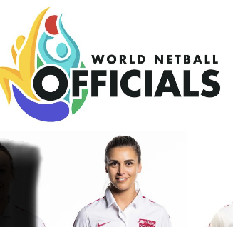
Officiating – Lesley Smith
All assessments froze for the 19/20 season
Piloted Written C paper on line on behalf of EN and now that’s been introduced
Into Assessment now Compulsory before C qualification
Those who had C written have had extension
Congratulations to Farrah Jaura on her appointment as a Vitality
Super League Umpire and also for receiving International Talent Identified
Umpire Status

Slide 10
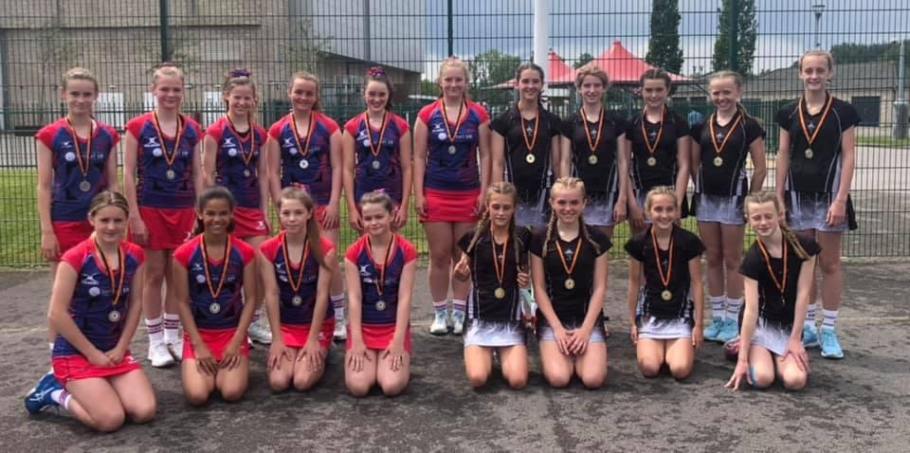
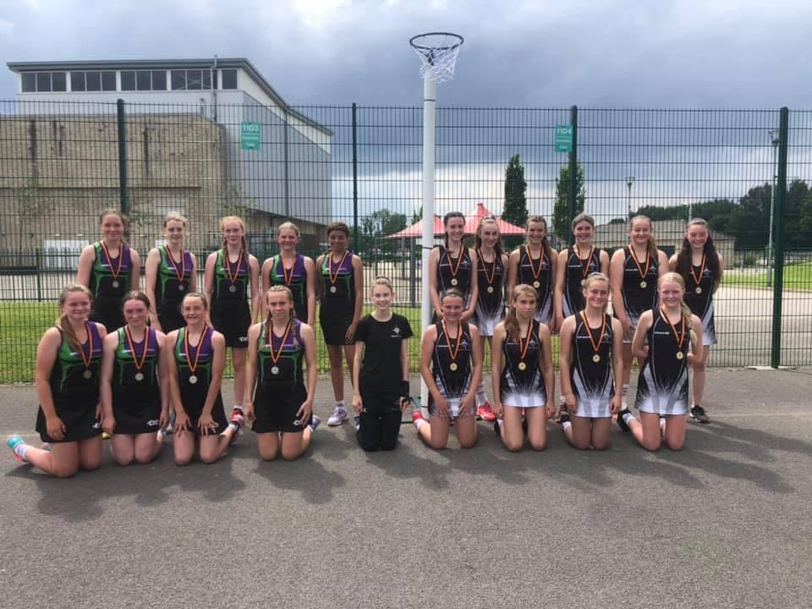
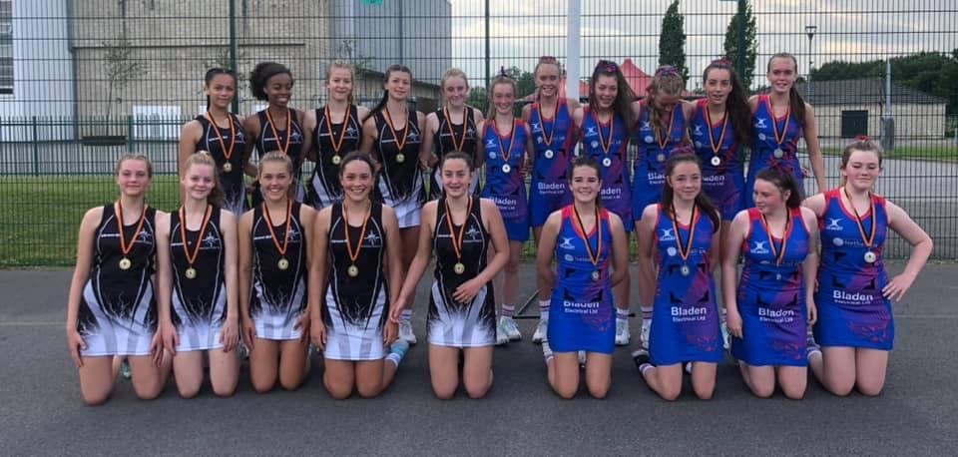
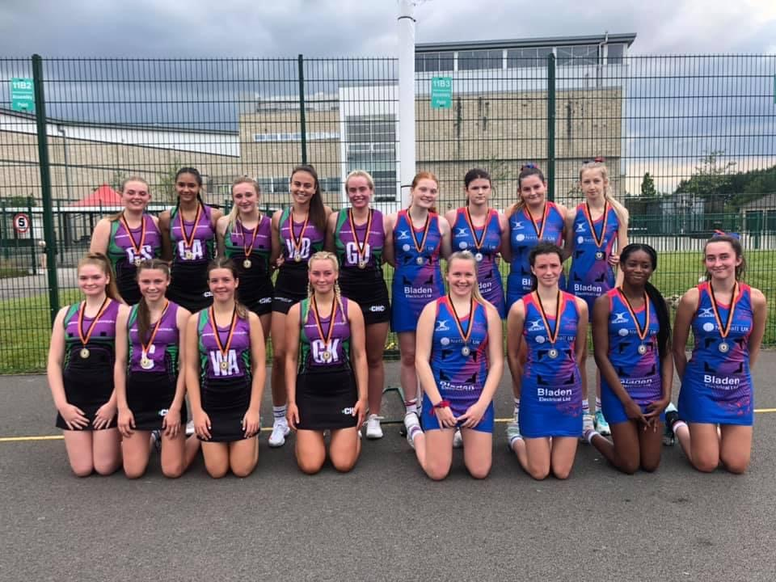
Competition – Dawn Day (GMJCCL)
47 teams took part – Saturday’s
Massive thank you to Dawn for co-ordinating the league, ensuring Covid requirements were met, amending fixtures due to weather.
Thanks to Lesley Smith for organising the Umpires
Thank you to the Committee members who gave up their time to ensure the league ran smoothly.
Age Group | Winners | Runners Up
U12 | Kingsway Power | Oldham
U13 | Kingsway Power | YW Bury
U14 | Kingsway Power | Oldham
U15 | YW Bury | Oldham

Slide 11
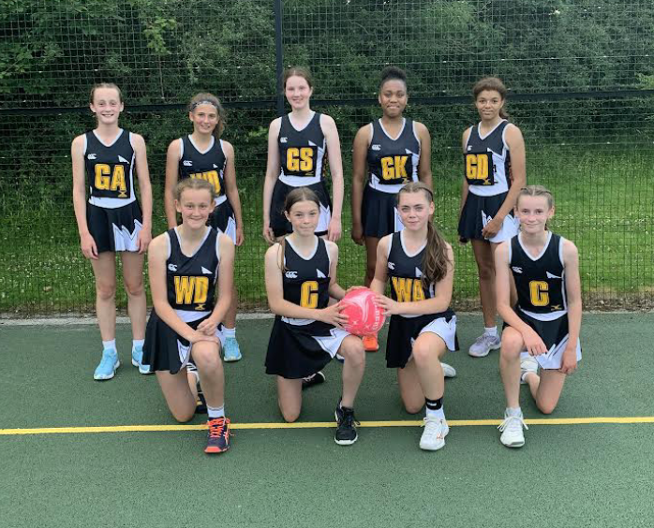
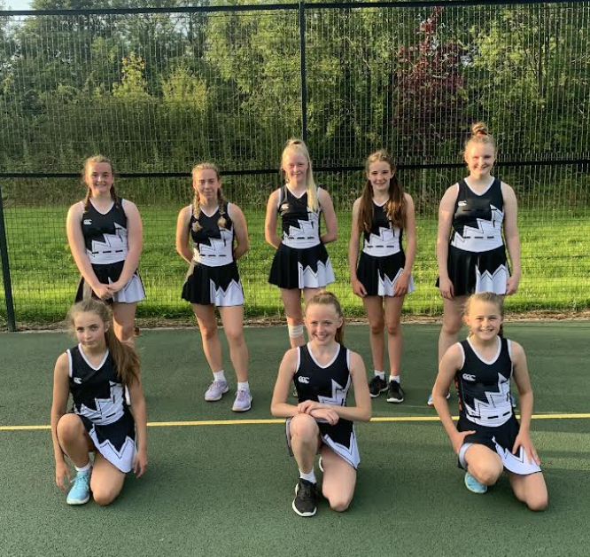
Performance – Sam Longley
Shorter programme ran for Under 15 -16 athletes (2 of which were Under 14 Thunder athlete so did a joint programme) and Under 13 - 16 athletes –
2 fixtures against Lancashire that we were very successful at despite the challenges of Covid-19
Massive thank you to Miss Edwards, Celia Poole & Mark Lees for their invaluable coaching and the selectors and support staff and the umpires who represented Manchester at the play days and helped at trials.

Slide 12
Schools
Unfortunately due to Covid no County/Regional or National Schools fixtures were played.
Due to COVID-19 EN - National Clubs did not take place
National Competition

Slide 13
Development – Abbey Barry

Slide 14
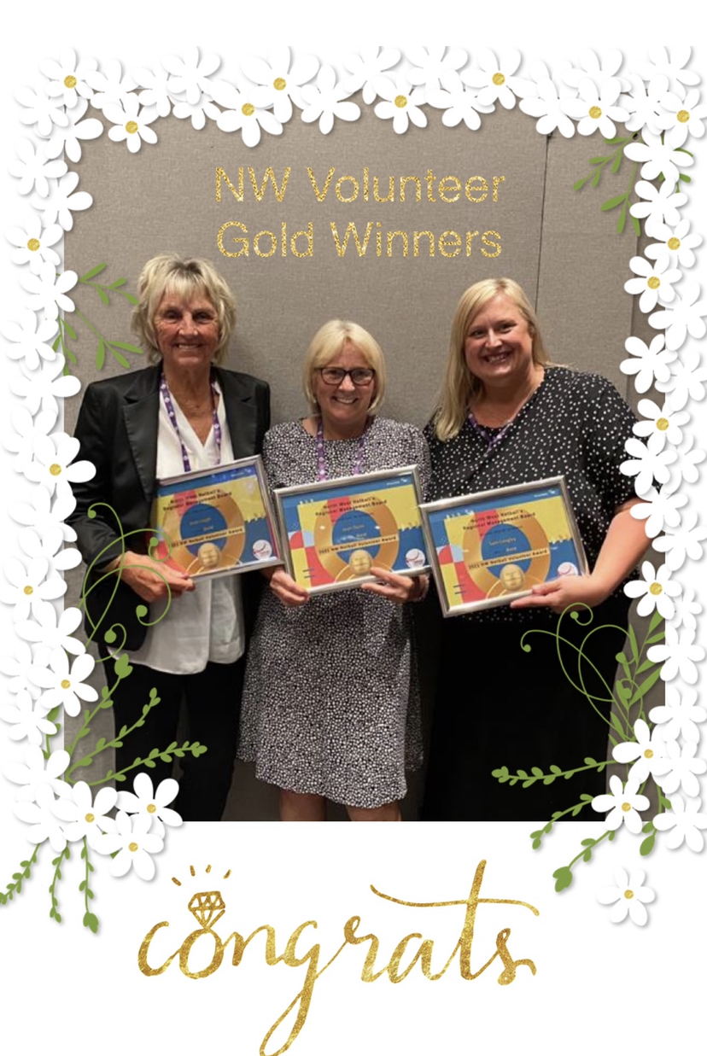
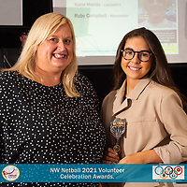
Volunteers
Netball would not have survived Covid without the wonderful Volunteers we have in our
County – so thank you to each and everyone of you!
England Netball ran their first ever on line Goalden Globes in December where a number of volunteers were nominated for #RiseAgain Champion Award.
North West Netball also ran their Goalden Globes via Zoom
North West Netball then ran their Celebration of Volunteers in September for the 20/21 and this was held in Warrington and it was lovely to see so many wonderful volunteers together in a room together. We has 3 nominations for Greater Manchester volunteers and I’m very proud to say they all were awarded with a Gold Award on the evening in recognition of their hard work and commitment to the game we love.
Jean Leigh
Joan Dunn
Sam Longley
Ruby Campbell was also presented with the Chris Brien Performance Award for Manchester

Slide 15
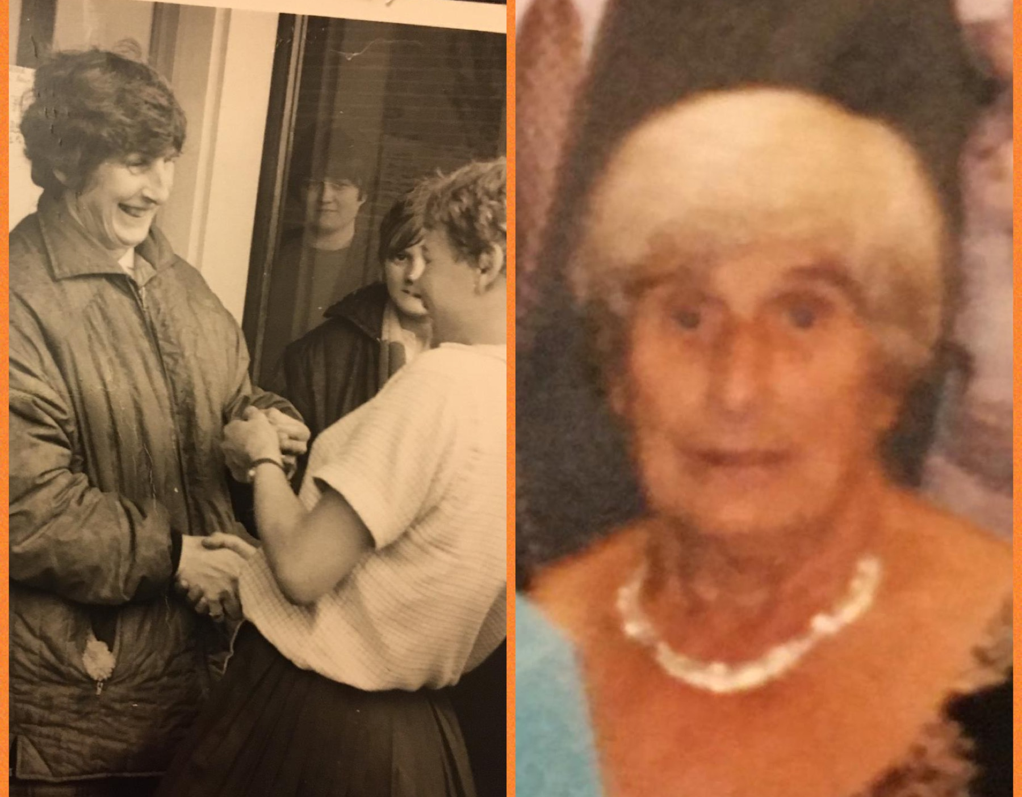
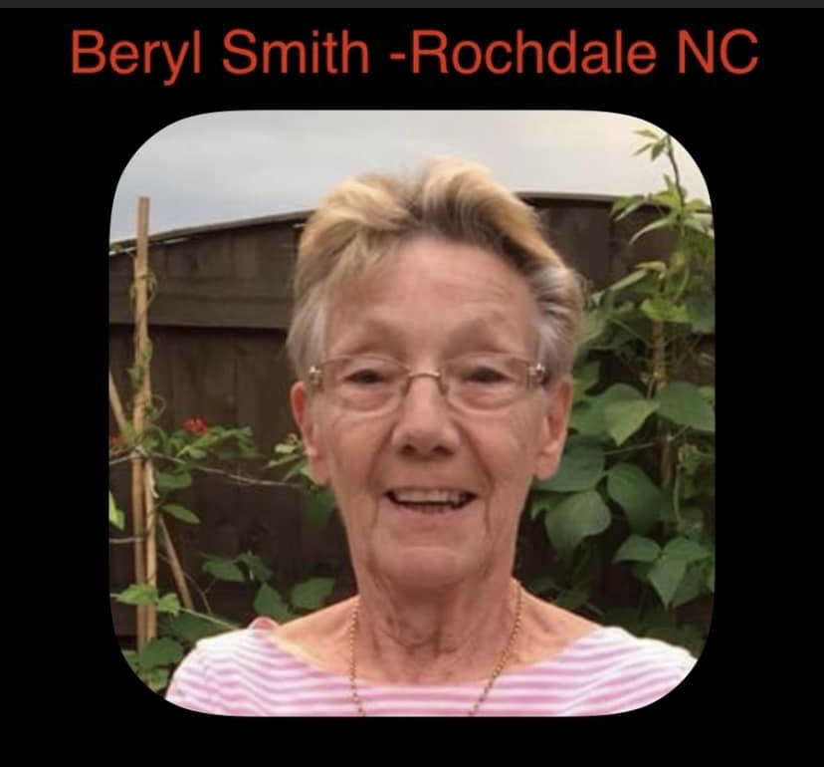
Sad News
We were saddened to hear about the sudden passing of one of our County Legends Iris McGarva – our thoughts go to her family and friends.
We were also saddened to hear about the passing of one of Rochdale’s founders – Beryl Smith – our thoughts are with her family and friends also.

Slide 16
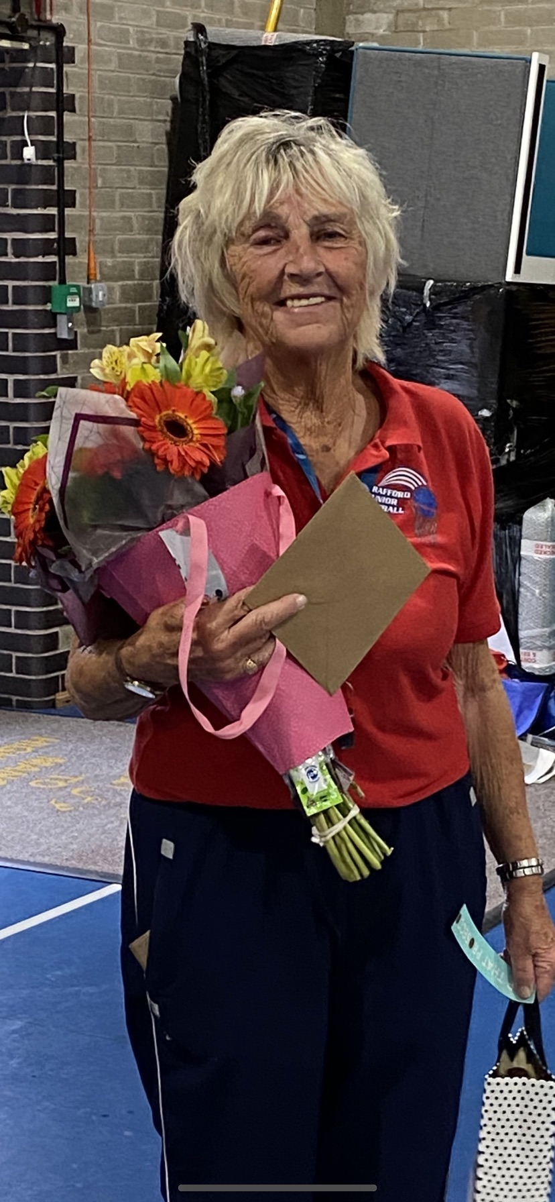
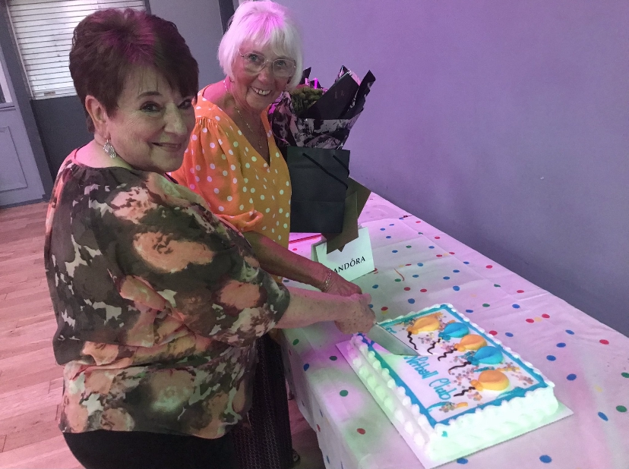
Retirement News
Some very special legends of the game have decided the time has come to retire. We owe them a massive thank you for all their hard work, dedication and commitment to the sport for such a long long time – it will not be the same without you around!
Trafford Junior NC – Jean Leigh
Tameside (Stamford) NC
–Jean Beresford & Kath Eddlestone

Slide 17
2021/2022
Covid is still here so we must take it in consideration and prepare accordingly
Junior league will have an Elite section Oct – Dec with the top 2 teams in Under 14 and Under 16 qualifying for the regional league
Development league being played January – July along side second phase of Elite league
Assessments for officiating can now re commence
Return of face to face meetings
NW first Para Netball Club
EDI Projects
Recruit – Disability Officer, Resolutions Officer

Slide 18

Massive Thank You To All!

Slide 19
League & Borough Reports
MENL – ran summer league and will recommence full league for 21/22
Bury – didn’t manage to run and currently will not run until 2022 due to venue issues
Bolton – is running in 21/22
Wigan & Leigh – is running in 21/22

Slide 20
Other Agenda Items
Adoption Of Reports
Election of Officers
Election of Auditor

Slide 21

Questions

Slide 22
Thank you for joining us this evening and if you do have any questions please do not hesitate to get in touch! greatermanchesternetball@gmail.com or abbey.barry@englandnetball.co.uk

