Slide 1

Greater Manchester County Netball Association - GMCNA
Annual General Meeting – 22nd September 2020
Zoom Call

Slide 2
Zoom Call Rules
Please can we ask that you are all on mute. We will have time for any questions at appropriate times during the presentation.
Please avoid using the chat during the delivery of the presentation as it is distracting
Present & Apologies For Absence
Before we begin please put your name and who you are representing in the chat, so that we can ensure we have quorum and know how many votes we have.
List of apologies

Slide 3
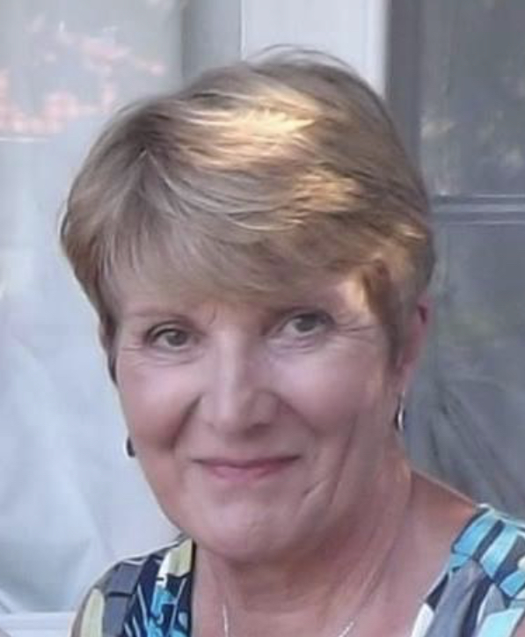
Welcome & President’s Address
This AGM is covering the period 1st September 2019 – 31st August 2020
Following the reports of the AGM period we will open and discuss our plans for 2020/2021
President – Kath Pemberton

Slide 4
Agenda
Minutes of the last meeting – these have been circulated to those who attended or have requested them and need to be voted as a true record
Affiliation notification – this is to set the affiliation rates for 2021/2022
Changes to the constitution – the committee propose an up dated constitution which is in line with England Netball and Tier 1 Sports Governance.

Slide 5
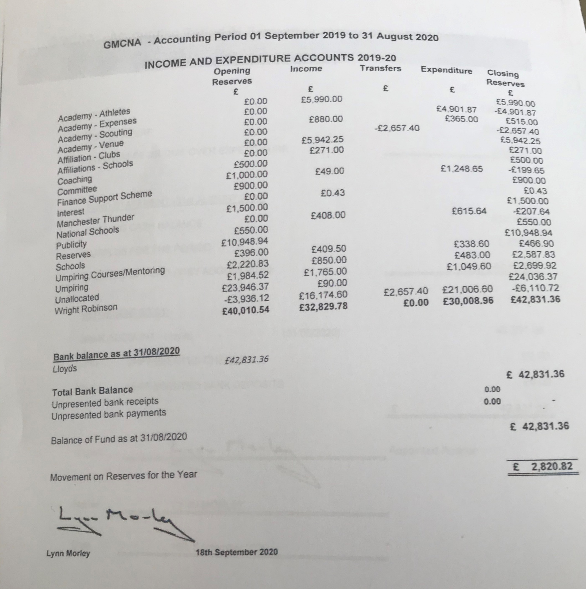
Treasurer Report – Janet Murray
Income and Expenditure 2019/2020

Slide 6
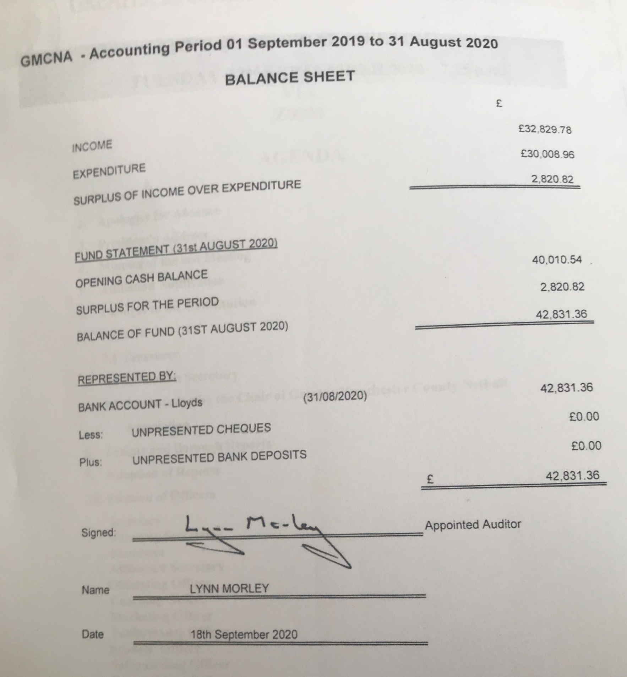
Treasurers Report - Janet Murray
Balance Sheet 2019/2020

Slide 7
Affiliation Secretary – Janet Murray
Schools & Colleges 2019/2020

Slide 8
Affiliation Secretary – Janet Murray
List of affiliated clubs in 2019/2020

Slide 9
Officer Reports
Chair – Sam Longley
Successes
Implementing change in governance – Sport England Tier 1
Clear plans for the season for all areas
Regular meetings
Dealt with demands and unexpected challenges brought on by COVID-19
Strength and commitment from committee
Challenges
COVID-19 – leagues and programmes unable to be completed
Volunteer time and demands
Pressures of commercial leagues on membership
Goalden Globe Nominations

Slide 10
Chair – Sam Longley
Positives – embracing the COVID-19 down time
Joining in with COVID craze – which brought us a new volunteer to the committee in Kat
https://www.facebook.com/sam.longley.14/videos/10157555743094864/
Beginning to collate the history of GMCNA – thank you to those who have sent photos and memories in for this which is an ongoing project
Creating our new website via Engage – massive thank you to Kat Richardson
https://gmcna.englandnetball.org

Slide 11
Vice Chair – Sandy Castell
Black, Asian and Ethnic Minority Communities
Here to Listen
England Netball Board Member
Following recent global events, we have been taking the time to speak and listen to the Netball Family to better understand the experiences of Black, Asian and Ethnic Minority groups within netball. What emerged from these discussions was the need for more representation, as it became clear that our Board does not currently represent the diversity of our audience, members and participants and we wish to take action on this matter.
As part of this, we are seeking applications for an additional England Netball Board position from candidates who have the skills and experience to represent minority groups within a sporting context. The successful applicant will support driving progress around our equality and diversity agenda, to ensure inclusivity within our sport.

Slide 12
Officiating – Lesley Smith
36 Candidates passed C award between September 2019 and February 2020
New assessor – Christina Davidson
8 active assessors for C awards
36 candidates passed written test and 18 who have not yet met criteria – all candidates have 12 month extension
One C course was held in November
Lots of information from EN for members has been issued re new rules and rule modifications due to COVID-19 plus zoom calls
Thank you to Katie & Helen for all their hard work putting courses on
Thank you to our assessors for their continued support
Mary Slade, Janet Murray, Dawn Day, Lona Williams, Jackie Cash, Ruth Ward & Lesley Smith (me)

Slide 13
Competition – Dawn Day (GMJCCL)
86 teams took part
Thanks to Lesley Smith for organising the Umpire Assessments at some of the matches and thank you to the teams who allowed us to use their games
All was going well then COVID-19 hit!
Places had to be finalised in line with advice from EN using the average points system – many congratulations to all (winning cheques have been sent)
The qualifying teams for the regional competition for 2020/2021 are
Under 13’s moving to 14’s – Oldham, Saddleworth, Trafford, Tameside (DNA were not eligible due to not having completed CAPS and Rivington declined the invitation)
Under 15’s moving to 16’s – Oldham, YWCA Bury, Saddleworth, Tameside
Age Group | Division | Winners | Runners Up
U11 | 1 | Oldham | Rivington
U12 | 1 | Oldham | DNA
 | 2 | Rivington | South Ribble
U13 | 1 | Kingsway Power | Oldham
 | 2 | Warrington | YWCA Bury Wildcats
U14 | 1 | Oldham | Kingsway Power
 | 2 | Wilmslow Lightning | Saddleworth
U15 | 1 | Oldham | YWCA Bury
 | 2 | Ribble Valley | Wilmslow Lightning
U16 | 1 | Oldham | Tameside

Slide 14
Performance – Sam Longley
Successes
1 under 15 squad - 21 initially in squad (1 dropped out a few weeks in), 7 additional athletes brought in mid season and 2 promoted to Thunder.
1 under 13 squad – 16 initially in squad ( 2 moved to Thunder before training commenced) with a further 7 selected mid season and 2 moving up to Thunder mid season.
4 play days took place, involving 5 counties, hosted in Lancashire, Cheshire, Manchester and Merseyside
Massive thank you to Miss Edwards & Celia Poole for their invaluable coaching and the selectors Miss Edwards, Celia Poole, Joan Dunn, Teresa Monaghan and Nichola Lawless for their support and the umpires who represented Manchester at the play days and helped at trials.
Challenges
S & C time, nutrition sessions
Court time
Athlete demands
COVID-19

Slide 15
Schools
Endeavour award (Best Sportsmanship voted by the umpires): Holy Cross (Under 19)
Best defensive team (Best defensive average across all three age groups): Joint Winners – Guildford High School and Stockport Grammar School (U14’s)
Massive thank you to Liz Harris for all her years involved in School netball and we wish her well for the future.
Regional National Schools – Results
U14’s - Withington / Stockport GS
U16’s - Bluecoat
U19’s - Holycross
National School’s finals – Results
U14’s – Stockport GS – 3rd
U16’s – Bluecoat – 3rd
U19’s – Holycross

Slide 16
Development – Katie Thompson
During the 2019/20 year (Sept-Aug) the county team has run the following programmes which has resulted in a total of 1030 participants (616 whom were New to Netball). The table opposite shows the total number of programmes run and participants engaged this year, which of those participants were new to netball (had not played the previous 12 months prior to joining) against the target for the financial year. As we know due to Covid all programmes stopped in March 2020, therefore no figures could be gained in the remaining 5-6months.
Programme | Number of Participants Sept 19-Aug20 | Number new to netball (if applicable) Sept 19-Aug20 | New to netball target
Back to Netball | 485 | 476 | Cannot report as our FY is Apr-Mar
Netball Festivals | 217 | 58 | Cannot report as our FY is Apr-Mar
Netball Now | 52 | 27 | Cannot report as our FY is Apr-Mar
Walking Netball | 39 | 39 | Cannot report as our FY is Apr-Mar
University Netball Officers | 114 | 22 | Cannot report as our FY is Apr-Mar
Netball Youth Camps | 29 | 0 | 0

Slide 17
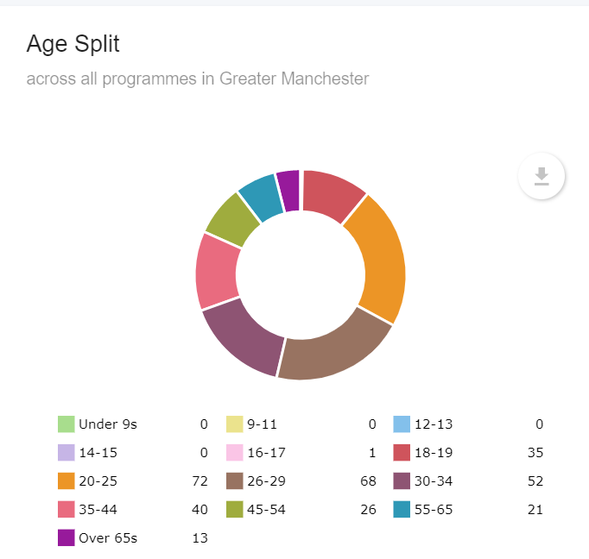
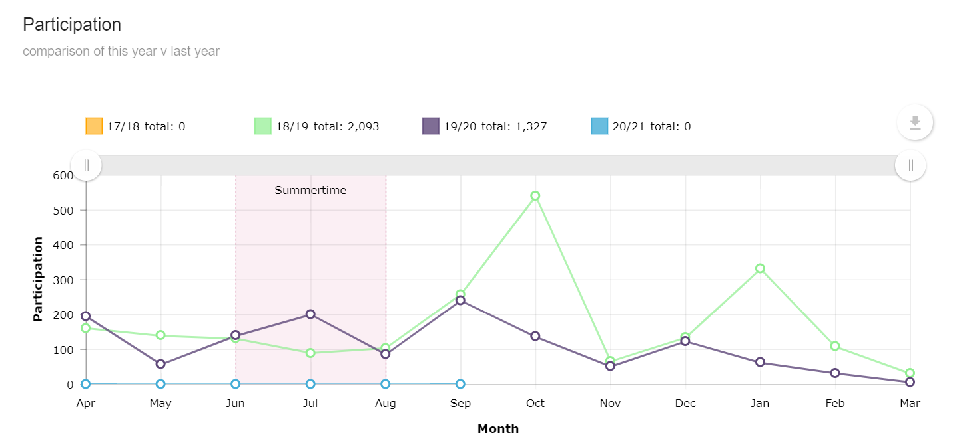
Development
County Programme participants for (April – March EN FY)

Slide 18
Development
County Club Membership & Development
This section shows club activity during the current financial year and membership statistics for the current season with a comparison to last season.
Figure 3: New clubs formed & CAPS accreditation
Clubs achieved CAPS Sept 19-Aug20 | Clubs working towards CAPS | Expired CAPS | Dates CAPS Due to Expire:
Rivington - Silver | Unicorns NC – July 2019 | Rochdale NC – Exp 13/6/16 | Tameside – 30/9/20 (Ext due to Covid until Dec)
Denton - Silver | DNA NC – Reg Sept 2019 | Dominoes NC – Exp 5/3/18 | Hathershaw – 4/3/21
Trafford Juniors - Silver | Manchester Giants NC – Reg May 2020 | Saddleworth NC – Exp 10/9/17 | Oldham – 6/3/21
 | Tameside – Reg Sep 2020 | Flava NC – Exp 12/9/16 | Seven Stars – 6/3/21
 | Bramhall – Reg May 2020 | Didsbury NC – Exp 3/9/18 | Tyldesley – 6/3/21
 | Chadderton Park Netball Club – Reg Aug 2020 |  | YWCA Bury – 20/4/22
 | Dominoes NC – Reg Feb 2020
 | Manchester Flava – Reg Sept 2020
 | Manchester Fury – Reg Oct 2019

Slide 19
Development
Education & Training
Affiliated members
By organisation and individual participants for the current season compared to the previous affiliation year
This year so far on ENgage we can see that as of 17/9/20 (In Red 19/20 Full Membership Year totals)
O18’s in Greater Manchester = 559 1394
U18’s in Greater Manchester = 304 400
U14’s in Greater Manchester = 506 734
U11’s in Greater Manchester = 380 733
Social & Supporting in Greater Manchester = 1
Total = 1750 3301
The following table shows the qualifications and courses run to date this financial year and the total number planned.
Figure 5: Education & training courses run and planned
Qualification/Course | Number Run In County | Total Number Planned
UKCC Level 1 | Jan/Feb – Wright Robinson
UKCC Level 1 | Feb/March – Wright Robinson
UKCC Level 2 | Sept 2019/Oct/Nov – MEA Central | Sept 2020/Oct/Dec MEA Central (rescheduled due to COVID)
Bee Netball | 18/1 – Wright Robinson | 1/4 – MMU Closed course planned, think postponed
Walking Netball Host Training | 26/1 – MEA Central
C Award | 1 – Oldham Ball Hall 2/11 | 1 – Wright Robinson 10.5.20 (postponed due to Covid )
Into-Officiating Award | 1 – Uni of Manchester closed course 24/11
Other Updates:
Two full time staff remain within the county, Katie Thompson (NDO), Eliza Morgan (NDCC) neither of which were Furloughed.

Slide 20
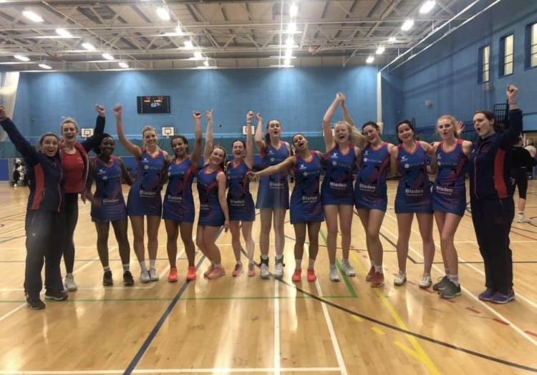
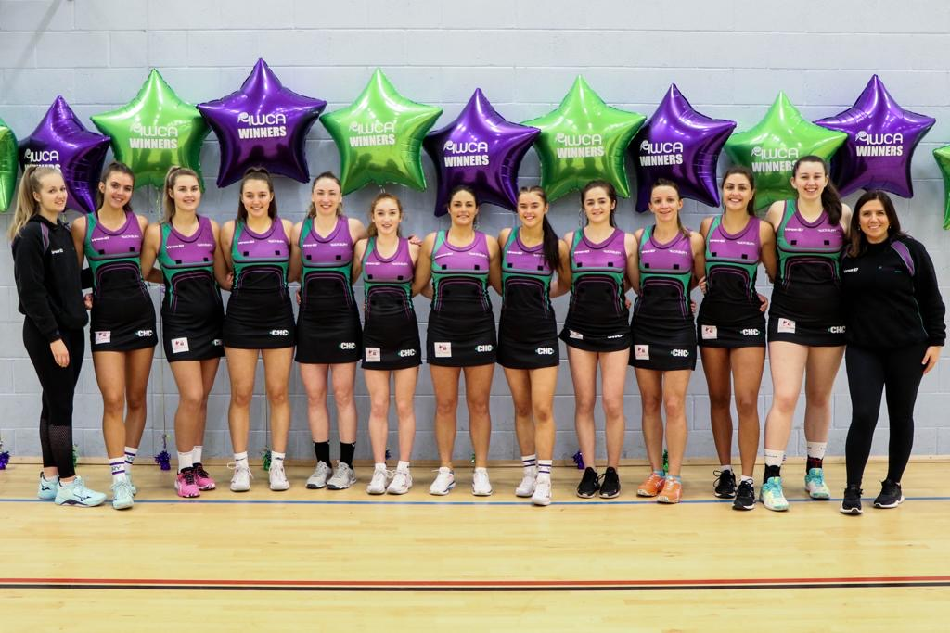
National Competition
Due to COVID-19 National Clubs did not take place
Vitality Netball Superleague was also not completed
National Prem League
National Prem League 2
Champions Oldham Netball Club - 8 out of 9 seasons – massive congratulations
Champions YWCA Bury Seniors, unbeaten and only team in history of the league to have gained 3 promotions in 3 consecutive seasons

Slide 21

Volunteers
England Netball launched Volunteer Strategy
Volunteer Week was launched and it was a great opportunity to say a massive thank you to so many nominations and to hear why people volunteer

Slide 22
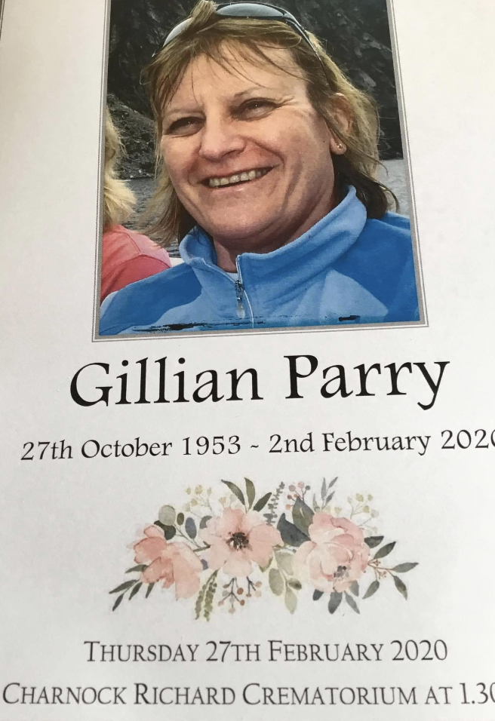
Sad News
We were saddened to hear about the sudden passing of ex County Player and friend Gill Parry – our thoughts go to her family and friends.

Slide 23
COVID-19 – Summer Updates
So what have we been tasked with doing:
Given lots of information to get us ready to begin netball at some point in 2020/2021
Care Package Developed
Covid Officers, Risk Assessments, Mitigation Plans, Opt in Statements
Zoom Calls
Specific information for coaches, clubs, umpires, leagues (In September 2020)
Membership Benefits - #Rise Again – promotional videos - discounts
Communication
Lots of Preparation ready for the new season – updates to follow

Slide 24

Massive Thank You To All
This Photo by Unknown Author is licensed under CC BY-NC-ND

Slide 25
League & Borough Reports
MENL – didn’t complete averaged scores used to determine final placings
Bury – did manage to complete
Summer league – didn’t happen
Saturday league – is no more

Slide 26
Other Agenda Items
Adoption Of Reports
Election of Officers
Election of Auditor

Slide 27
2020/2021
Competition – GMJCCL – Dawn Day
Hoping to commence in January 2021
Zoom call – to discuss planning
Appoint Covid officer
Use Engage
38 teams currently interested
Club | total | U12 | U13 | U14 | U15
Bramhall NC | 4 | 1 | 1 | 1 | 1
Chester | 4 | 1 | 1 | 1 | 1
Kingsway Power NC | 4 | 1 | 1 | 1 | 1
North Dragons NC | 1 |  |  |  | 1
Oldham | 4 | 1 | 1 | 1 | 1
Ribble Valley | 4 | 1 | 1 | 1 | 1
Rochdale | 3 |  | 1 | 1 | 1
Tameside | 4 | 1 | 1 | 1 | 1
Trafford | 4 | 1 | 1 | 1 | 1
Tyldesley | 2 | 1 | 1
YW Bury | 4 | 1 | 1 | 1 | 1
Total | 38 | 9 | 10 | 9 | 10

Slide 28
2020/2021
County – Sam Longley
Increase membership (currently adult membership is low)
Continue to develop the County website
Continue to implement appropriate Governance in line with Sport Governance Tier 1
Continue to gather history of County
Continue to guide and support our members through difficult times – COVID-19 has not gone away
Officiating – Lesley Smith
On line written tests
Courses still on hold
Assessments waiting on Netball Europe
Performance – Sam Longley
Trials will take place in January
Not as in depth season due to restrictions

Slide 29

Questions

Slide 30
Thank you for joining us this evening and if you do have any questions please do not hesitate to get in touch! greatermanchesternetball@gmail.com or Katie.Thompson@englandnetball.co.uk

