Slide 1
Greater Manchester
AGM October 2024
NDO – Abbey Barry
NDCC – Danielle Colebourne

Slide 3
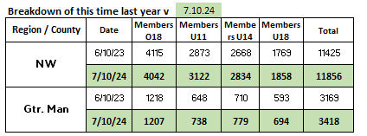
Membership
23/24 season:
Biggest growth is within u18s
We are 90% of the way to already achieving 23/24 figures
We are ahead of where we were this time last year

Slide 4

Back to Netball
Sessions in Oldham, Tameside, Bolton, Manchester, Salford, Rochdale, Trafford, and Wigan
Creation of the Back to Netball League (Oldham)
Back to Netball tournaments
Partnerships with Dominoes NC, Denton NC, Wythenshawe Ravens NC, BeActive Urmston, BeWell Wigan, University of Bolton,
and Active Ladies
Successful mentoring of new L2 coaches to deliver
B2Ners using INTO Officiating to gain confidence with the
rules

Slide 5
Walking Netball
Walking Netball in every borough of Greater Manchester at some point this year
Walking Netball League in partnership with BeWell Wigan
NW Walking Netball Tournament
Walking Netball Friendlies
Partnerships with Age UK, BeActive Urmston,
Sale Sports Club, BeWell, Wigan, Life Leisure, Heywood
Sports Centre and individuals

Slide 6
Bee Netball
Three clubs delivering bee netball
Denton Netball Club
Tyldesley Netball Club
Diamonds Netball Club
Launching Bee Netball in schools in partnership with Youth
Sport Trust
Wythenshawe Games delivery

Slide 7
Para Netball
Manchester Thunder sessions (2x monthly)
Weekly session in Prestwich with specialist school
GM ParaNetball festival, Wythenshawe Games and Better Things
Delivery
In the process of securing funding to deliver para netball in
every borough across Greater Manchester

Slide 8
Netball Projects
UniteHER annual event (Greater Manchester Violence Reduction Unit)
HMP & YOI Styal weekly netball sessions
City of Sanctuary weekly walking netball sessions saw BBC coverage on International Women’s Day
Mental Health netball delivery at the Edenfield Centre

Slide 9
ENgage
Club Finder
Lots of clubs are not appearing. Go into the club account and edit.
- Club contact and roles
- Training venue
- Actively recruiting / age groups
- Training / match / days

Slide 10
Safeguarding
Ensure safeguarding / welfare contact information is always visible to club members. Website / Facebook bio etc.
Ensure safeguarding / welfare information is sent to members should there be any change in personnel
Safeguarding newsletter for safeguarding committee member
Katie Thompson – Greater Manchester Moving
Sport Welfare Officer: katie@gmmoving.co.uk
LADO (Local Authority Designated Officer)
England Netball: besafe@englandnetball.co.uk

Slide 11
Courses
New rules sessions available on the England Netball YouTube page.
A huge demand for all courses; reminder to fill out the Expression of Interest form
Next Walking Netball Host Course is next weekend (19th) in Lancashire.
The next WNHC for Greater Manchester is on 15th March in
Salford

Slide 12

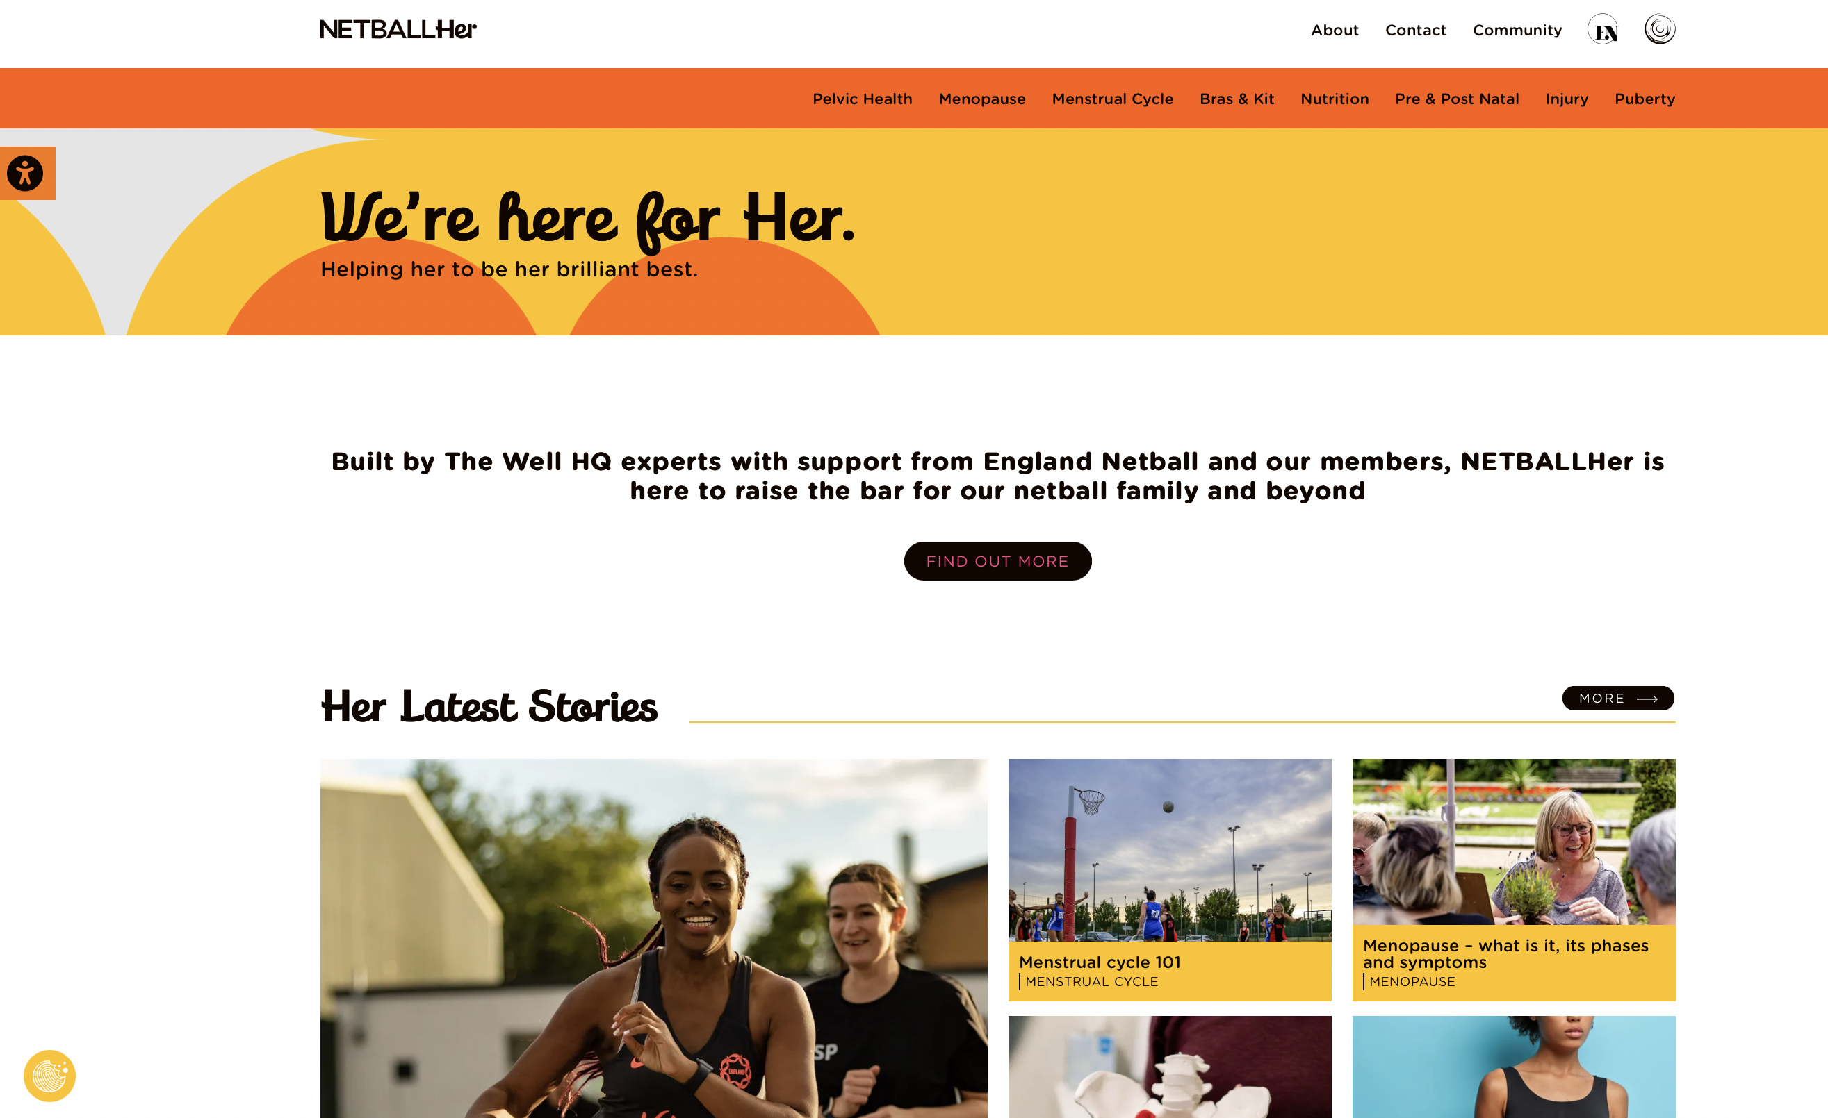
What
Changing the system so women and girls can turn up as their authentic selves
www.netballher.co.uk

Slide 13





Toilets & Access to Period Products
88% of women are caught short across the life stages.
Kit
Many netballers love the dress, but many do not and some don’t play because of it.
Injury
Women are 8 times more likely to suffer an ACL injury
Bras
Having a well-fitting sports bra is essential, Vitality Rose, Eleanor Cardwell has been active on social media talking about sports bras and their importance
For 81% of teens breast issues are a barrier to do exercise
44% of women don’t wear a sports bra during exercise
Education
38% of netball coaches want to learn more about how to support women and girls more effectively at every life stage.

Slide 14
Abbey.Barry@englandnetball.co.uk (NDO)
Danielle.Colebourne@englandnetball.co.uk (NDCC)

