Slide 1
Greater Manchester
AGM
October 2023
NDO – Abbey Barry
NDCC – Danielle Colebourne

Slide 3
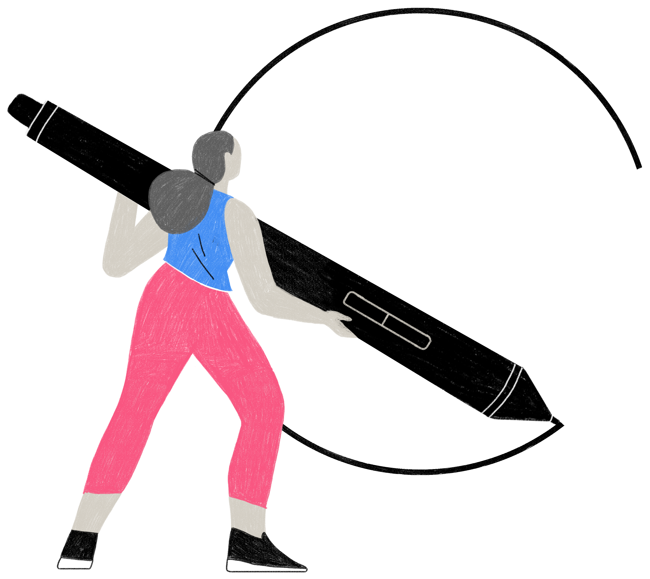
Membership
22/23 season:
3,647 members in Greater Manchester last year
We finished on 13,005 for the whole of the North West, with GM making up the biggest portion.
23/24 season:
3,076 members in Greater Manchester currently, with the
biggest rise coming from the u18 category.
Greater Manchester is currently the county with the largest
membership within the North West

Slide 4
Back to Netball
All local authorities have had a back to netball session at some point
Creation of the Back to Netball League (Oldham)
Back to Netball tournaments
9 new netball teams created from B2N sessions with the view to signposting to affiliated leagues
Partnerships with (but not limited to) Dominoes NC,
Denton NC, BeActive Urmston
Successful mentoring of 4 new L2 coaches via B2N
sessions

Slide 5
Walking Netball
All local authorities have had a walking netball session at some point
Creation of the Walking Netball League in partnership with BeWell Wigan
King’s Coronation Walking Netball Tournament
Walking Netball Friendlies
Partnerships with Active Community Experiences (A.C.E.),
Age UK, BeActive Urmston, Sale Sports Club, BeWell
Wigan, Life Leisure, Whitemoss Centre for the Youth,
Millenium Cultural Centre, Maccabi Centre

Slide 6
Bee Netball
Three clubs delivering bee netball
Denton Netball Club
Tyldesley Netball Club
Diamonds Netball Club
National Pilot underway in Greater Manchester looking at the
club and school relationship
Wythenshawe Games delivery
Stockport School Games festival

Slide 7
Para Netball
Manchester Thunder sessions (2x monthly)
British Sight Loss Council Sports Day with BBC News coverage
Weekly session in Prestwich with specialist school
Hate Crime Awareness Week delivery in Bury
GM ParaNetball festival, Wythenshawe Games and Better Things
Delivery

Slide 8
Netball Projects
UniteHER annual event (Greater Manchester Violence Reduction Unit)
HMP & YOI Styal weekly netball sessions
City of Sanctuary weekly walking netball sessions
Mental Health netball delivery at the Edenfield Centre
World Cup activation resulted in a 25% increase in new
netballers at sessions

Slide 9
ENgage
Club Finder
Lots of clubs are not appearing. Go into the club account and edit.
- Club contact and roles
- Training venue
- Actively recruiting / age groups
- Training / match / days

Slide 10
Safeguarding
Ensure Safeguarding contact information is always visible to club members. Website / Facebook bio etc.

Slide 11

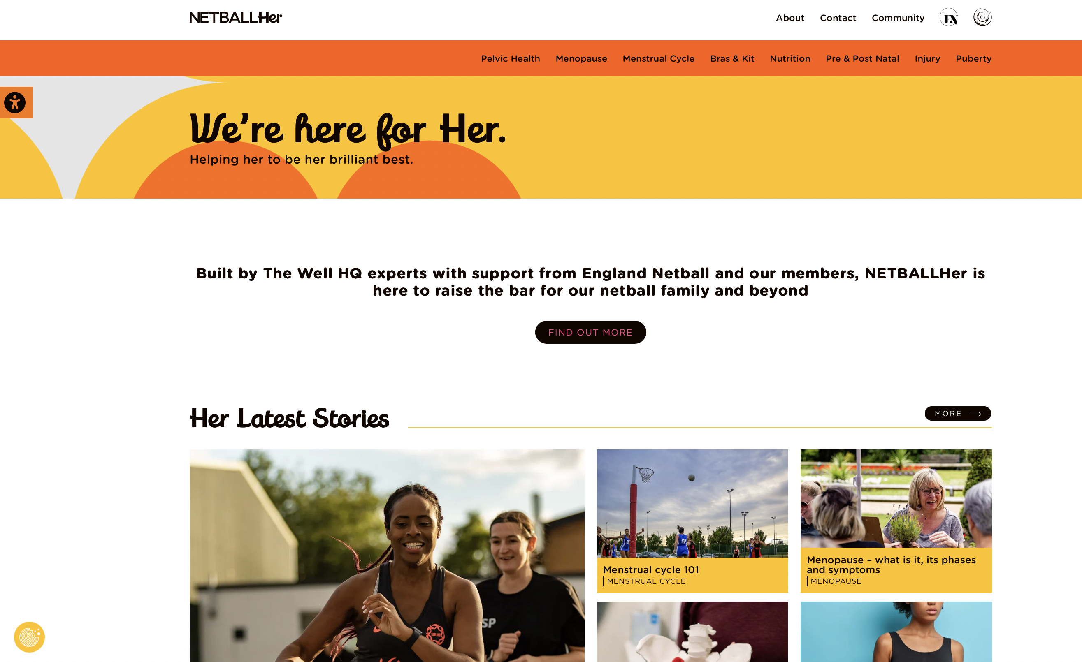
What
Changing the system so women and girls can turn up as their authentic selves
www.netballher.co.uk

Slide 12





Toilets & Access to Period Products
88% of women are caught short across the life stages.
Kit
Many netballers love the dress, but many do not and some don’t play because of it.
Injury
Women are 8 times more likely to suffer an ACL injury
Bras
Having a well-fitting sports bra is essential, Vitality Rose, Eleanor Cardwell has been active on social media talking about sports bras and their importance
For 81% of teens breast issues are a barrier to do exercise
44% of women don’t wear a sports bra during exercise
Education
38% of netball coaches want to learn more about how to support women and girls more effectively at every life stage.

Slide 13
Abbey.Barry@englandnetball.co.uk (NDO)
Danielle.Colebourne@englandnetball.co.uk (NDCC)

